Slide 1
The Role of Technology and Business Skills in Microenterprise Development: the Case of Mozambique
Catia Batista, Universidade Nova de Lisboa and NOVAFRICA
Sandra Sequeira, London School of Economics
Pedro C. Vicente, Universidade Nova de Lisboa and NOVAFRICA
March, 2016

Slide 2
Motivation
Over 50% of the urban poor are currently engaged in some form of microbusiness
A key determinant of low survival rates of microenterprises and limited growth is lack of access to credit
Sustaining an optimal level of savings can play a critical role in overcoming credit constraints and helping the poor optimize
cash flows

Slide 3
Motivation
Recent experiences with mobile money suggest that low-cost technologies such as cell phones could be an effective vehicle for the poor to access financial products that can enhance their savings capabilities
Recent setbacks with microcredit in Southeast Asia also highlight the importance of ensuring that microentrepreneurs have the required business skills to effectively mobilize and apply these savings

Slide 4
Research Objectives
Evaluate the role of mobile banking in increasing the savings capacity of microenterprises, and ultimately their investment and growth
Identify the importance of financial and managerial literacy to promote the development of the microenterprise
Quantify potential synergies between providing the technology to increase savings and the business skills necessary to best manage those savings

Slide 5
Research Design
Sample: 1,200 microentrepreneurs randomly selected from 23 formal and informal urban markets located in the Greater Maputo area
Sample restricted to vendors operating in proper stores and stalls, for which vendors have paid an operating fee to stay in the market throughout the year
These vendors are often engaged in retail businesses (textiles, electronics, clothing, groceries) or manufacturing (shoemakers, seamstresses, tailors, hairdressers, etc)

Slide 6
Research Design
Random assignment to
Group 1 (“mKesh intervention”): open savings account through mobile money
Group 2 (“financial literacy intervention”): receive “business training” on how to best manage savings and investments with a goal to maximize the growth of the business
Group 3 (“combined interventions”): open savings account plus “business training”
Group 4 (“control”): does not receive either intervention

Slide 7
mKesh Intervention
Information about mKesh
Participation incentive: vendors were given 76MTN in order to test usage of the mKesh service
Saving incentive: payment of bonus corresponding to 5% of the average mKesh value kept in their account each month, over a three-month period with a top limit of 25MTN per month (corresponding to 5% of an average monthly mKesh value of 500MTN)

Slide 8
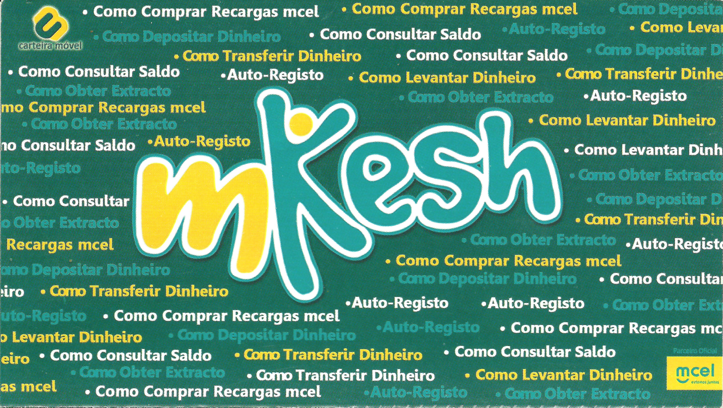
mKesh leaflet distributed

Slide 9
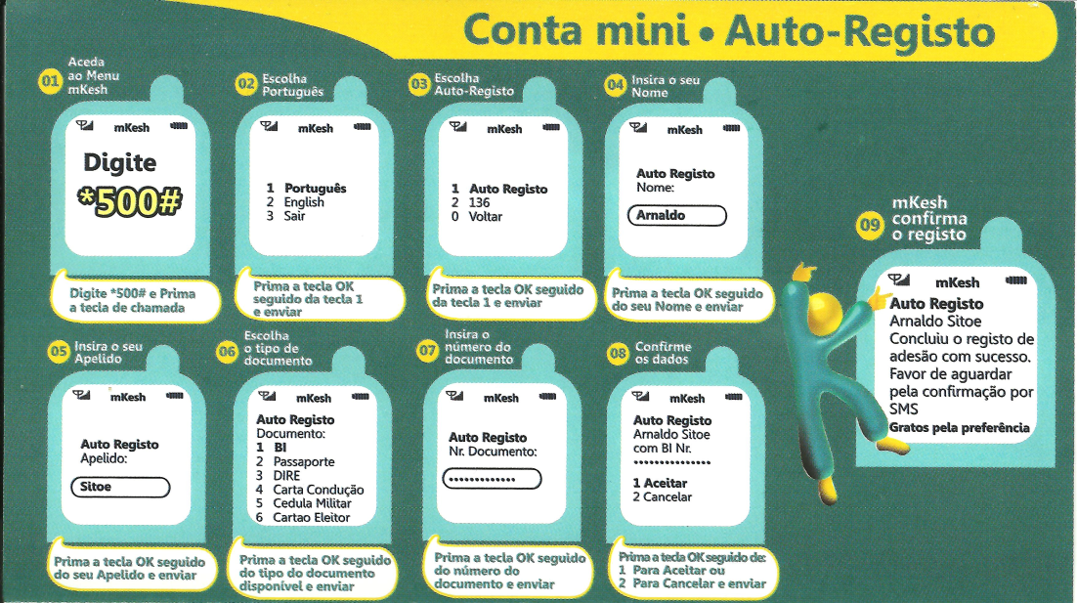
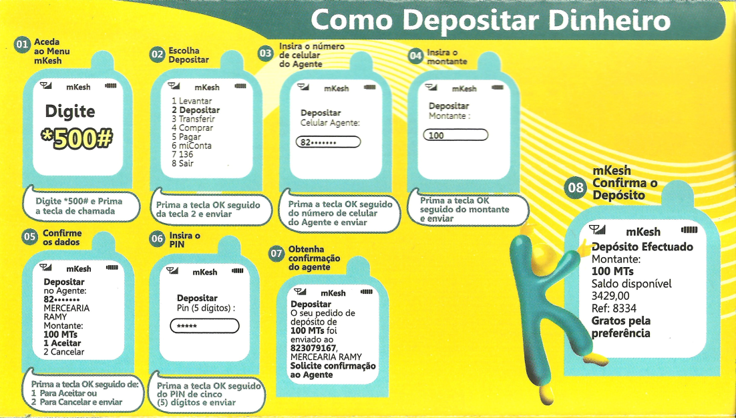
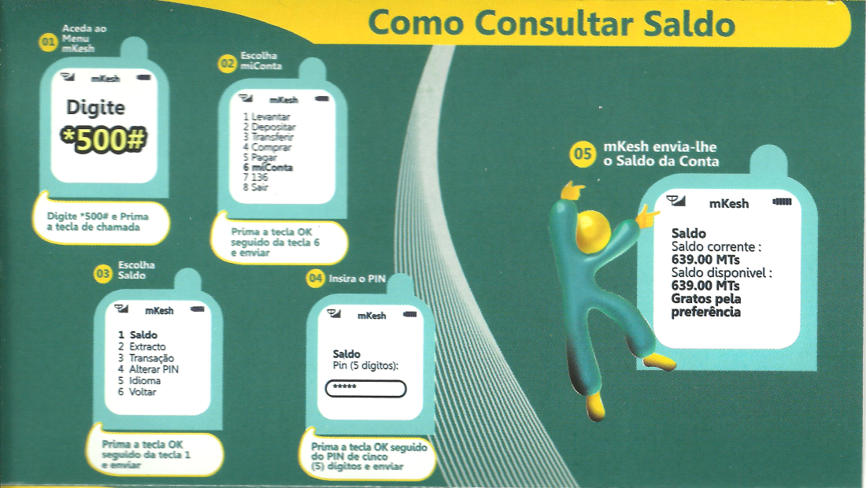
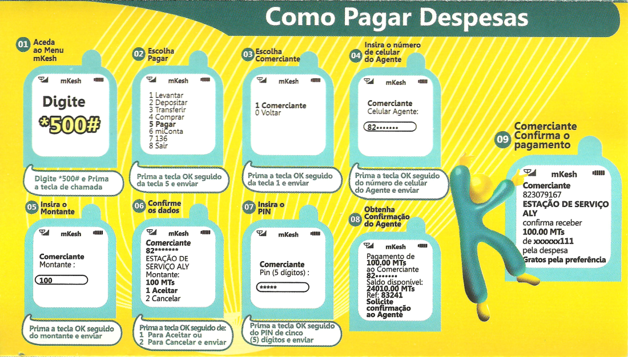
Operations done as part of individual treatment:
self-registration, cash-in, checking balance, buying from agent

Slide 10
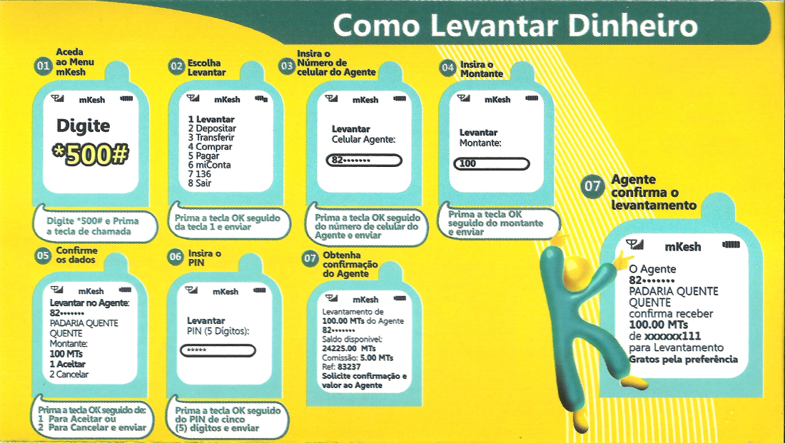
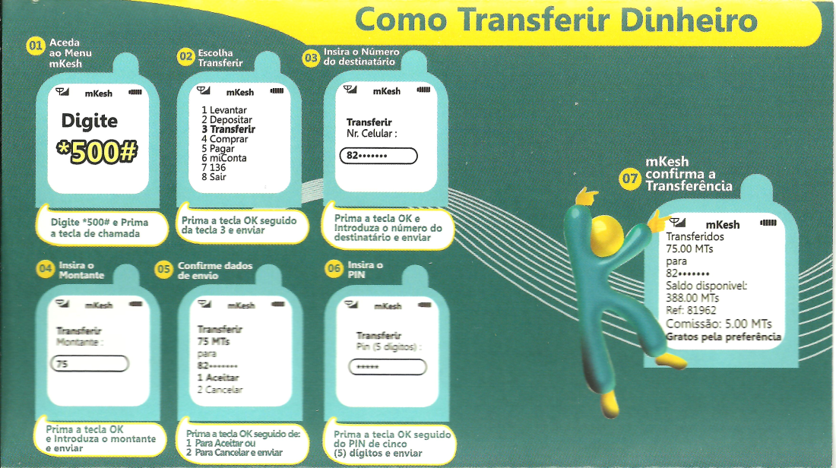
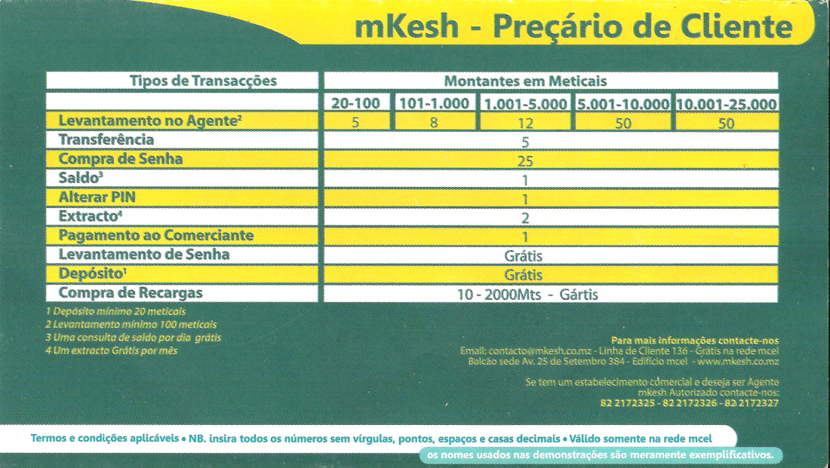
Other information: cash-out, transfer, pricing

Slide 11
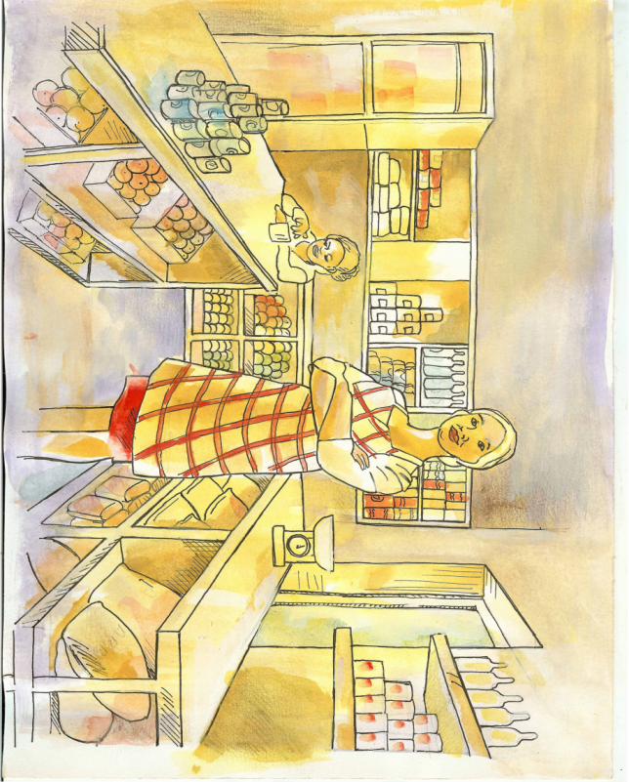
BÓNUS POUPANÇA
Pôr dinheiro no agora dá mais dinheiro!
Como funciona isso?!
Recebe 5 meticais por cada 100 meticais que conseguir MANTER na sua CONTA MKESH durante 1 mês!
Vamos dar-lhe este BÓNUS durante 3 meses!
*Os bónus são pagos em cada mês, mas pode existir um desfasamento de dias entre o final do mês e o pagamento do bónus.
APOIO:

Slide 12
Business Training Intervention
Financial literacy module, taught over weekly visits to microentrepreneur, based on manual
Simple financial notions: revenue, profit, savings, investment and valid expenses for the business
Simple accounting procedures
Separation of accounts
Business objectives
Logbooks distributed to microentrepreneur during the first visit
Comic strip distributed to microentrepreneur during the first visit

Slide 13
Business Training: Materials
Comic Strip
Business Training Manual
Logbooks

Slide 14
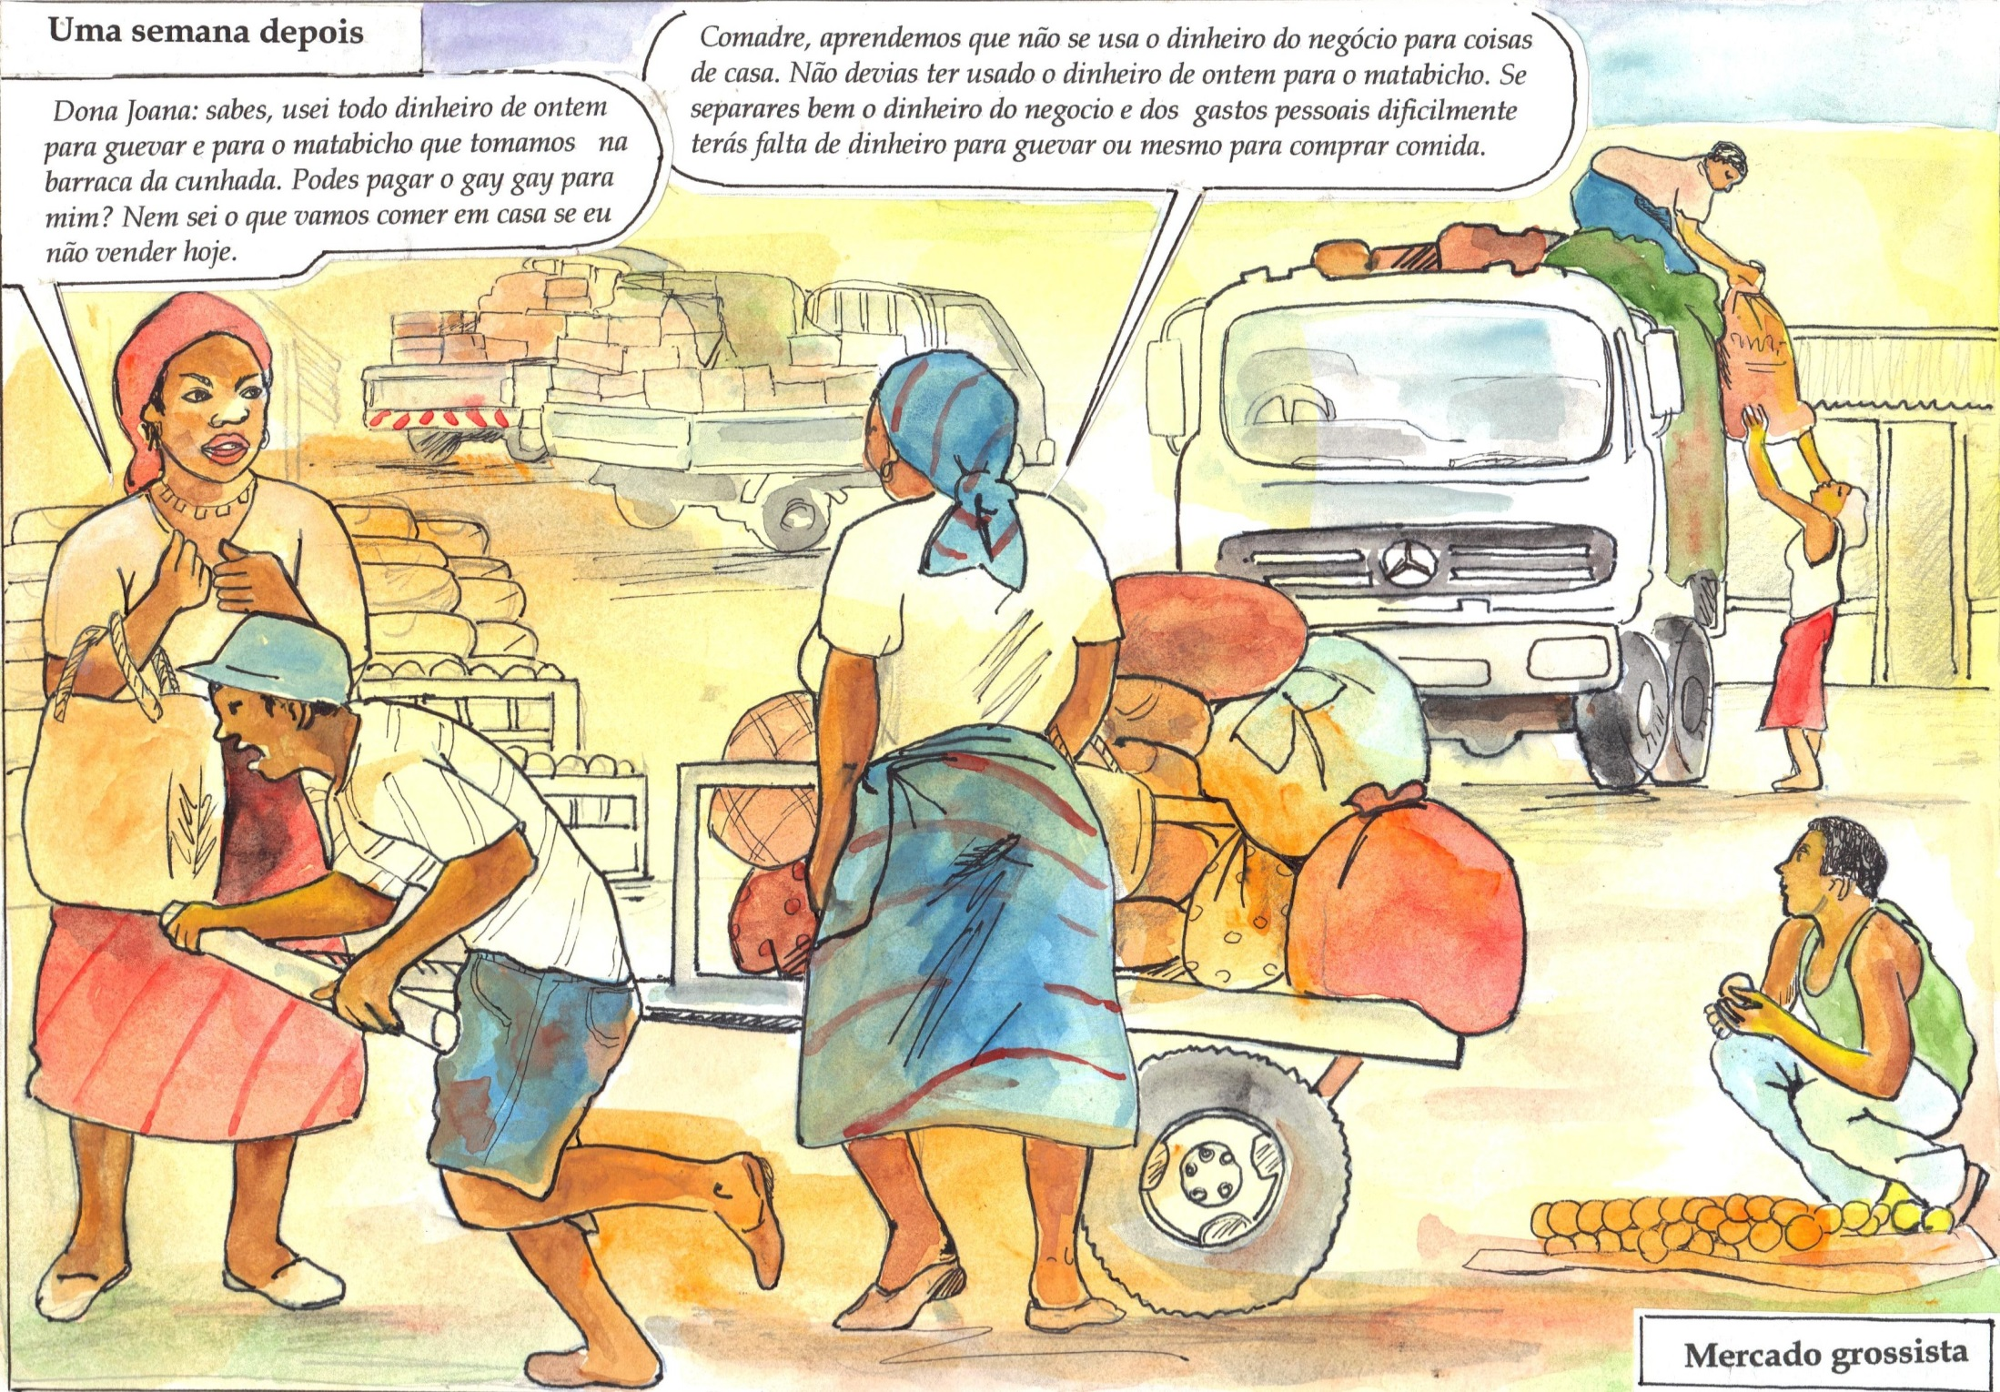

Slide 15
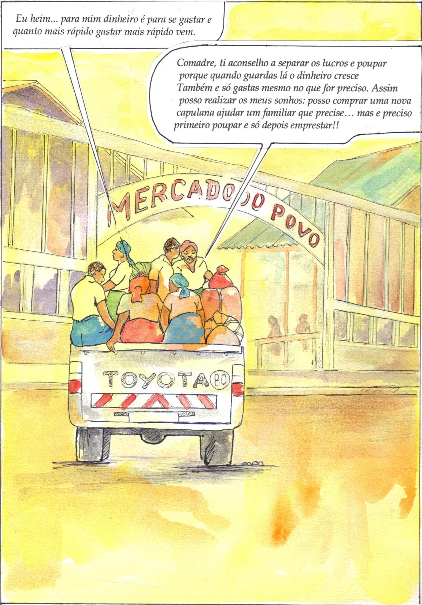

Slide 16
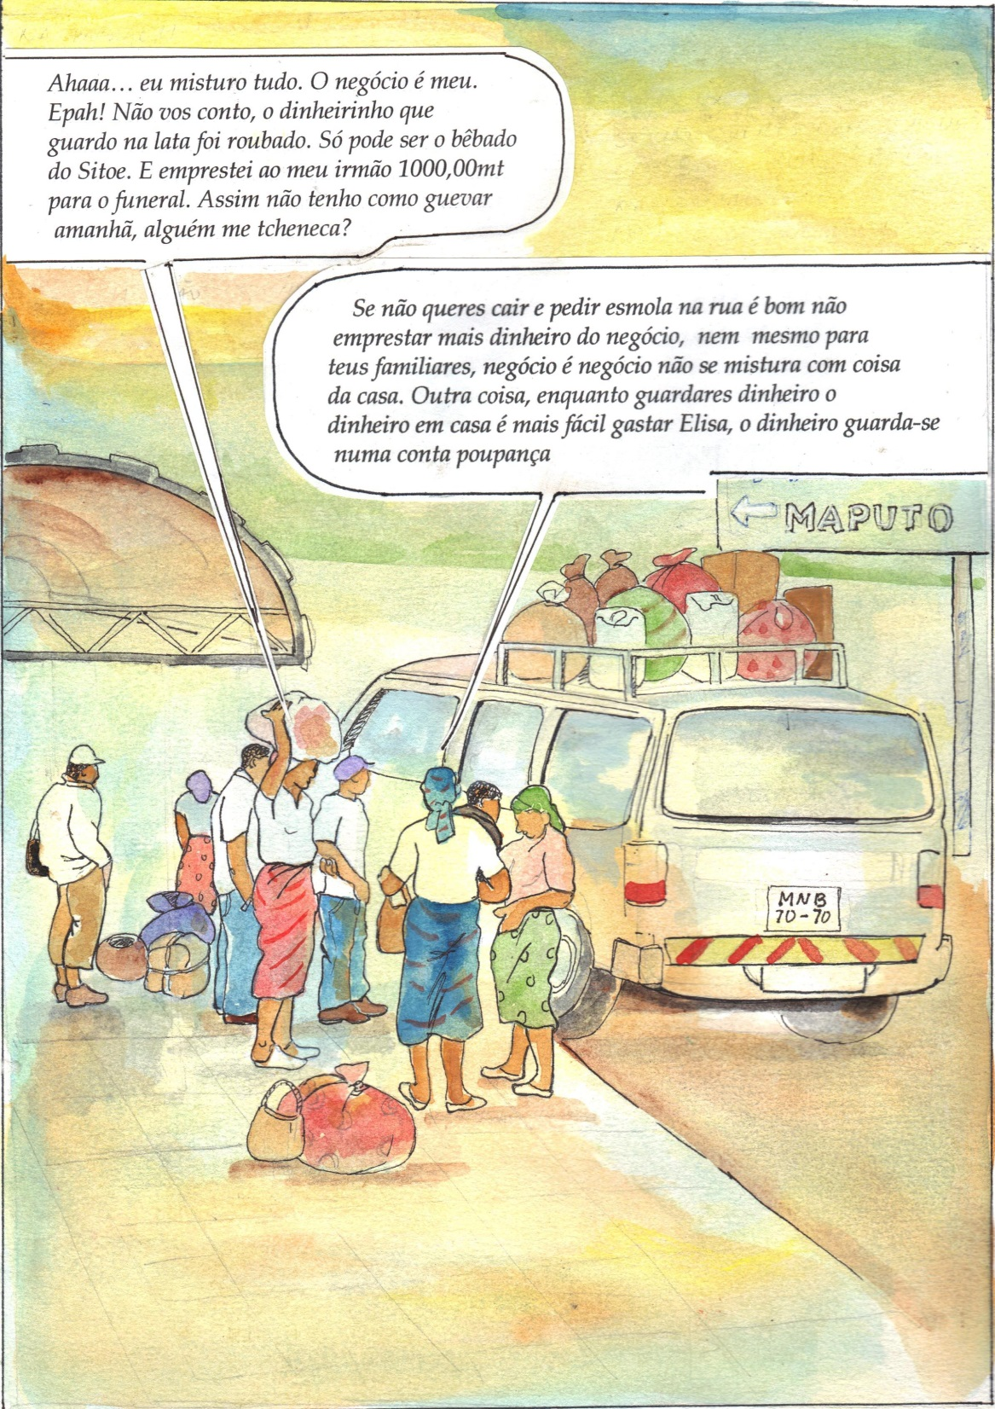

Slide 17
Manual de Formação dos Micro-Empresários nos Mercados Urbanos DA CIDADE de Maputo

Slide 18
Tabela de Conteúdos
Introdução
Receitas e despesas – como calcular o lucro do negócio?
Como calcular o lucro do negócio? Alguns avisos e exemplos.
Poupança: o que fazer com o dinheiro?
Poupança: evitar voltar para trás
Investimento: o que é? Como conseguir dinheiro para investir?
Investimento: quando pedir emprestado (txenecar) dinheiro?
Investimento: a que taxa de juro peço emprestado?
Orçamento: o que é e como se deve fazer?

Slide 19
Caderno de Registo
Data | Compras Valor Total – Custos Directos | Vendas Valor Total – Receitas – Pago | Vendas Valor Total – Receitas – Não Pago (a crédito) | Despesas com a loja (eletricidade, taxa de mercado,…) |  | Transferências/Empréstimos |  | Poupança
 |  |  |  | Valor | Descrição | Valor | Pessoa - Descrição | Xitique | mkesh | Banco

Slide 20
Logbook examples
Livro 3
Exemplo:
No dia 30 de Março de 2012, o Senhor Ezequiel quer preencher a Folha 3 (folha de registo diário).
Sabendo as compras, vendas e clientes a crédito do dia 30 de Março, registados na folha 1 e 2, e sabendo que o Senhor Ezequiel pôs 400 MTn no xitique, depositou 50 MTn na sua conta mKesh, e pagou as despesas de eletricidade em 700 MTn.
Ainda mais, o Senhor Ezequiel emprestou 300 meticais ao amigo Joaquim, para este puder pagar as despesas da escola do filho.
2ᵒ Passo
Prever as compras
Como é que o Senhor Ezequiel faz o registo ao final do dia?
3ᵒ Passo
Prever Despesas
4ᵒ Passo
Despesas Novas

Slide 21
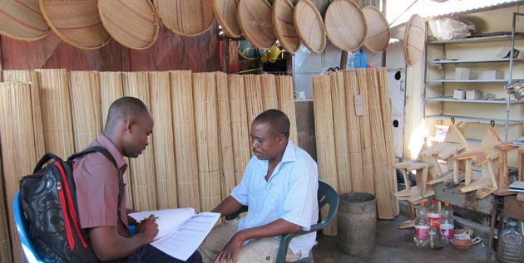
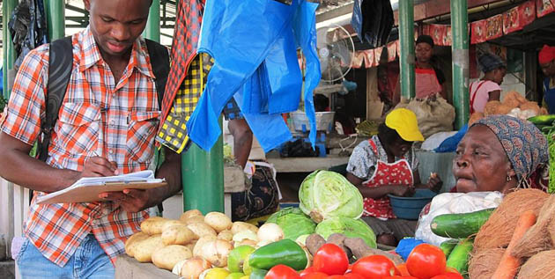

Slide 22
Business Training: Incentives
Participation incentive: 20MTN purchase for microentrepreneur to fill in logbook at the time of the first visit of our team (goal: clarify any questions on logbook usage)
Commitment incentive: incentive to fill in logbooks after the research team’s visit; when logbooks were distributed, all targeted individuals were told they would receive 130MTN (equivalent to 5USD) if they filled in their logbooks correctly
[The payment was only made during our final visit]

Slide 23
Baseline Data
General Characteristics:
71% with no employees
25% use a logbook to track sales, purchases or credit transactions
Hold an average inventory to continue selling for 15 days
1% has a cash register
60% own a Bank account, 95% of them are current accounts
60% understand what “savings” mean
95% of them report the desire to save more
71% report the desire to save to invest in more products
51% believe sales will grow next year

Slide 24
Preliminary Results
Business Training was well received and it increased understanding of basic accounting.

Slide 25
Preliminary Results
Impact Evaluation:
Business Training decreased transfers to relatives (14%) and increased total sales (64%)
Strongest result for combined treatment
Unclear impact on savings and expenditures
Process Evaluation:
Main challenge was securing agents in markets
Microentrepreneurs were interested in the training and kept their manual throughout the experiment

Slide 26
Concluding Remarks
Next steps:
Endline Survey finished in late 2015; data cleaning and analysis in progress
Preliminary Results:
Suggest mKesh and business training have significant impact on sales but no evidence yet of impact on investment or savings

