Slide 1
Financial Inclusion and its Discontents
KEYNOTE LECTURE
6th India Growth Center-Jadavpur University-ISI West Bengal Growth Conference
27 – 29 December 2016
RANJULA BALI SWAIN
Professor
STOCKHOLM SCHOOL OF ECONOMICS &
SÖDERTÖRN UNIVERSITY
Ranjula.Bali@hhs.se

Slide 2
Outline
Evolution of the financial inclusion in India
Microfinance – Self Help Group Bank Linkage program
Methods and Main Results
Financial inclusion and its discontents
Towards sustainability and sustainable development

Slide 3
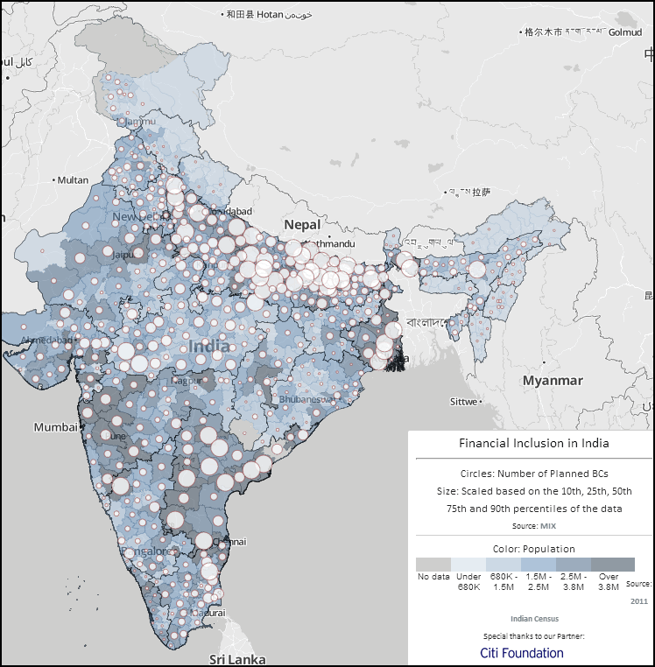
Unbanked in India:
World’s 8th largest nation ahead of Bangladesh, Russia and Japan

Slide 4
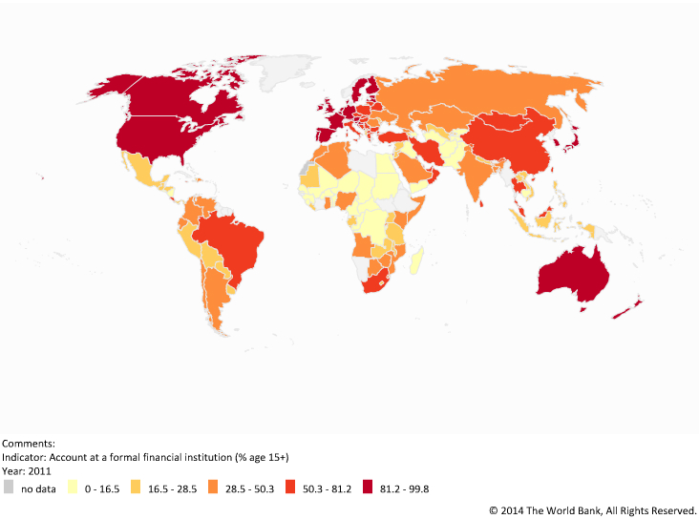
Financial Inclusion in India
Financial landscape before Microfinance in India
Rural
branches
Limited Penetration in Rural Areas
Subsidized Rural Credit (typical through 70s-80s)
Corruption
Low repayment rates/ high default rates

Slide 5
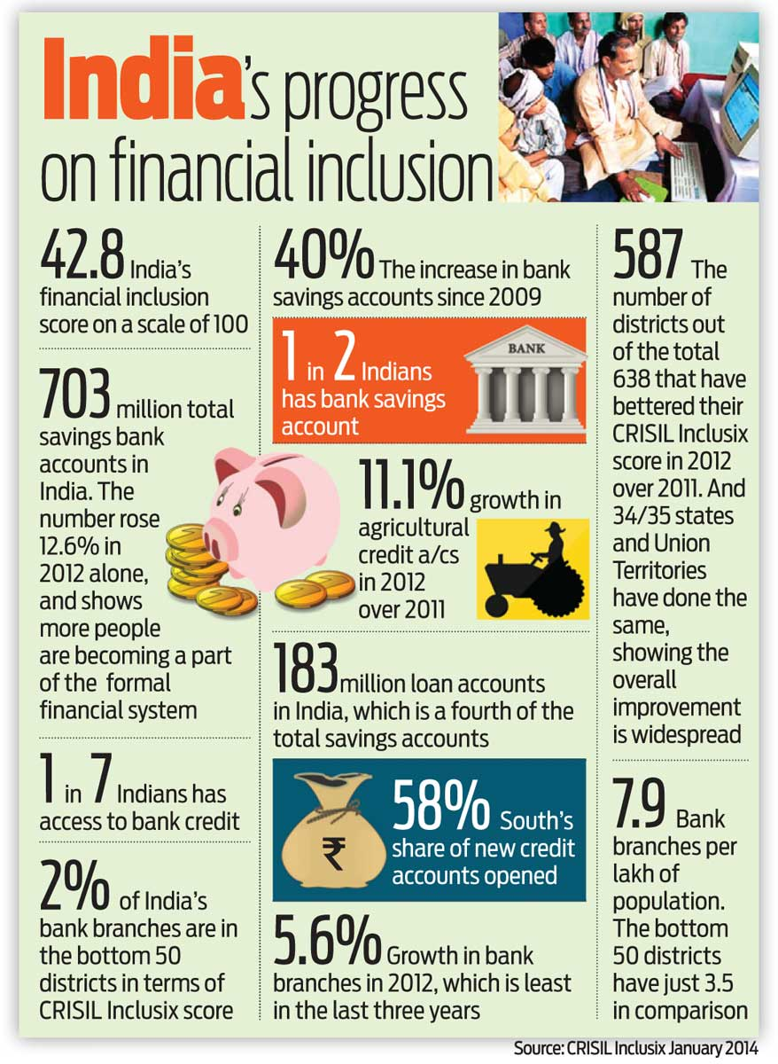
Financial Inclusion in West Bengal
2011-12 – ranked 3rd best on FIIND Andhra Pradesh and Karnataka ahead of Maharastra, UP, Kerala, Odisha, Tamil Nadu

Slide 6
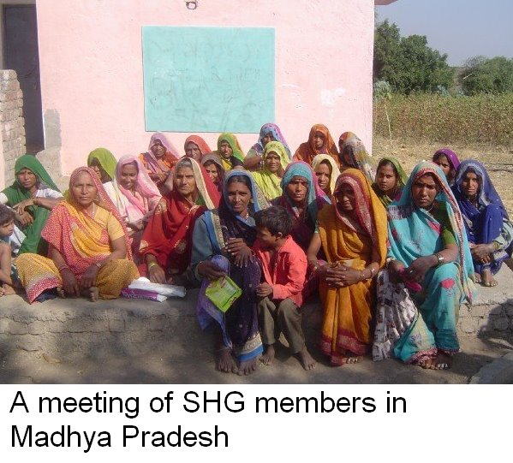

Self Help Group Bank Linkage Programme
Economics of Development Lecture 3
6

Slide 7
Methods
Coleman pipeline method for impact on assets and income
Measuring Vulnerability
Propensity Score Matching
Structural Equation Models for impact on women empowerment
Measuring competition
IV- GMM estimation for impact of competition on MFIs
Dynamic System modeling

Slide 8

Structural Equation Model
Share of income
x1
Primary activity
x2
Independent savings
x3
Investment to improve home
x4
Confidence to meet financial crisis
x5
Economic
ξ1
Family Planning
Decision
y1
Arranging credit and other inputs
x6
Purchase of raw material
x7
Plan work
x8
Autonomy
ξ2
Buying & Selling
Of Property
y2
Officials you have met
x9
Women
Empowerment
η
Communications
x10
Network,
Communication
& Political
ξ3
Sending daughter to school
y3
Know about reservations
x11
Involvement in village politics
x12
Verbal abuse
x13
Social
Attitudes
ξ4
Children’s marriage decision
y4
Change in family violence
x14
Treatment by spouse
x15
Reaction to physical abuse
x16
Use of birth control
y5
Education
ξ5
Reaction to emotional abuse
x17
Involvement in family decision
x18
Increase in self confidence
x19
Education level
x20

Slide 9
Results: The Microfinance Impact
Poverty and Vulnerability
Assets
Income
Women Empowerment
Training Impact, Infrastructure and Training Type
Notes:
Result 1: Interpretation
1. Impact on vulnerability and povertySHG members are poorer but less vulnerable (their probability of being poor in the next period is less) as compared to non-SHG members
2. Impact on Vulnerability improves with better infrastructure and when SHGs are linked by NGOs and financed through banks
3. Impact on assets and income:
Members poorer than Non Members
Six Years of Membership to Catch Up
Dependency Ratio, Education Matters
Asset definition does not matter
Disaggregated assets: Dwelling, Livestock*, Savings*, Other Borrowings
4. Impact on income: Training helps
Movement away from agriculture
Movement towards other sources: livestock, fisheries, etc.
No impact on business profits and total expenditure
5. Impact on empowerment Group of SHG members were about 26 percent more empowered as compared to the non-SHG members.
Some members might have been more empowered than others and not everyone was empowered at the same pace.
Economic factors empower Self Help Group members (women) the most.
Greater autonomy and social attitudes also have significant impact on empowering SHG members (women).
6. Training impact Infrastructure important!
Training has a higher impact on assets when made available to SHGs in villages closest to paved roads (access to markets)
For those with training- one kilometer less of paved road can drop assets by Rs. 5000
Business training results indicate – sufficient amount of credit is needed for training to have positive impact ; or skills take time to be absorbed before the impact is observed.

Slide 10
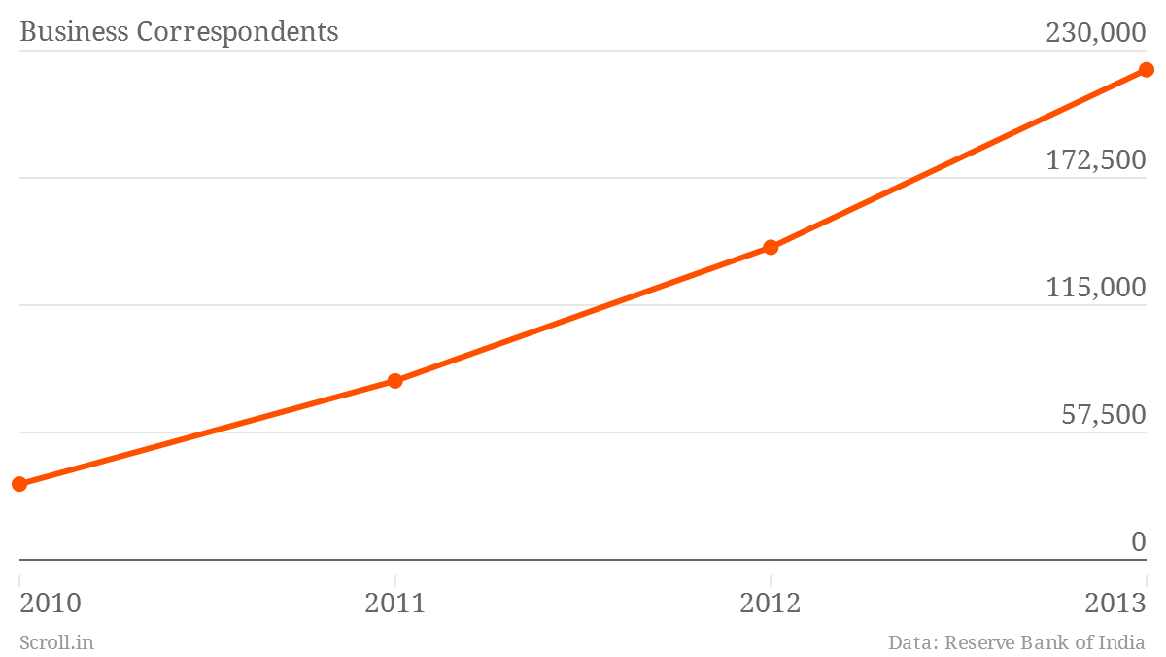
Post-scaling up of SHGs
Source: Acharya & Parida, 2013
Notes:
with fast expansion in terms of numbers and geographies, delinquencies are creeping into SBLP. As per NABARD data
the Non-Performing Assets of banks against loans to SHGs has gone up by 2.9% of NPA to O/S SHG loans in 2007-08 4.7% of NPA) in 2010-11
Banking Correspondents
“As of March 2012, banks had covered 74,199 villages, or 99.7% of the target assigned to them," reported a study carried out by the New America Foundation and MicroSave. "Two years earlier, banks had 21,475 branches in rural areas, but by March 2012, they provided banking services in rural areas through 138,502 outlets, comprising 24,085 rural branches, 111,948 BC outlets and 2,469 outlets through other modes such as ATMs and mobile vans.”

Slide 11
Challenges /Discontents
Outreach and Sustainability
Capacity constraints, cost of group formation, & group quality
Political Interference and overloading groups
Savings
Flexible Products
Interest rates
Competition
Regulations

Slide 12
Additional challenges
Does not fit Agriculture (farm sector)
Business Correspondents
Pradhaan Mantri Jan Dhan Yojana
Demonetisation

Slide 13
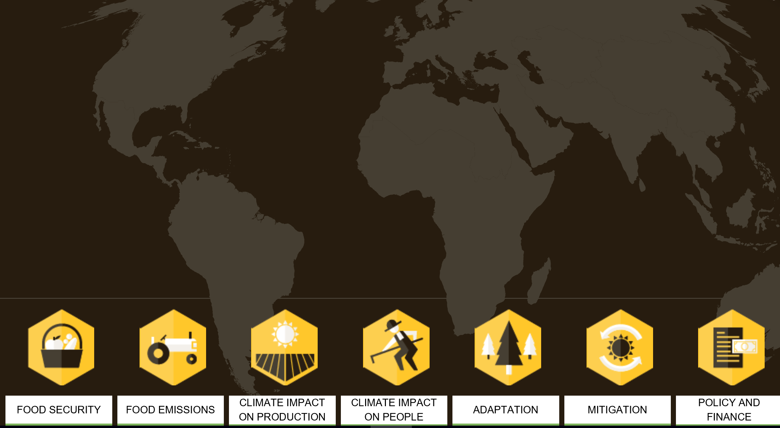
Agriculture, Sustainable Development and Microfinance
FOOD SECURITY
FOOD EMISSIONS
CLIMATE IMPACT ON PRODUCTION
CLIMATE IMPACT ON PEOPLE
ADAPTATION
MITIGATION
POLICY AND FINANCE

Slide 14
SUSTAINABLE DEVELOPMENT GOALS

Slide 15
AGENDA 2030 – QUAGMIRE?
Spaiser, S., Ranganathan, S., Bali Swain, R. and Sumpter, D. The Sustainable Development Oxymoron: Quantifying and Modelling the Incompatibility of Sustainable Development Goals, International Journal of Sustainable Development & World Ecology, Published online: 23 Sep 2016

Slide 16
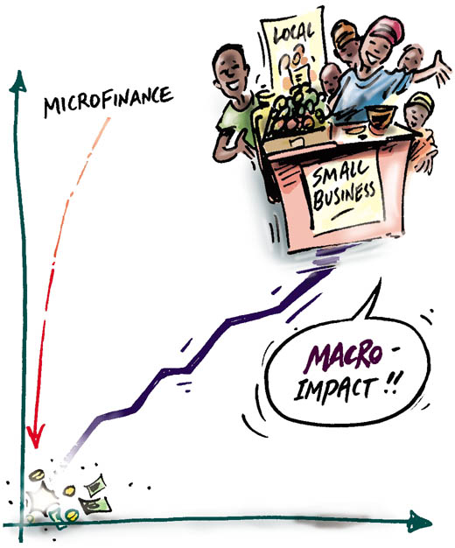

Thank you!
Ranjula.Bali@hhs.se
Twitter: @ranjbali

