Slide 1
Messaging Matters: The Effects of Different Messages on Individual Tax Payment in Uganda
Nicholas Musoke, Uganda Revenue Authority
Isabelle Cohen, University of Washington
30th June, 2021

Slide 2
What Message Does URA Convey?
RWA
DRC

Slide 3
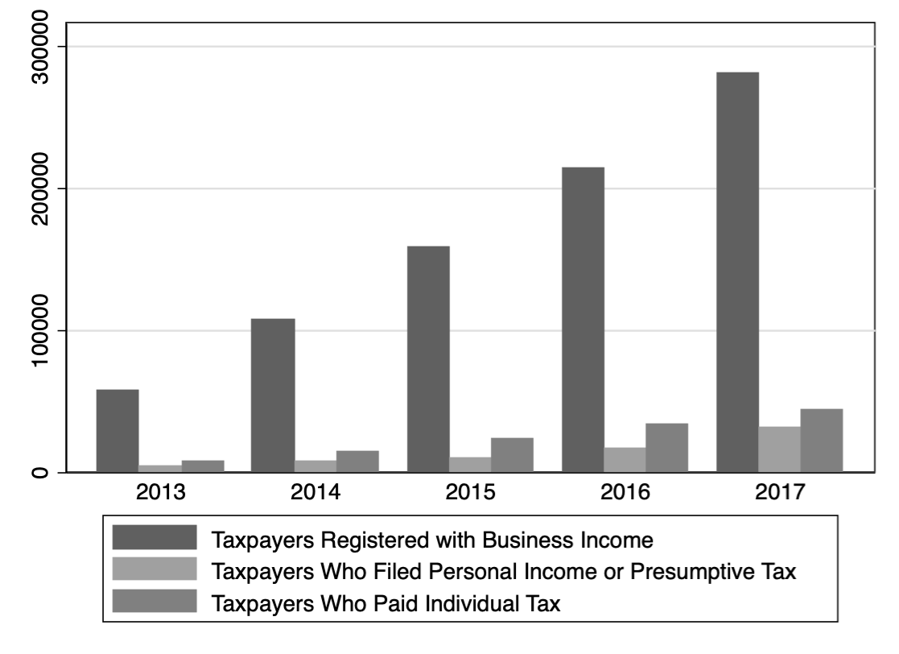
History of Individual Taxpayers in Uganda
RWA
DRC
Notes:
The number of taxpayers who have registered is increasing – but payments are lagging behind for individual taxes

Slide 4
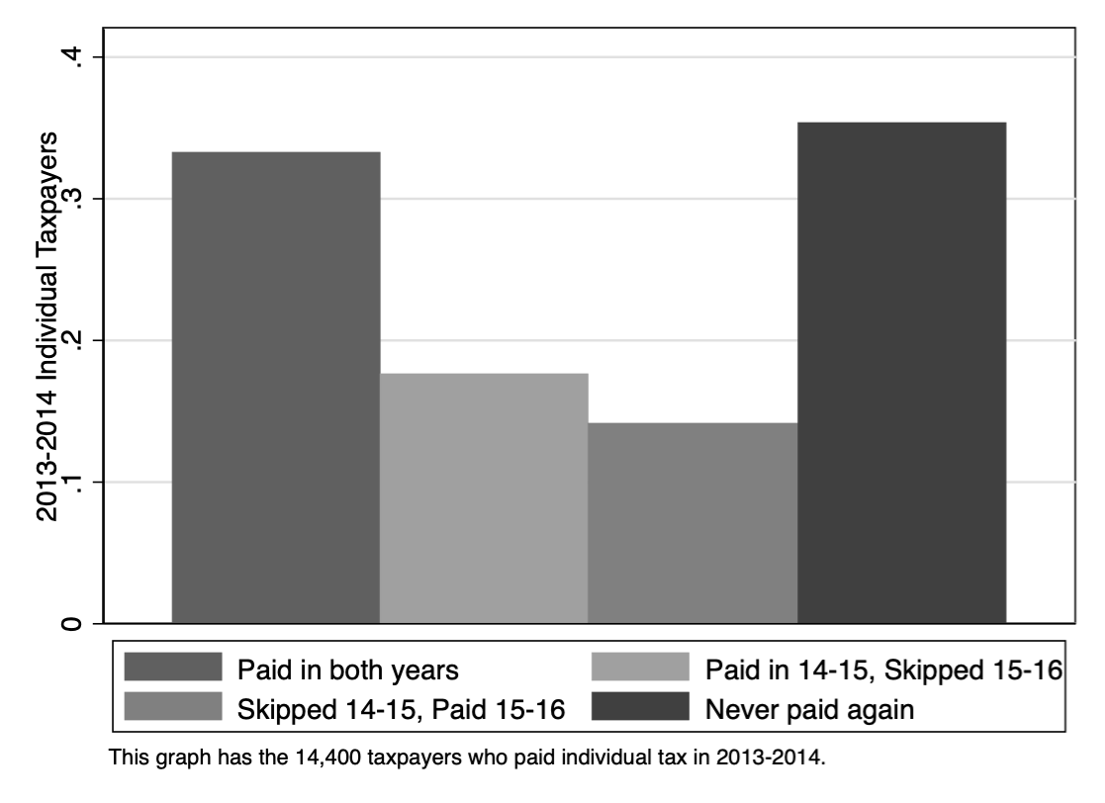
Making Payments Over Time
RWA
DRC
Notes:
Many taxpayers switch in and out of paying – this figure tracks the taxpayers who paid in 2013-14 over 2014-15 and 2015-16.

Slide 5
Design of the Research Study
Group | Size | Message
Control | 24,535 texts | No message sent
Inform | 24,534 texts | “Dear esteemed client, please file your income tax return and pay the tax due by 30th June 2019. URA”
Encourage | 24,534 texts | “Dear esteemed client, by paying your taxes you make it possible to educate our children, fund our healthcare, and keep us safe. URA.”
Enforce | 24,534 texts | “Dear esteemed client, file your income tax return and pay the tax to avoid unnecessary payment of interest, penalties, and possible enforcement actions like the closure of business.”
RWA

Slide 6
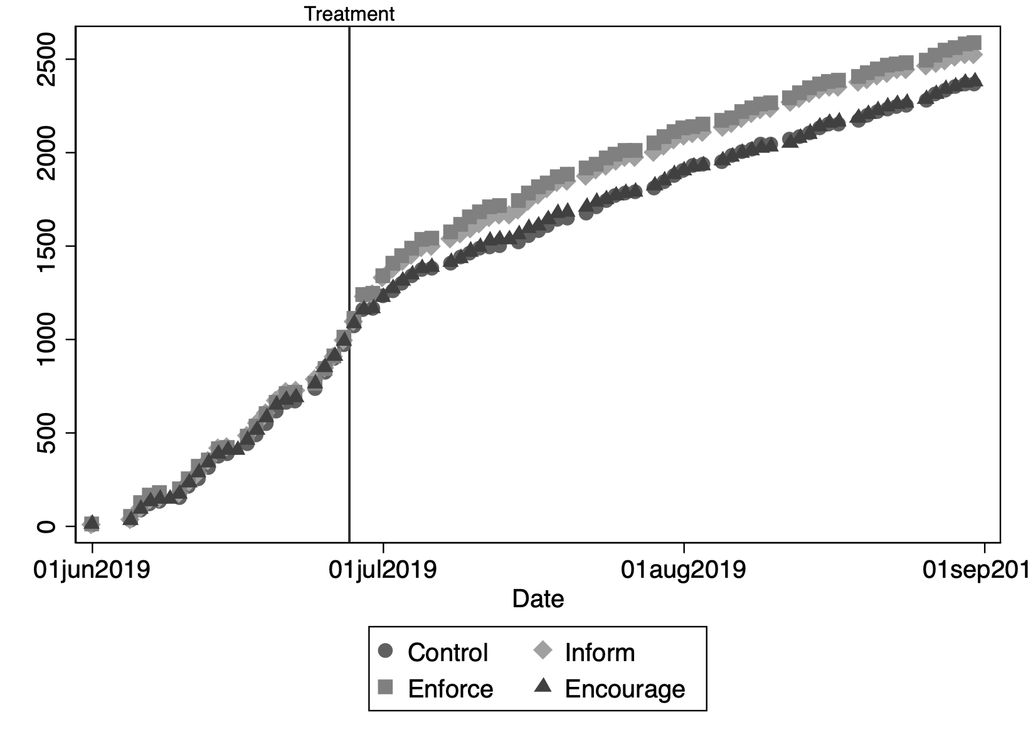
Treatments Increase Payment Likelihood

Slide 7
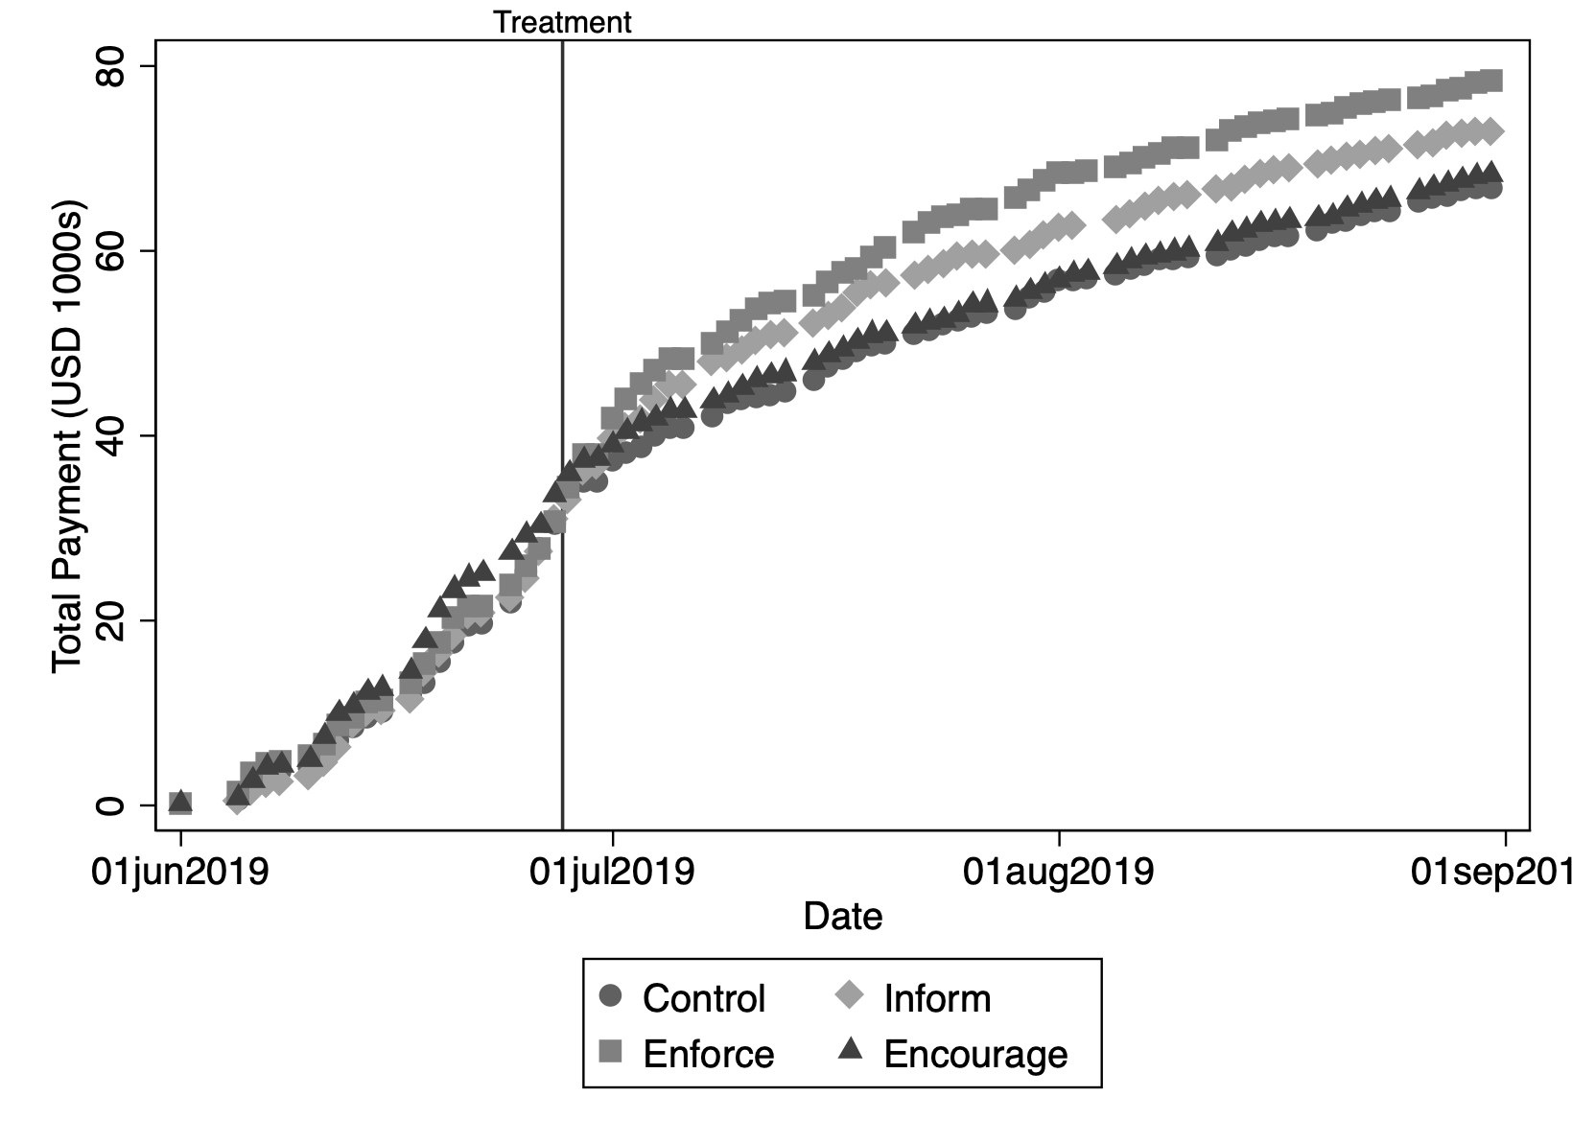
Treatments Increase Tax Collection

Slide 8
Cost-Benefit Analysis of Messaging
Cost of Individual Text: ~100 UGX
Benefit of Individual Text:
Any Message: ~570 UGX 5.7x rate of return
Enforcement Message: ~1,340 UGX 13.4x rate of return
Benefit Increases When:
Business is Smaller
Business is Newer
Business Owner Lives Near Service Improvement
UAE
Notes:
Receiving the texts affected different people differently
Texts worked better for those with smaller businesses and more recent registrations
Texts worked better for those in areas with fewer social services, but especially with recent investments in infrastructure

Slide 9
Policy Implications
Messaging matters
Stick versus Carrot
Content of messaging to taxpayers may be very important to increase tax revenue
Targeting also matters
What works in messaging and what works in action may be different
Other activities for engagement may work better in areas where social services are improving
Notes:
The stick works in messaging, but the carrot works in action

