Slide 1
Taxation & Development
Henrik Kleven
Professor, London School of Economics
Co-Director, IGC State Capabilities Programme
DFID Presentation, 28th October 2014

Slide 2
Tax Take vs GDP Per Capita
Source: Kleven, Kreiner, Saez (2014)

Slide 3
Taxation & Development: Two Approaches
  Big-picture macro approach: what shapes tax capacity and tax policy in the long run?
    “How does a government go from raising around 10% of GDP in taxes to raising around 40%?” (Besley-Persson 2013)
  Nitty-gritty micro approach: given weak tax capacity, what can governments do to incrementally improve
    Tax administration
    Tax enforcement
    Tax policy
    Tax morale

Slide 4
We Take the Nitty-Gritty Micro Approach
The big-picture macro approach is intellectually interesting, but unlikely to yield concrete and conclusive policy guidance
We therefore take the more nitty-gritty micro approach
  Start from the specific context and problems of a given country
  Address concrete problems, one problem at a time
  Based on empirically grounded research, design (incremental) policy innovations suited for that context
  Lends itself to—and often requires—collaborations between researchers and policy makers

Slide 5
Taxation is Ideally Suited for such Micro Work
  Tax records represent a great administrative data source
  There is often exogenous variation in policy parameters due to tax reforms, enforcement changes, policy discontinuities, etc.
  The desired outcomes are measurable (e.g. revenue collected)
  Public Finance has a well-developed theory that can be brought to bear in helping policy design
  Strong interest from policy makers in getting taxes right

Slide 6
Overview of Topics
Tax enforcement
Tax policy
Tax morale
Tax administration

Slide 7
Tax Enforcement
  The key components of tax enforcement are
  Audits
  Penalties
  Third-party information reporting & withholding
  Other verifiable information trails
  Kleven et al. (2009, 2011): tax enforcement is successful if and only if verifiable third-party information (3-4) has wide coverage
  Absent wide coverage of 3-4, we want to know
  Can we expand 3-4 and what are the effects?
  How should we design 1-2?

Slide 8
Third-Party Reporting: Evidence from Denmark
(World Record Holder in Tax Take: about 50%)
Source: Kleven, Knudsen, Kreiner, Pedersen, Saez (2011)

Slide 9
Third-Party Reporting: Cross-Country Evidence
Tax Take vs Fraction Self-Employed
Source: Kleven (2014)

Slide 10
Tax Enforcement: IGC Research Agenda
  Policy recommendation to IGC country X is not to replicate the Danish information reporting system as many context-specific factors are key:
  Tax administration, self-employment; industrial composition; firm size and complexity; financial sector; scope for evasion substitution
  Examples of IGC tax enforcement research:
  Almunia-Gerard-Hjort (ongoing) [Uganda]
  Best (ongoing) [Pakistan]
  Olabisi (ongoing) [Liberia]
  Kleven-Kreiner-Saez (2009, 2014) [cross-country]

Slide 11
Overview of Topics
Tax enforcement
Tax policy
Tax morale
Tax administration

Slide 12
Tax Policy
  Traditional recommendations from the tax theory literature:
  Use progressive income taxes and VAT
  Do not use differentiated consumption taxes, capital taxes, and taxes on turnover, trade, and intermediate goods
  These theoretical results generally assume:
  Perfect tax enforcement
  Full set of tax instruments available to policy makers

Slide 13
From Tax Rates to Tax Instruments
  Much academic work studies optimal tax rates taking the tax policy instrument as given
  E.g., much work on the optimal progressive income tax schedule
  This is typically not first order for developing countries in which personal income taxes are hard to implement and enforce
  In settings with weak tax capacity, the choice of instruments is key
  Which instruments represent the best trade-off between standard efficiency-equity concerns and compliance/administration concerns?
  Example: Best-Brockmeyer-Kleven-Spinnewijn-Waseem (2014)

Slide 14
Tax Take across Countries
Source: Kleven, Kreiner, Saez (2014)

Slide 15
Tax Structure across Countries
Modern Taxes to GDP
Traditional Taxes to GDP
Source: Kleven, Kreiner, Saez (2014)

Slide 16
Tax Take and Tax Structure over Time
Source: Kleven, Kreiner, Saez (2014)

Slide 17
From Macro to Micro
  Diamond-Mirrlees (1971): assuming perfect enforcement, only production efficient tax instruments should be used
Ubiquitous production inefficient tax policy in developing countries: Minimum Tax Schemes (MTS) whereby firms are taxed on either profits or turnover depending on which tax liability is larger
Turnover taxes are production inefficient, but maybe harder to evade?
  Best et al. (2014) studies the MTS in Pakistan:
  Turnover taxes reduce evasion by up to 60-70% of corporate income
  These compliance gains outweigh the loss of production efficiency
  So the MTS is a good policy in a weak tax capacity setting

Slide 18
Tax Policy: IGC Research Agenda
  Again, the default recommendation to IGC country X is not to replicate policies from high-income countries, but to consider the specific context
  Sometimes the conclusion is that the existing policy is exactly right, sometimes that it’s not
  Both findings are useful
  Examples of IGC tax policy research:
  Gadenne-Singhal (ongoing) [India]
  Best-Brockmeyer-Kleven-Spinnewijn-Waseem (2014) [Pakistan]
  Waseem (2014) [Pakistan]
  Kleven-Waseem (2013) [Pakistan]

Slide 19
Overview of Topics
Tax enforcement
Tax policy
Tax morale
Tax administration

Slide 20
Tax Morale
  A typology of tax morale (Luttmer-Singhal 2014):
  Intrinsic motivation (within-individual preference)
  Social norms (depend on other individuals)
  Reciprocity (depends on the state)
  Culture (long-run societal effect)
  Such effects may be important, but we know relatively little about them
  Key questions:
  What is the quantitative importance of tax morale mechanisms?
  Can policy makers affect tax morale through policy design?

Slide 21
Tax Morale and Policy
  Two types of policy questions:
  Interaction between tax morale and standard policy measures
  (enforcement policy, tax instruments, expenditure policies)
  Effect of non-standard policies aimed at providing social incentives
  (social recognition, social comparison, shaming, reciprocity etc.)
  Examples of IGC tax morale research:
  Chetty-Mobarak-Singhal (2014) [Bangladesh]
  Khan-Khwaja-Olken (ongoing) [Pakistan]

Slide 22
Overview of Topics
Tax enforcement
Tax policy
Tax morale
Tax administration

Slide 23
Tax Administration
  In many developing countries, incentives for civil servants are poor:
    Pay is relatively low
    Pay is untied to performance
    Career advancement opportunities are limited/uncertain
    Non-pecuniary job benefits (e.g. social status/influence) and rents/corruption can be substantial
  Some research on public sector incentives in education and health
  Little research incentives and corruption in tax administration

Slide 24
IGC Project: Pakistan Performance Pay Project
  Multi-year collaboration between researchers (Khan, Khwaja, Olken) and the Excise & Taxation Department in Punjab, Pakistan
  Focus on the local property tax in Punjab
  Implement performance pay in order to:
    Raise tax revenue
    With minimum cost (wage outlays, taxpayer satisfaction)
  Randomly allocate tax officials to different incentive schemes:
    Revenue
    Revenue PLUS (adjusts for accuracy and taxpayer satisfaction)
    Flexible Bonus (wider set of criteria, subjective adjustments)

Slide 25
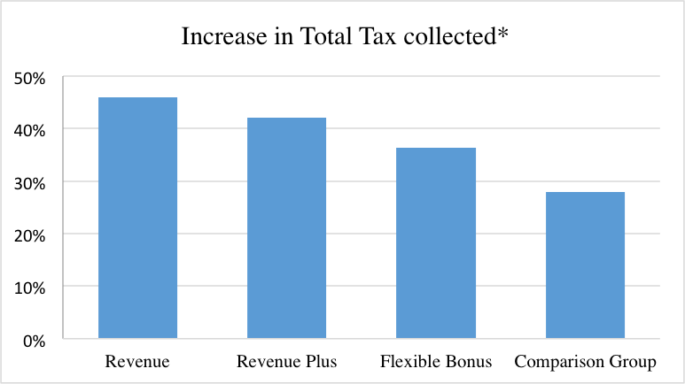
IGC Project: Pakistan Performance Pay Project
Source: Khan, Khwaja, Olken (2014)

Slide 26
Recap: Taxation & Development
  Rather than rely on transplanting developed country solutions, we
    Take a more “nitty-gritty micro approach” grounded in the specific context and constraints of the country in question
  This is more challenging:
    Data: High-quality data [e.g. administrative data]
    Design: Credible research design [RCTs, quasi-experiments]
    Evaluation: Rigorous evaluation techniques
    Collaboration: Engagement btw policy makers and researchers
  BUT IT IS DOABLE
    Today we have seen a few examples of what is feasible in the area of taxation

