Slide 1
PUBLIC FINANCE AND URBAN GROWTH
“the case for a NATIONAL URBAN POLICY for zambia”
Presentation to the IGC Cities Research Conference: 21st-22nd May, 2015
Held at the London School of Economics
Meembo Nchimunya Changula
Principal Planner - Forward Planning
Department of Physical Planner – Forward and Housing
Ministry of Local Government and Housing
Lusaka, Zambia

Slide 2
URBANISATION IN ZAMBIA
One of most urbanised countries in Sub-Saharan Africa.
Historical drivers:
  Discovery of minerals at turn of 20th century in Copperbelt Province → South-North urban development axis (line of rail)
  Urbanisation drivers: rural-urban migration and natural population growth

Slide 3
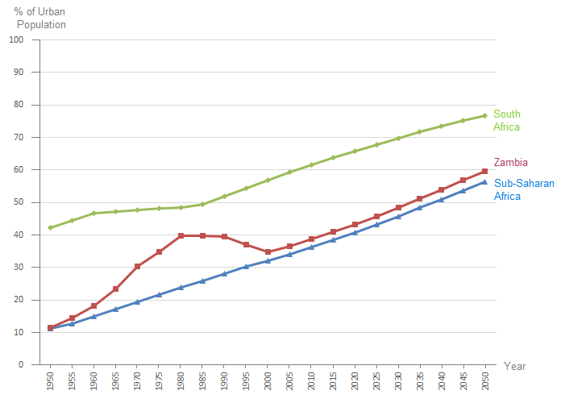
URBANISATION IN ZAMBIA
39% by 2010; 50% by 2030; 60% by 2050.
Absolute numbers:5 times growth 2010 to 2050.
Source: Ministry of Local Government and Housing, NUP Zambia Discussion Paper, 2014

Slide 4
HISTORIC URBAN GROWTH
Level in Hierarchy | Main urban centres of Zambia | Population in 1990 | Population in 2000 | Population in 2010 | % change 2000 - 2010
Level 1 (>1,000,000) | Lusaka | 769,353 | 1,084,703 | 1,747,152 | 61.1%
Level 2 (200,000-500,000) | Kitwe | ... | 363,734 | 501,360 | 37.8%
 | Ndola | 329,228 | 374,757 | 451,246 | 20.4%
Level 3 (100,000-200,000) | Kabwe | 154,318 | 176,758 | 202,360 | 14.5%
 | Chingola | 142,383 | 147,448 | 185,246 | 25.6%
 | Mufulira | 123,936 | 122,336 | 151,309 | 23.7%
 | Livingstone (Maramba) | 76,875 | 97,488 | 134,349 | 37.8%
 | Luanshya | 118,143 | 115,579 | 130,076 | 12.5%
 | Chipata | 52,213 | 73,110 | 116,627 | 59.5%
 | Kasama | 47,653 | 74,243 | 101,845 | 37.2%
Level 4 (50,000-100,000) | Solwezi | 23,435 | 38,121 | 90,856 | 138.3%
 | Mansa | 37,882 | 41,059 | 78,153 | 90.3%
 | Chililabombwe | 48,055 | 54,504 | 77,818 | 42.8%
 | Kafue | 43,801 | 45,890 | 72,166 | 57.3%
 | Mazabuka | 24,596 | 47,148 | 71,700 | 52.1%
 | Mongu | 29,302 | 44,310 | 52,324 | 18.1%
 | Kalulushi | 31,474 | ... | 51,863 | N.A.
 | Choma | 30,143 | 40,405 | 51,842 | 28.3%
 | Kapiri Mposhi | 13,540 | 27,219 | 44,783 | 64.5%
Notes:
4

Slide 5
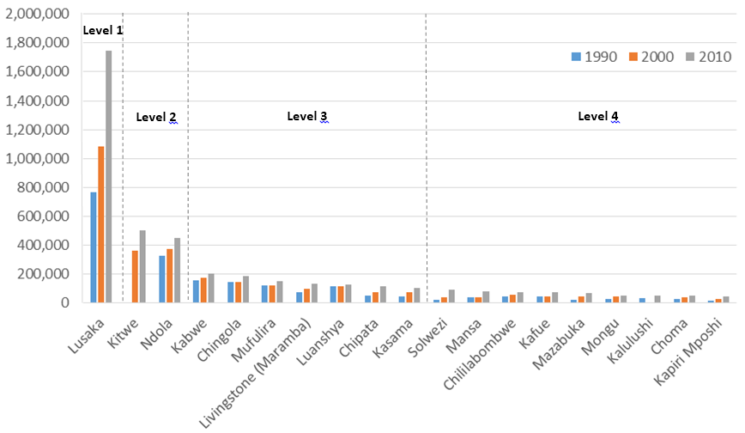
HISTORIC URBAN GROWTH

Slide 6
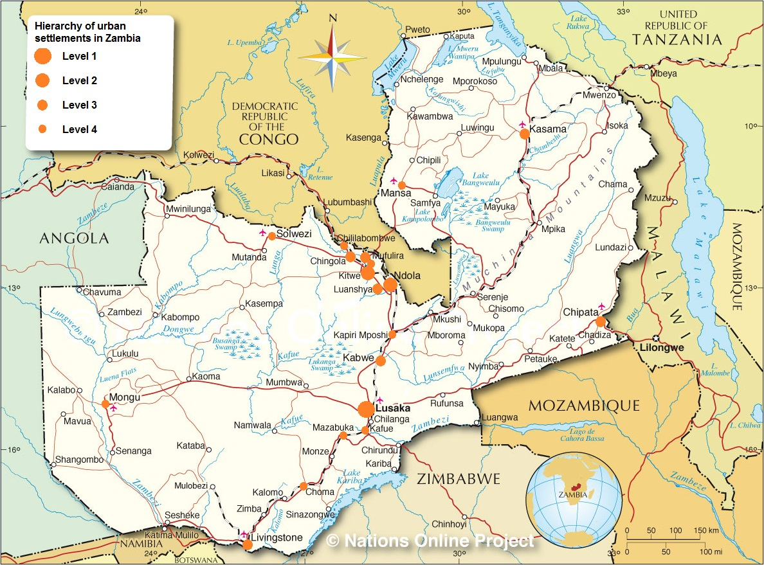

Slide 7
Greatest Historic Increase In Population
Main urban centres of Zambia | Population in 2000 | Population in 2010 | Actual Increase
Lusaka | 1,084,703 | 1,747,152 | 662,449
Kitwe | 363,734 | 501,360 | 137,626
Ndola | 374,757 | 451,246 | 76,489
Solwezi | 38,121 | 90,856 | 52,735
Chipata | 73,110 | 116,627 | 43,517
Chingola | 147,448 | 185,246 | 37,798
Mansa | 41,059 | 78,153 | 37,094
Livingstone (Maramba) | 97,488 | 134,349 | 36,861
Nakonde | 9,332 | 41,836 | 32,504
Mufulira | 122,336 | 151,309 | 28,973
Kasama | 74,243 | 101,845 | 27,602
Kafue | 45,890 | 72,166 | 26,276
Kabwe | 176,758 | 202,360 | 25,602
Mazabuka | 47,148 | 71,700 | 24,552
Chililabombwe | 54,504 | 77,818 | 23,314
Kalulushi | 52,800 | 76,015 | 23,215
Mpulungu | 7,488 | 29,103 | 21,615
Kapiri Mposhi | 27,219 | 44,783 | 17,564
Mwense | 3,818 | 21,137 | 17,319
Nchelenge/Kashikishi | 20,709 | 36,894 | 16,185
Notes:
7

Slide 8
Fastest Historic Rate Of Increase
Urban Centre | % change 2000 and 2010
Mwense | 453.6%
Nakonde | 348.31%
Mpulungu | 288.7%
Solwezi | 138.30%
Katete | 105.7%
Petauke | 103.4%
Mansa | 90.30%
Nchelenge/Kashikishi | 78.2%
Kapiri Mposhi | 64.50%
Monze | 61.57%
Lusaka | 61.10%
Chipata | 59.50%
Kafue | 57.30%
Mpika | 53.6%
Mazabuka | 52.10%
Kalulushi | 44.0%
Chililabombwe | 42.80%
Mbala | 41.8%
Kitwe | 37.80%
Livingstone (Maramba) | 37.80%
Notes:
8

Slide 9
Future Urban Growth
Main urban centres of Zambia | Population in 2010 | Estimated Population 2015 | Estimated Population 2025 | Estimated Population 2035
Lusaka | 1,747,152 | 2,281,702 | 3,285,329 | 4,560,560
Kitwe | 501,360 | 627,130 | 871,560 | 1,190,534
Ndola | 451,246 | 530,129 | 646,417 | 777,276
Kabwe | 202,360 | 221,077 | 253,429 | 286,418
Chingola | 185,246 | 259,981 | 331,747 | 417,590
Mufulira | 151,309 | 176,929 | 208,330 | 238,112
Livingstone | 134,349 | 159,251 | 214,579 | 280,508
Luanshya | 130,076 | 147,310 | 163,775 | 182,773
Chipata | 116,627 | 146,088 | 224,086 | 331,642
Kasama | 101,845 | 120,284 | 162,640 | 216,620
Solwezi | 90,856 | 133,200 | 238,623 | 354,546
Mansa | 78,153 | 105,106 | 176,538 | 272,307
Chililabombwe | 77,818 | 98,843 | 140,927 | 196,673
Kalulushi | 76,015 | 96,787 | 137,811 | 191,006
Kafue | 72,166 | 93,110 | 131,490 | 178,793
Mazabuka | 71,700 | 88,763 | 125,801 | 166,493
Mongu | 52,324 | 56,682 | 66,044 | 78,081
Choma | 51,842 | 59,600 | 75,276 | 92,465
Kapiri Mposhi | 44,783 | 58,260 | 94,749 | 150,129
Nakonde | 41,836 | 56,432 | 95,888 | 153,376
Notes:
9

Slide 10
Future Urban Growth - Fastest Growing
Main urban centres of Zambia | Population in 2010 | Estimated Population 2035 | % change between 2010 and 2035
Mumbwa | 20,390 | 153,368 | 652.17%
Mpulungu | 29,103 | 215,151 | 639.27%
Mwense | 21,137 | 150,463 | 611.85%
Solwezi | 90,856 | 354,546 | 290.23%
Nchelenge/Kashikishi | 36,894 | 138,782 | 276.16%
Nakonde | 41,836 | 153,376 | 266.61%
Petauke | 29,728 | 104,225 | 250.60%
Mansa | 78,153 | 272,307 | 248.43%
Mpika | 39,724 | 135,472 | 241.03%
Kapiri Mposhi | 44,783 | 150,129 | 235.24%
Chipata | 116,627 | 331,642 | 184.36%
Monze | 39,752 | 112,099 | 182.00%
Lusaka | 1,747,152 | 4,560,560 | 161.03%
Chililabombwe | 77,818 | 196,673 | 152.73%
Kalulushi | 76,015 | 191,006 | 151.27%
Kafue | 72,166 | 178,793 | 147.75%
Kitwe | 501,360 | 1,190,534 | 137.46%
Mazabuka | 71,700 | 166,493 | 132.21%
Chingola | 185,246 | 417,590 | 125.42%
Kasama | 101,845 | 216,620 | 112.70%
Livingstone (Maramba) | 134,349 | 280,508 | 108.79%
Notes:
10

Slide 11
Ten Biggest Cities 2010 and 2035
Main urban centres of Zambia | Ranking in 2010
Lusaka | 1
Kitwe | 2
Ndola | 3
Kabwe | 4
Chingola | 5
Mufulira | 6
Livingstone | 7
Luanshya | 8
Chipata | 9
Kasama | 10
Main urban centres of Zambia | Ranking in 2035
Lusaka | 1
Kitwe | 2
Ndola | 3
Chingola | 4
Solwezi | 5
Chipata | 6
Kabwe | 7
Livingstone | 8
Mansa | 9
Mufulira | 10
Notes:
11

Slide 12
Future Urban Growth – Change In Rank
Size | Number in 2010 | Number in 2035 | Note
1,000,000 plus | 1 | 2 | Lusaka 4.56 million and Kitwe 1.19 million
500,000 - 999,000 | 1 | 1
400,000 - 499,999 | 1 | 1
300,000 - 399,999 | 0 | 2
200,000 - 299,999 | 1 | 6
100,000 - 199,999 | 6 | 13
Total over 100,000 | 10 | 25
Notes:
12

Slide 13
URBANISATION CHALLENGES
Socio-economic challenges
  Attractive opportunities in cities/towns resulting in strong migration and fast urban growth
  Poverty and high living costs in cities compared to rural areas
Spatial and environmental challenges
  Strong migration towards North - South corridor
  City boundary encroachment on agricultural and customary land
  Growing city expansion
  Proliferation of informal settlements
  Environmental degradation
  Inefficient urban planning practices
Policy, legal and institutional challenges
  Obsolete urban legislation and weak regulatory framework
  Poor coordination & low institutional capacity

Slide 14
WHAT IS A NATIONAL URBAN POLICY?
National Urban Policy is meant to be a deliberate government-led process of coordinating and rallying various actors for establishing a shared vision for the desired urbanisation within 20-30 years horizon or more.

Slide 15
NEED FOR NATIONAL URBAN POLICY
Zambian cities account for more than 80% of GDP
By ensuring density, diversity and innovation, cities can boost economic activities.
By sharing the same infrastructure and services, cities can maximise cost-effectiveness
NUP can support poverty reduction, spatial planning, land management, housing, basic and social services, infrastructural development and coordination of large-scale investments
NUP is not an anti-rural policy, thriving towns and cities will assist rural development
More functional importance needs to be provided to urban centres located in under-developed regions.
The NUP can promote principles of good urbanism

Slide 16
URBANISATION AND CITY ECONOMY
“There is a direct link between urban growth and city economy”

Slide 17
NUP OBJECTIVES
Avoid future human-made and environmental disasters from unplanned rapid urban population and physical growth.
Create jobs to lift people out of poverty by harnessing agglomeration advantages of concentrated economic activity.
Deliver more cost-effective public services and infrastructure.
Strengthen municipal institutions to plan and manage urban growth.
Develop a more functional national urban system that contributes to rural development and transformation.

Slide 18
Identification of urban
development priorities
1.
DEVELOPMENT
OF
NATIONAL URBAN POLICY
Guidance on the future
development priorities
RESULTs
2.
Better coordination and
guidance of actions
3.
Increased and more coordinated investments priorities
4.

Slide 19
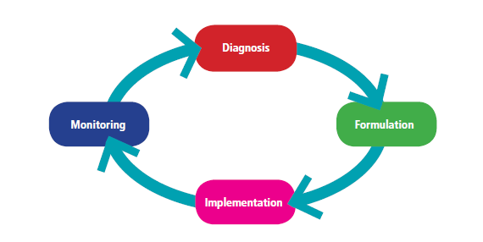
KEY NUP STAGES

Slide 20
CONCLUSION
The rate of urbanisation, especially in developing countries will continue to increase at almost exponential rates.
  Urbanisation should be viewed as an opportunity rather than a challenge - urban growth presents greater economic opportunities for cities and their residents.
The focus for urban policy makers should be on harnessing economic opportunity and promoting sustainable urban growth through the right planning frameworks and policies.

