Slide 1
“The economic consequences of peace?” Understanding South Africa’s stagnation
Alan Hirsch
Graduate School of Development Policy and Practice

Slide 2
In his analysis of the outcome of the Versailles peace talks at the end of WW I, Keynes argued that the settlement was too tough on the losers and that the consequence would be further crises
Here it is argued that the settlement of the South African struggle for freedom was too soft on the “losers”, the consequences of which are economic stagnation and a difficult environment for reform

Slide 3
Structure of argument
South Africa is growing slowly relative to its peers
This is because the economy is moribund relative to peers (weak exports, low investment, weak innovation, poor competition)
South Africa is more unequal than its peers especially in the gap between insiders and outsiders
Ironically, the miraculous political settlement of 1994 inhibited the transformation needed to address inequality and growth
High inequality and slow growth preceded the transition but are rooted in the settlement and have undermined social cohesion and political legitimacy
Under these circumstances reform is challenging in the near term
But near term reforms are not impossible, and we should celebrate, defend and build on islands of excellence

Slide 4
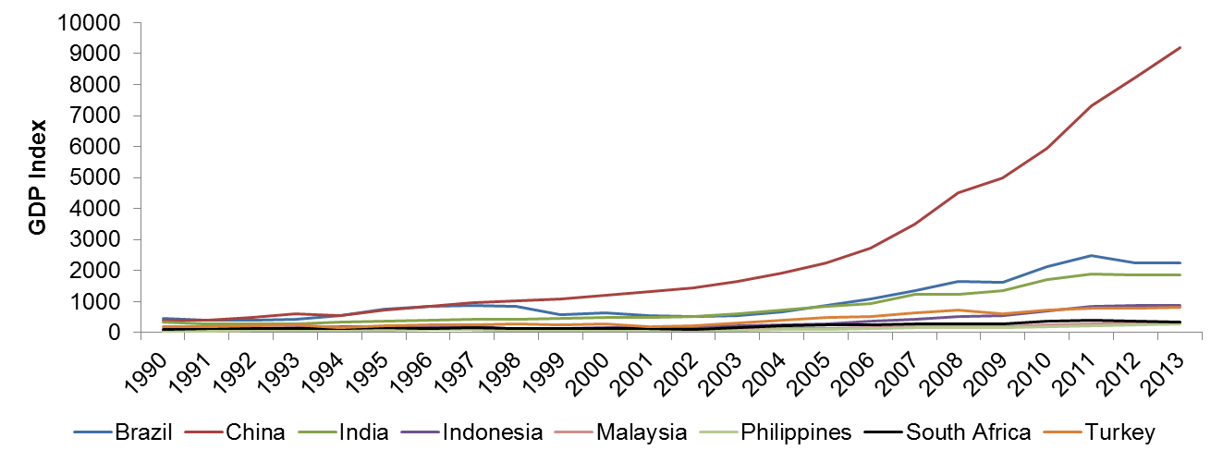
South Africa is growing slowly relative to its peers
Bhorat, Cassim and Hirsch, (2015)
Notes:
So why, when South Africa shares so much with rapidly growing emerging markets and has one of the largest and diversified sub-Saharan African economies, has the country failed to converge? (Bhorat and Hirsch, 2014)

Slide 5
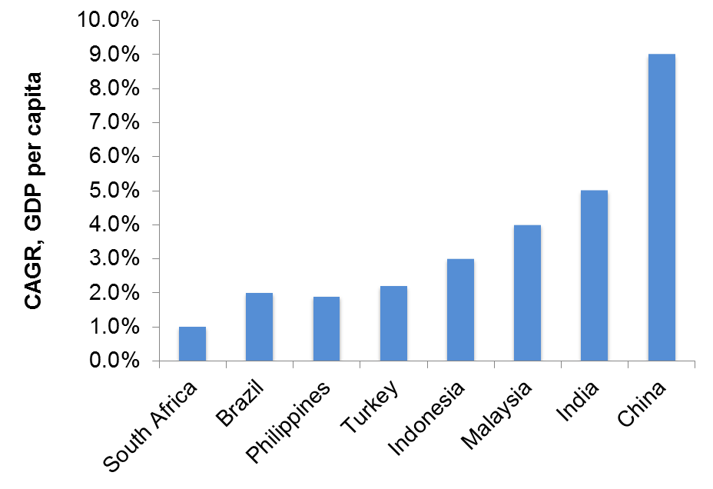
A growth trap?
Average Annual growth of GDP per capita between 1990 and 2013
Bhorat, Cassim and Hirsch, (2015)
Notes:
Economies such as South Africa, Brazil, the Philippines and Turkey unable to significantly increase per capita growth rates.
This may represent a growth trap in these emerging economies.

Slide 6
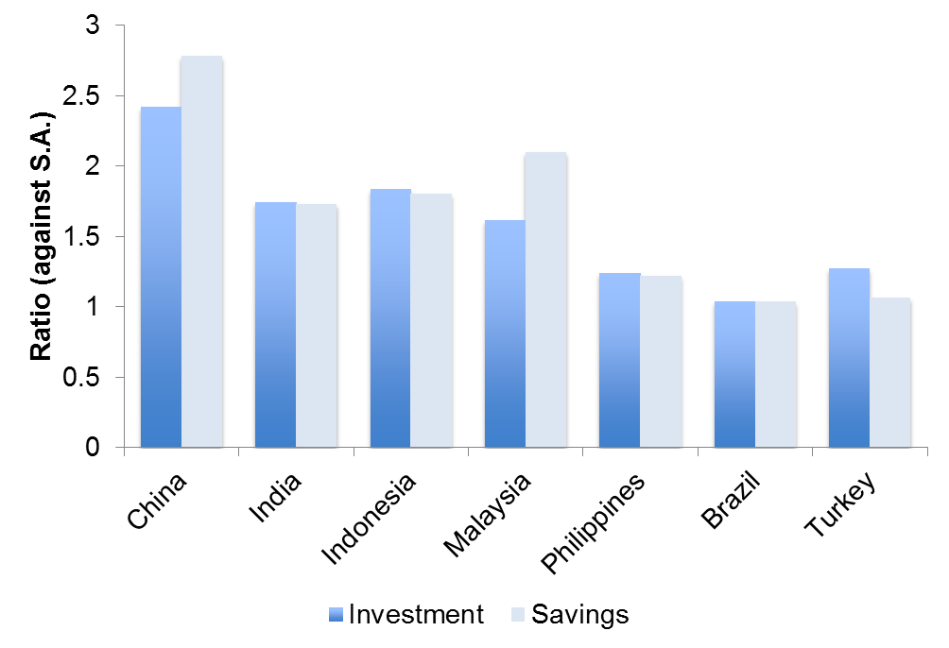
Low investment
Bhorat, Cassim and Hirsch, (2015)
Notes:
Countries experiencing low growth - Philippines, Brazil and Turkey - had investment and savings similar to South Africa.
Savings and investment in China, Malaysia, India and Indonesia at least 1.5 times greater than South Africa.
Why are SA savings and investments so low?

Slide 7
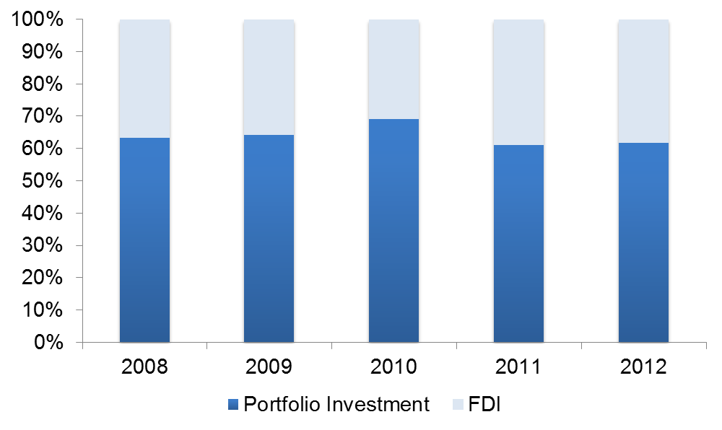
Inward investment pattern
Bhorat, Cassim and Hirsch, (2015)
Notes:
Financing of the deficit been dependent on (volatile) portfolio investment rather than FDI.
Short term capital inflows perpetuate dependence on the resource sector, processers of resources, and powerful, publically-quoted oligopolies in the services sector.

Slide 8
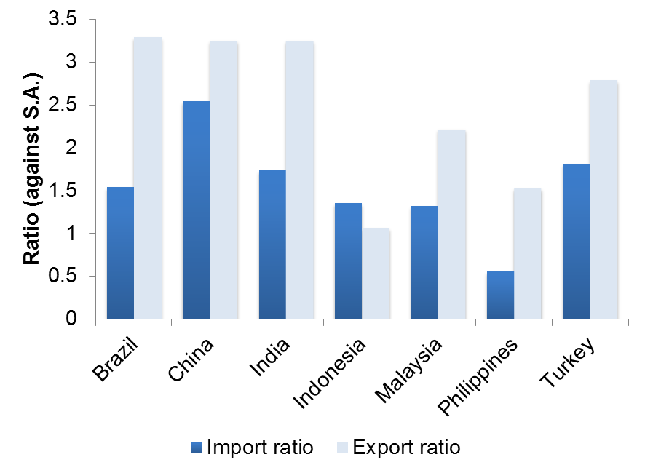
Poor trade performance
Bhorat, Cassim and Hirsch, (2015)
Notes:
SA exports grew 3.5 % pa over 1990-2012, less than 1/2 of Malaysia and 1/3 of China, Brazil and Indonesia.
Reflects poor response to commodity boom and poor integration into global value chain.
SA’s export profile is capital-intensive & driven by natural resources.

Slide 9
Anatomy of a Growth Trap
Ratio of export production relative to South Africa, 2000 and 2012
 | High-technology exports | Insurance and financial services | Manufactures exports | Food exports | Ores and metals exports | Agricultural raw materials exports
 | (% of manufactured exports) | (% of commercial service exports) | (% of merchandise exports) | (% of merchandise exports) | (% of merchandise exports) | (% of merchandise exports)
Brazil | 2.34 | 0.93 | 0.9 | 3.3 | 0.47 | 1.76
China | 4.68 | 0.18 | 1.75 | 0.41 | 0.07 | 0.26
India | 1.18 | 0.7 | 1.32 | 1.19 | 0.21 | 0.67
Indonesia | 2.31 | 0.26 | 0.87 | 1.58 | 0.3 | 2.41
Malaysia | 9.16 | 0.21 | 1.36 | 1.08 | 0.06 | 1.1
Philippines | 11.69 | 0.13 | 1.59 | 0.78 | 0.14 | 0.28
Turkey | 0.39 | 0.43 | 1.55 | 1.2 | 0.12 | 0.27
Korea, Rep. | 5.4 | 0.56 | 1.71 | 0.14 | 0.08 | 0.4
Notes: High-technology exports are products with high R&D intensity, such as in aerospace, computers, pharmaceuticals, scientific instruments, and electrical machinery.
Source: World Bank (2014), Bhorat, Cassim and Hirsch, 2015

Slide 10
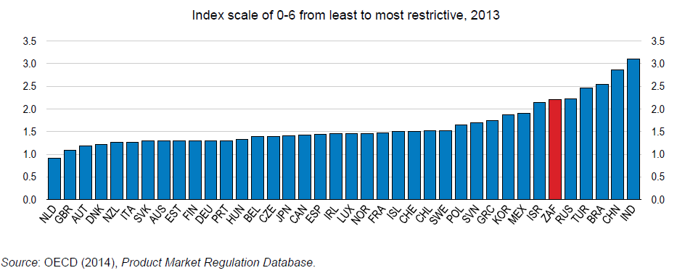
Competition in product markets is low: OECD Product market regulation index

Slide 11
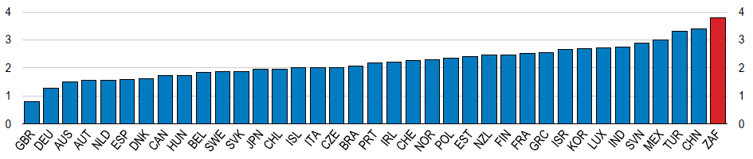
And the regulatory burden is high Especially in network industries

Slide 12
Innovation capacity Science, Engineering and Technology Graduates
Ratio of graduates at tertiary institutions in SET, 1994-2011
Notes: Brazil, Malaysia, Korea and Turkey reflect engineering, construction and manufacturing graduates; South Africa reflects the Science, Engineering and Technology graduates and China reflects Maths, Science and Engineering graduates.
Source: The Presidency (2012); UNESCO (2014), Bhorat, Cassim and Hirsch (2015)
Notes:
The proportion of graduates from high school leavers is 15-17 %.
Only 4-6 % graduated with SET degree.
Brazil had a similar number of graduates to South Africa, Turkey had double, but Malaysia had just over 5 times and China 6.7 times, the proportion of graduates in this field.
Here, mention Cobb Douglas results

Slide 13
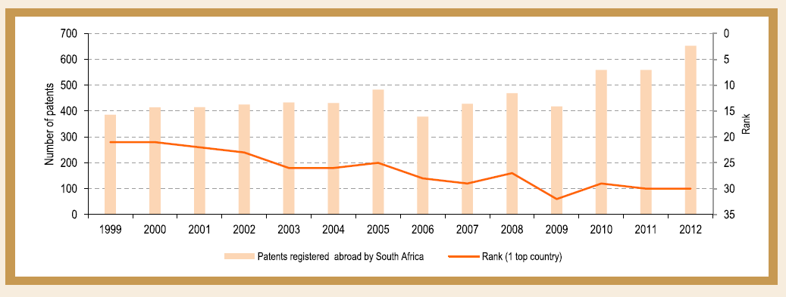
International patent registration Declining global rank
Source: DPME Development Indicators 2014, South African Presidency

Slide 14
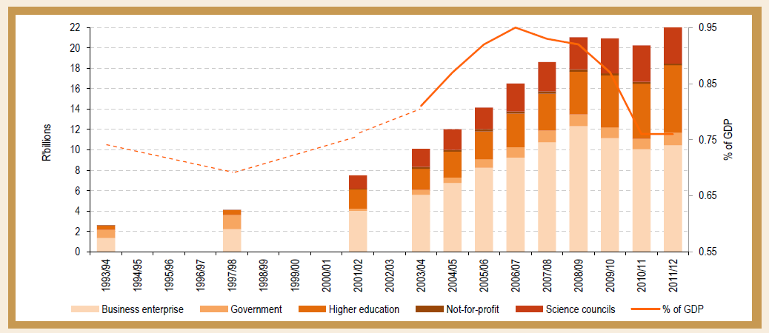
Weakening expenditure on innovation Value and percentage of GDP
Source: DPME Development Indicators 2014, South African Presidency

Slide 15
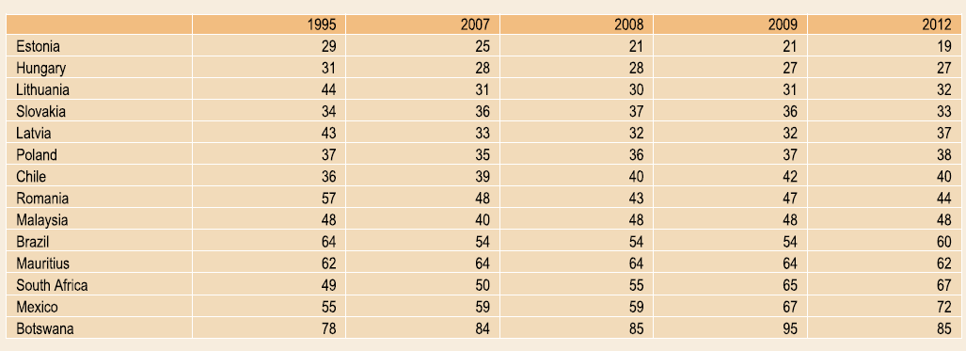
Falling behind in competitive knowledge: Declining rank in the knowledge based economy index
Source: DPME Development Indicators 2014, South African Presidency

Slide 16
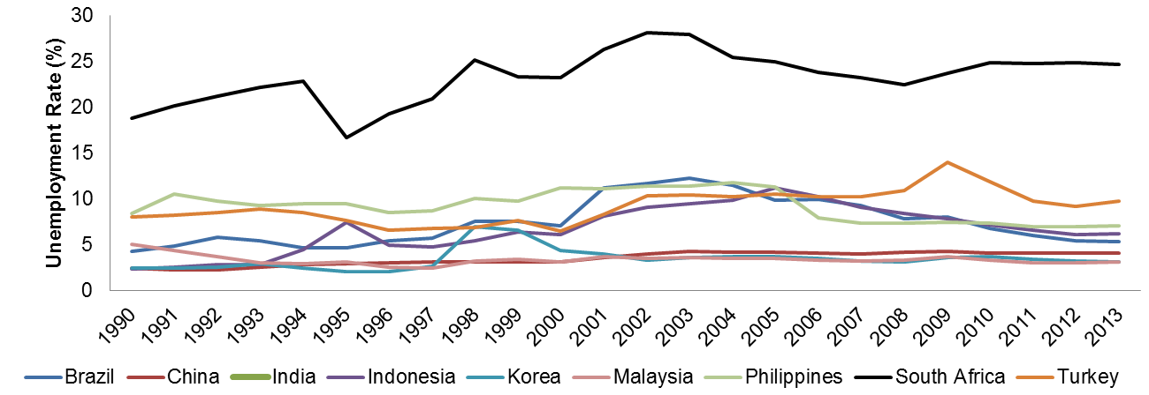
Persistent high unemployment is not surprising Though the roots of high unemployment are structural
Rate of unemployment 1990-1013
Bhorat, Cassim and Hirsch, (2015)
Notes:
South Africa’s unemployment rate is extraordinarily high.
Even true amongst economies that have experienced low levels of growth and investment - Brazil and Turkey.
South Africa’s informal sector smaller and unable to absorb low-skilled workers exacerbating unemployment.

Slide 17
Equally striking is the extent and nature of inequality
Inequality is persistently high in South Africa
It is high in comparison with peers
That the gap between the elite and the middle cohorts is very large

Slide 18
Measuring distribution
Use expenditure data (NIES 2000, 2005, 2010)
Expenditure per capita
Facilitates comparison with Milanovic data set
Disaggregated per capita shares by ventiles
Measure of distribution after taxes and transfers
Underestimates inequality relative to:
Actual expenditure (undersamples at top)
Income data
Wealth data

Slide 19
Patterns of expenditure distribution
 | South Africa (2000)
Top 5% | 42.1%
Next 15% | 32.2
Next 40% | 20.2
Bottom 40% | 5.5
 | 100%
Levy, Hirsch and Woolard, (2014)

Slide 20
Patterns of expenditure distribution
 | South Africa (2000) | South Africa (2010)
Top 5% | 42.1% | 37.5%
Next 15% | 32.2 | 32.8
Next 40% | 20.2 | 22.8
Bottom 40% | 5.5 | 6.9
 | 100% | 100%
Levy, Hirsch and Woolard, (2014)

Slide 21
Patterns of expenditure distribution
 | South Africa (2000) | South Africa (2010) | Brazil (2000) | Mexico (2000) | Thailand (2000) | Turkey (2000)
Top 5% | 42.1% | 37.5% | 33.7% | 27.9% | 19.8% | 23.1%
Next 15% | 32.2 | 32.8 | 29.8 | 28.2 | 27.1 | 26.5
Next 40% | 20.2 | 22.8 | 28.4 | 32.5 | 36.0 | 35.3
Bottom 40% | 5.5 | 6.9 | 8.1 | 11.4 | 17.1 | 15.1
 | 100% | 100% | 100% | 100% | 100% | 100%
Levy, Hirsch and Woolard, (2014)
Notes:
Top 5% are considerably richer in SA
“Middle 40%” are considerably poorer in SA
Poorest 40% are poorer than other MICs.

Slide 22
What happened? Why did South Africa not transform more?
Is it a matter of time? Is it too soon to judge?
Is there more transformation outside of income measurements? (Yes for services, no for wealth)
Is there something about the South African transition to democracy that inhibited deep reform?

Slide 23
A short history of the transition 1. Late apartheid reforms
Reform initiatives e.g.
Wiehahn labour reforms
tri-cameral parliament
abolition of influx controls
From PFP and the Urban Foundation to IDASA the trajectory of Slabbert (vs. Oppenheimer on the ANC)
Meeting with the ANC 85-89 business and verligtes (enlightened Afrikaners)

Slide 24
A short history of the transition 2. During the interregnum
The repositioning of Business 1989-1994
The National Business Initiative
Nedbank Scenarios (etc)
Post-1990 engagements of business and the ANC
The “golden triangle” and the NEF

Slide 25
A short history of the transition 3. Pro-status-quo constitutional/legal outcomes
The bloated parliament and sunset clauses
The sanctity of private property
Independence of monetary authorities with no employment or developmental mandate
The location of power over agriculture
Limits to the competition law (conduct vs structure)

Slide 26
A short history of the transition 4. The rise and fall of social partnership from NEF to NEDLAC
NEDLAC as a site of creative policy development
Weakening of trust around GEAR (vs RDP Plan and Labour Market Commission)
The failure of the Jobs Summit and the Growth and Employment Summit
Impatience of policymakers
Capture of NEDLAC?
The weakening of leadership participation

Slide 27
A short history of the transition 5. Black economic empowerment
Includes “affirmative action” and personal redistribution of wealth
The former was central to ANC notions of economic transformation—the latter came later
Affirmative action has grown a middle class and the white collar working class, with African women benefiting notably
But affirmative action is limited by the growth rate and the availability of skills (plateaued)
Redistribution of ownership has had an extremely limited impact except for a small largely politically connected elite
BEE has not had a significant impact on new firm development, innovation, competition or exports
Rather, it has reinforced existing oligopolistic patterns

Slide 28
Forbes Africa rich list extract
16 out of the richest 50 Africans are South African
3 out of the top 4 are South African
None of the South Africans are Women
Only 2 out of the 16 South Africans are black
8 out of the 16 are in finance & retail

Slide 29
Outcome of the transition
The transition was hindered by intimacy with the established business elite (who in turn were mired in a oligopolistic model which tended towards stagnation)
Social partnership failed to be a basis for innovative policy when the trust of labour was lost
Political society is fragmented and trust is rare
Ambitious, broad coalitions for reform look far-fetched in the short term (however desirable they are)

Slide 30
Also there were accidents of the transition
Lassez faire reforms in agriculture
Poor design for basic education
Poorly designed partial privatisations and partial liberalisations, especially Telkom

Slide 31
Missed opportunities What more radical reform might have included
Asset and income transfers: how much more could have been done?
The role of the central bank
Trade, competition and industrial policy
SMEs and innovation
Restructuring apartheid cities

Slide 32
What is to be done?
Gains, not perfection, could be the goal
A broad-based social compact has long been the ‘holy grail’ – but there are no grounds for optimism that it currently is attainable—maybe down the road it will be
When broad-based reform is unavailable, progress can come from the accumulation and demonstration effects of many smaller gains

Slide 33
Islands of effectiveness – examples of improvements
Renewable electricity generation contracts
Rescue of electronics plant through multi-stakeholder deal
Gains in high-school performance in Free State (and possibly elsewhere)
Some successes in some SETAs (=> governance lessons?)
Some successes in roll-out of labour-intensive public works
The use of the Constitution as a spear and a shield by civic movements to drive reforms

Slide 34
Islands of effectiveness – some possible new opportunities
Export zone e.g. in Eastern Cape with ambitious (say, 500,000) jobs target
Empower ‘mid-level’ multi-stakeholder coalitions to strengthen public service provision (e.g. in basic education)
Joint government, business and labour initiatives to build stable communities in mining towns

Slide 35
Some key sources:
Aghion, P, M Braun and J.W. Fedderke (2008) Competition and Productivity Growth in South Africa’ Economics of Transition 16(40 741-68.
Haroon Bhorat and Alan Hirsch (2014), “South Africa: “Perspectives on Divergence and Convergence”, in Kemal Dervis and Homi Kharas (eds), Growth Convergence and Income Distribution: The road from the Brisbane G20 Summit, Brookings, Washington DC
Haroon Bhorat, Alan Hirsch, Ravi Kanbur and Mthuli Ncube (eds),(2014), The Oxford Companion to the Economics of South Africa, Oxford University Press, Oxford,
Haroon Bhorat, Aalia Cassim, Alan Hirsch, (2015) ”Policy Co-ordination and Growth Traps in a Middle-Income Country Setting”, Joint KOICA UNU-WIDER PROJECT, Helsinki
Neo Chabane et al (2003) “10 year review: Industrial structure and competition policy”, Corporate Strategy and Industrial Development research project, School of Economic and Business Sciences, University of the Witwatersrand
Fedderke, J.W. (2012), Competition, Industrial Structure and Economic Growth”, in Monetary Policy and the Challenge of Economic Growth: The South African Reserve Bank Conference Series, 2012, South African Reserve Bank, 91-132
Fedderke J.W. (2009), Determinants of Investment in Its Impact on South African growth , in J.Aron and J. Muellbauer (eds), A Review of South African Economic Policy Under Democracy, Oxford, Oxford University Press, 182-210
Hirsch, Alan (2005), Season of Hope: Economic reform under Mandela and Mbeki, UKZN Press and IDRC, Scottsville and Ottawa.
IMF Regional Economic Outlook, April 2014, Table 1.1 https://www.imf.org/external/pubs/ft/reo/2014/afr/eng/sreo0414.pdf
Brian Levy, Alan Hirsch and Ingrid Woolard, (2014) “South Africa’s evolving political settlement in comparative perspective”, Saldru Working Paper Number 138, University of Cape Town
Sandeep Mahajan, “South Africa’s suboptimal political economy equilibrium” in Haroon Bhorat, Alan Hirsch, Ravi Kanbur and Mthuli Ncube (eds), The Oxford Companion to the Economics of South Africa, Oxford University Press, Oxford, 2014
OECD (2014) Economic Surveys: South Africa, PARIS, OECD Publishing.
Wörgötter, Andreas, “Industrial structure and competition policy” in Bhorat et al (eds) The Oxford Companion to the Economics of South Africa, Oxford University Press, Oxford, 2014.

