Slide 1

Justification of “Kanyashree Prakalpa” in West Bengal and the initial findings on evaluation
Arijita Dutta, Professor, Department of Economics, University of Calcutta
Anindita Sen, Associate Professor, Department of Economics, University of Calcutta

Slide 2
Critical position of the state of West Bengal: Early marriage & adolescent dropout
Two factors reinforcing each other are under-age marriage (before 18 years) and adolescent dropouts by girls between the age of 13-18 years.
Resulting in social problems and economic losses
In terms of both these indicators, West Bengal appeared to be in a critical position.
District level Health Survey 4 (2012-13) confirms that among non-EAG states of India, West Bengal has the least mean age at marriage for women (19.2 years). Consequently, 31.6% of currently married women belong to less than 18 years. This figure too, is by far the highest among the reported states. Tripura (18.9%) reports the second highest share.

Slide 3
Adolescent dropouts
Among girls (13-18 years)
Jammu &
Kashmir
HP
Legend
% of female adolescent dropped
0% to 19.7%
19.8% to 21.8%
21.9% to 24.1%
24.2% and above
Punjab
Arunachal
Pradesh
Uttarakhand
Haryana
Sikkim
Delhi
Rajasthan
Uttar Pradesh
Assam
Nagaland
Bihar
Meghalaya
Manipur
Madhya Pradesh
Jharkhand
Gujarat
West
Bengal
Mizoram
Chhattisgarh
Tripura
Maharashtra
Orissa
Telangana
Goa
Andhra Pradesh
Lakshadweep
Karnataka
Tamil Nadu
Andaman & Nicobar Is.
Kerala

Slide 4
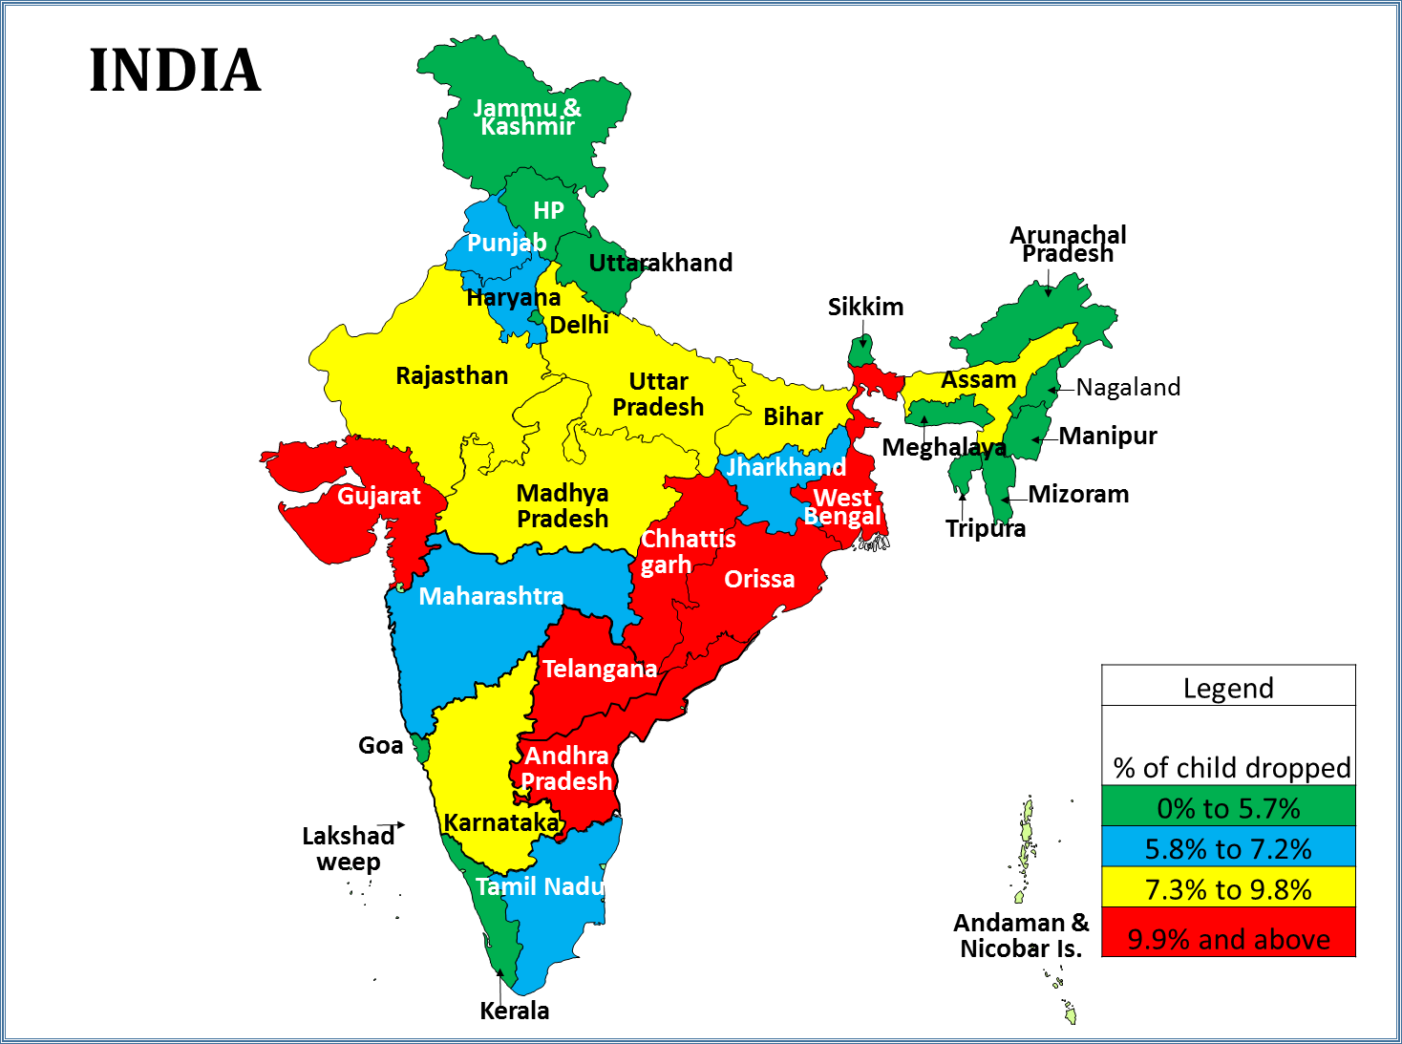
Distribution of Child Dropouts across states
(Average being 8.07 & 9.03 for boys & girls respectively)

Slide 5
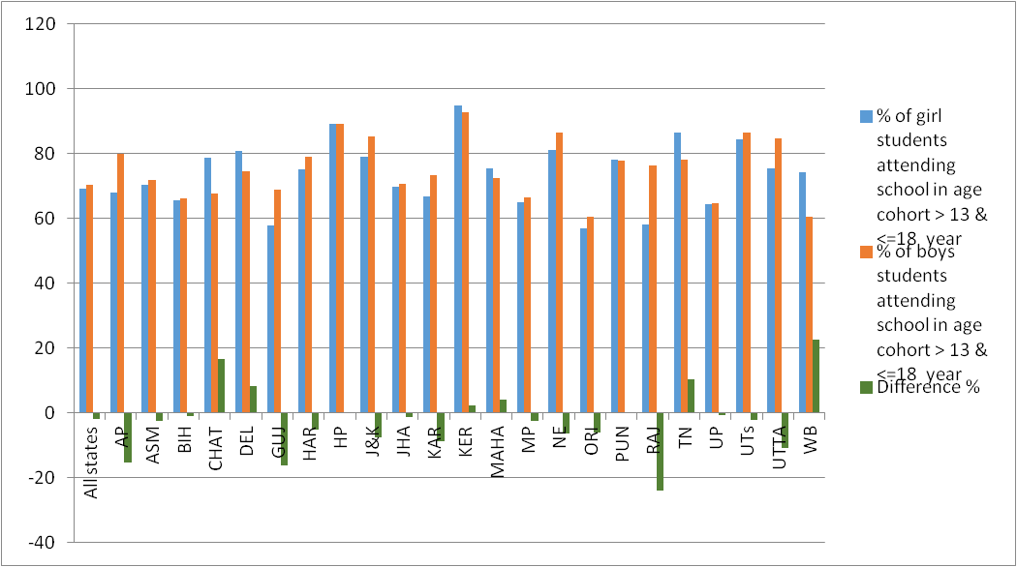
Gender-wise school attendance in age cohort 13-18 years (Highest gap in WB)

Slide 6
Adolescent Dropout in West Bengal across income classes

Slide 7
Reasons reported for adolescent dropouts across states % shares
 | Gujarat |  | West Bengal |  | Karnataka |  | Orissa |  | India
Reasons for DO | M | F | M | F | M | F | M | F | M | F
Not interested | 14.67 | 15.26 | 21.39 | 11.41 | 21.20 | 15.28 | 30.21 | 21.10 | 24.71 | 14.30
Economic activities | 55.92 | 12.50 | 64.20 | 31.20 | 64.37 | 21.68 | 50.18 | 27.52 | 57.07 | 20.57
Domestic activities | 0.91 | 40.25 | 1.99 | 16.21 | 3.58 | 23.62 | 3.45 | 24.49 | 5.14 | 31.10
School infrastructure | 0.29 | 6.09 | 0.25 | 0.90 | 0.85 | 4.63 | 0.48 | 3.53 | 0.68 | 4.70
Marriage | 0.00 | 6.55 | 0.00 | 30.52 | 0.00 | 21.03 | 0.00 | 5.13 | 0.00 | 15.80
Completed desired level | 10.58 | 6.79 | 1.25 | 0.56 | 0.48 | 2.96 | 0.57 | 0.74 | 2.11 | 2.64
Unable to cope with studies | 15.95 | 10.05 | 8.25 | 6.29 | 7.69 | 7.84 | 12.05 | 11.99 | 7.42 | 6.55
Others | 1.69 | 2.50 | 2.66 | 2.91 | 1.83 | 2.94 | 3.06 | 5.50 | 2.87 | 4.06

Slide 8
Conditional marginal effects of Bivariate Probit regression
Categories | Girls | Boys
Religious group ( Hindu reference)
Muslim |  | 0.01***
Others | -0.17***
Social group (SC & ST reference)
OBC |  | -0.06**
Education of household head (illiterate reference)
Above secondary | -0.09***
Above higher secondary | -0.13*** | -0.19***
Log MPCE | -0.19*** | -0.19***
This actually explains
why a CCT for adolescent
girls might help to reduce
Dropout

Slide 9
Kanyashree Prakalpa
Given this situation, Conditional Cash Transfer (CCT) scheme- Kanyasree Prakalpa (KP) was introduced by the Government of West Bengal in 2012.
This programme targets adolescent girls aged 13-19 years and offers a two-tier scholarship of an annual Rs 500 (now Rs 750) for continuing education (K1) and a one-time payment of Rs 25,000 on completion of 18 years, conditional upon the girl remaining unmarried AND continuing education till that age (K2).
The aim of this scheme is two-fold –to stop marriage of girls before the official age of 18 & to promote secondary education among females.
In certain blocks, additional interventions are initiated. Tagging with other schemes. Special training and social networking. (KP+).

Slide 10
Districts | % of women without secondary education | Education Index (EI) | % of currently married women below 18 yrs | Marriage Index (MI) | Total Index
Kolkata | 50.10 | 0.00 | 8.50 | 0.00 | 0.00
Darjeeling | 73.80 | 75.00 | 10.20 | 5.40 | 20.12
Jalpaiguri | 73.70 | 74.68 | 16.90 | 26.67 | 44.63
Haora | 70.90 | 65.82 | 20.60 | 38.41 | 50.28
Hugli | 69.50 | 61.39 | 25.00 | 52.38 | 56.71
Maldah | 70.40 | 64.24 | 25.80 | 54.92 | 59.40
Purba Medinipur | 69.90 | 62.66 | 26.50 | 57.14 | 59.84
Koch Bihar | 71.90 | 68.99 | 31.50 | 73.02 | 70.97
North 24 Parganas | 74.20 | 76.27 | 29.70 | 67.30 | 71.64
Paschim Medinipur | 67.50 | 55.06 | 39.20 | 97.46 | 73.26
South 24 Parganas | 77.20 | 85.76 | 29.10 | 65.40 | 74.89
Uttar Dinajpur | 76.70 | 84.18 | 31.40 | 72.70 | 78.23
Puruliya | 77.60 | 87.03 | 30.70 | 70.48 | 78.31
Dakhin Dinajpur | 76.50 | 83.54 | 32.10 | 74.92 | 79.12
Birbhum | 73.90 | 75.32 | 35.20 | 84.76 | 79.90
Barddhaman | 77.50 | 86.71 | 34.30 | 81.90 | 84.27
Nadia | 81.70 | 100.00 | 31.20 | 72.06 | 84.89
Bankura | 75.60 | 80.70 | 40.00 | 100.00 | 89.83
Murshidabad | 81.30 | 98.73 | 39.10 | 97.14 | 97.94

Slide 11
Broad objectives
To estimate the coverage of the project and its possible effects on female dropout and early marriage.
To locate any impact of educational status of the siblings and of friends of Kanyashree recipients using network effect in the locality.
To examine whether the cash transfer to the adolescent girl changes the bargaining equations within and outside the family and whether it empowers the adolescent girls to continue education and postpone marriage in spite of family and social pressures.
To examine how the money received from this scheme was actually used. Whether it was used for educational purposes and to promote the career of the recipients or whether the money was used for meeting marriage expenses, including dowry, and thus partially defeating the purpose of the scheme.

Slide 12
District
Block 1 (with highest female literacy)
Village 1 (surrounding a school with high KP coverage)
Village 2 (surrounding a school with low KP coverage)
Block 2 (with lowest female literacy)
Village 1 (surrounding a school with high KP coverage)
Village 2 (surrounding a school with low KP coverage)
Complete
Listing of
All house-
Holds with
Women
aged 14-25
years
Random
Selection
of HHs
containing
women in
3 age
cohorts
Age cohort 1 (14-18 years)
Age cohort 1 (19-21 years)
Age cohort 1 (22-25 years)

Slide 13
Districts | Blocks | Not school going | Married | Failure of KP
Howrah | Sankarial | 11.78 | 9.09 | 14.81
 | Uluberia | 29.02 | 21.77 | 30.60
Murshidabad | Hariharpara | 31.84 | 28.42 | 34.61
 | Suti 2 | 24.09 | 13.56 | 25.75
Age cohort 1
(14-18 years)
The coverage is high in better developed block, namely Sankrail.
Shocking to find that even with such a celebrated program, about 30%
of girls in the age group 14-18 years do not go to school in Uluberia &
nearly 22% are married off. Worse condition prevails in Hariharpara.
Age category in years | Family pressure for UAM | Resistance against such pressure
19-21 | 9.28 | 33.33
22-25 | 14.29 | 23.53
However, the family pressure on girls to marry
below 18 years have gone down; In case of
such pressure, girls have successfully
resisted the UAM more.

Slide 14
Dropout and Under age marriage decreased appreciably in Howrah while comparing between age cohort 3 (attending 18 years before KP period) & cohort 2 (attending 18 years during KP period).
Age Group | % DO | % M<18 KP
19-21 | 53.49 KP Period | 19.83 KP Period
22-25 | 87.86 | 27.33
Region | UAM P | UAM S
Howrah
14-18 | 4.49 | 5.06
19-21 | 11.45 | 15.27
22-25 | 14.09 | 13.42
Sankrail
19-21 | 6.94 | 12.50
22-25 | 35.06 | 14.29
Uluberia
19-21 | 16.95 | 18.64
22-25 | 13.89 | 15.28
However, on the whole UAM arranged by parents
fell, though UAM arranged themselves increased.
Different pattern of changes in Sankarail and
Uluberia.
Does this mean something beyond KP matters?
Is it the enabling environment or KP+?

Slide 15
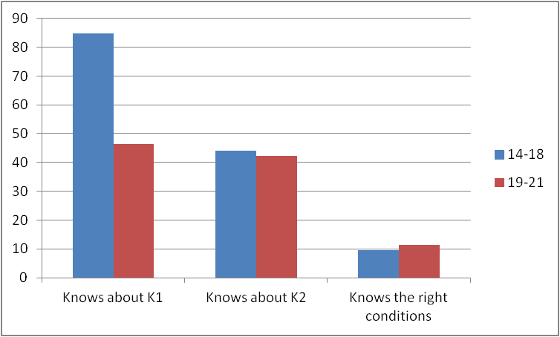
Knowledge about KP among two age groups

Slide 16
Use of K2 money
Those who reported that
K2 has been used for
education, have actually
enrolled themselves
for higher education

Slide 17
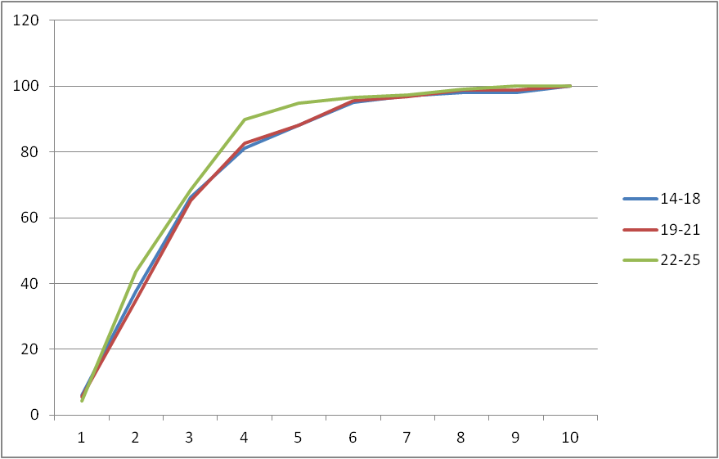
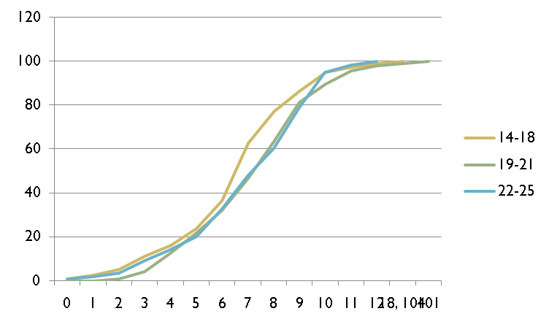
Exposure score and General awareness across age cohorts

Slide 18
Yet to do…
To identify the reasons behind failure of the project by econometric analysis.
To locate the impact on siblings.
To locate the effectiveness of convergence of the policies.

