Slide 1
A COIN BOX FOR HEALTH
EVIDENCE FROM A RANDOMIZED EXPERIMENT OF COMMITMENT SAVINGS AS HEALTH INSURANCE IN RURAL WEST BENGAL
Sayantan Mitra & Kartikeya Batra
December 2016

Slide 2
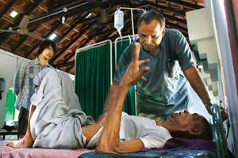
Healthcare expenditure is key driver of poverty generation in India
~25 million HH pushed into poverty (‘financial catastrophe’)
Out-of-pocket health expenses affect HHs beyond expenditure
  Ability to repay debt (Van Damme et al, 2004)
  Investment in productive assets (Kochar, 2004)
Nationally, 5% HHs have health insurance*
  Situation worse in rural areas (~3%)
  1.6% poorest households have insurance coverage
  NGO-facilitated schemes associated with high premia/administrative costs
*Source: International Institute for Population Sciences, District Level Household and Facility Survey, 2007-2008

Slide 3

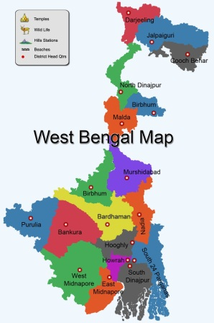
Literature suggests potential for additional savings for low income groups through commitment-based savings products
Jones et al (2003)
Banerjee & Duflo (2007)
Banerjee, Duflo & Glennerster (2006)
Bernheim, Ray and Yeltekin (2015)
Banerjee & Mulainathan (2010)
Ashraf, Karlan and Yin (2006)
Karlan et al (2011)
Kast, Meier & Pomeranz (2011)
Massaro and Woong (1995)
Xu et al (2003)
Dupas & Robinson (2013)
MOTIVATION

Slide 4
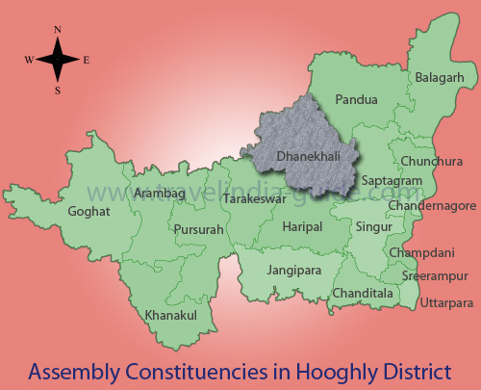
Research Design includes randomized selection of SHGs within selected villages
Two similar villages with active NGO involvement* were identified
  Similar demographics
  Adequate distance between them to avoid spillover effects
  Between them, there was random assignment into Control and Treatment
Control Village
  Representative sample** of SHGs (10) was randomly selected
  NGO savings program was active
Treatment Village
  Representative sample of SHGs (8) was randomly selected
  NGO savings program was active; each HH was given a coin box

Slide 5
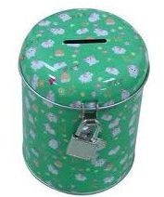
The Coin Box intervention
Safe storage space for savings
  Locked box, key with program officer
Social group pressure for saving
  Min. individual monthly savings decided by group
  (at least 30 rupees monthly)
  Fine for non-compliance, monthly checks
Accounting of household savings
  Deposit record sheet
Earmarking for health emergencies
  Two claims of up to 3 x Min. Individual Monthly Contribution
  Claims approved by group, amount taken from all members
Assured access to household savings
  Amount received after intervention= Total savings – Amount claimed

Slide 6
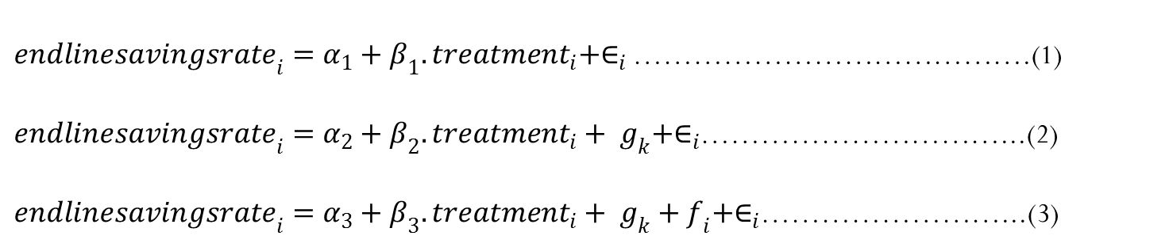
Econometric Methodology
Standard OLS
  ITT (Intention to Treat Effect)
  Three Specifications Used
${endlinesavingsrate}_{i}=α_{1}+β_{1}.{treatment}_{i}+∈_{i}$ ………………………………….(1)
${endlinesavingsrate}_{i}=α_{2}+β_{2}.{treatment}_{i}+ g_{k}+∈_{i}$…………………………...(2)
${endlinesavingsrate}_{i}=α_{3}+β_{3}.{treatment}_{i}+ g_{k}+f_{i}+∈_{i}$……………………...(3)

Slide 7
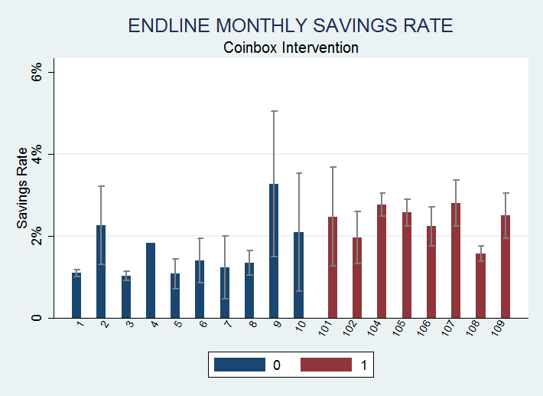
Results (1/3)

Slide 8
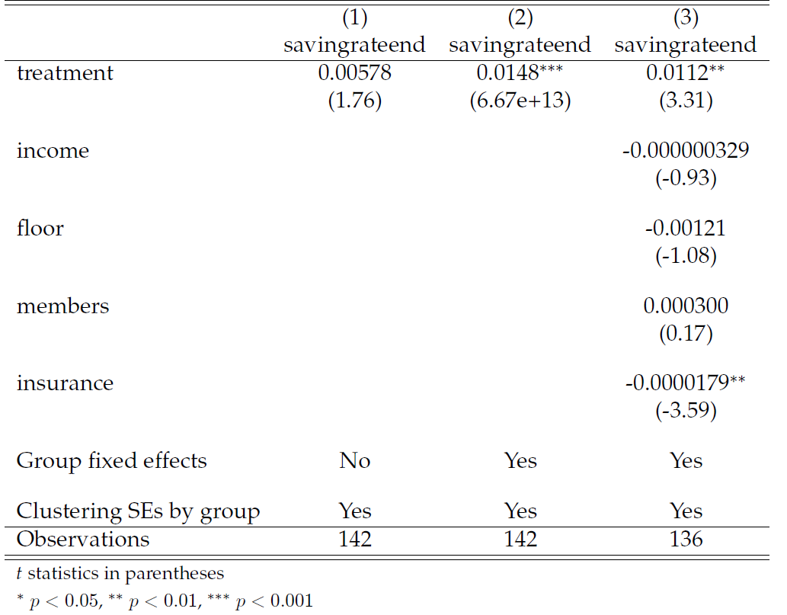
Results (2/3)

Slide 9
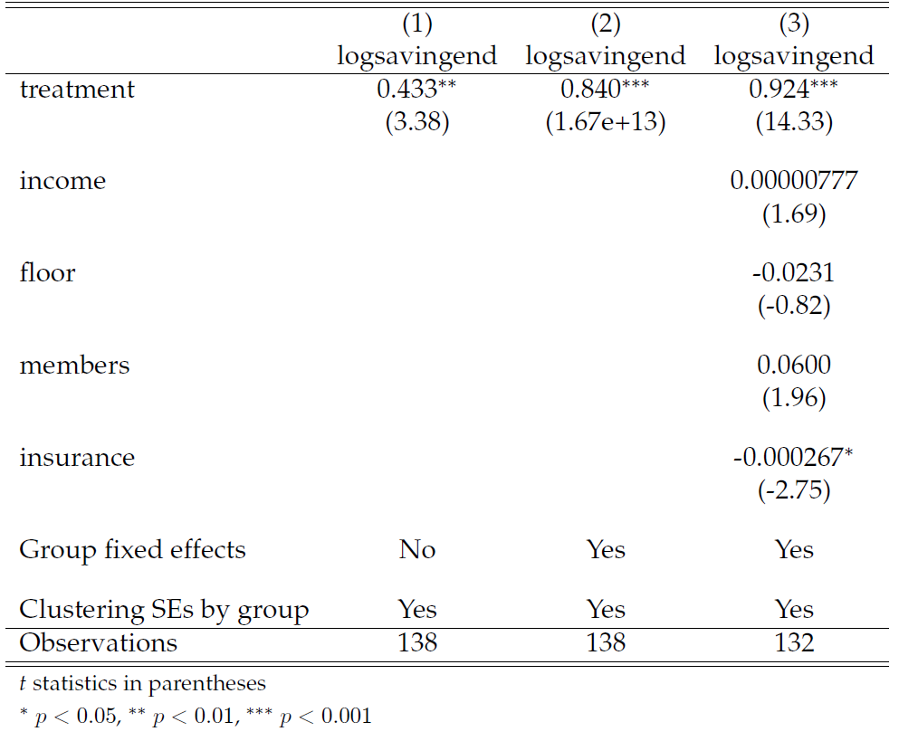
Results (3/3)

Slide 10
Conclusions
Jump in overall savings rate
  Concurs with existing literature
  Suggests existing appetite for additional savings among low-income groups
Some possible causes
  Easy to access “financial instrument” (kept at home)
  Amount decided, not imposed
  Flexibility to break the piggy bank
  Implicit trust in NGO and informal networks
However, we can’t apportion magnitude of change among the above
NGO activity is another concern, although it applies to both groups

Slide 11
Next Steps
Sources of additional savings?
  Discretionary spending?
  Partial substitution of conventional savings?
  Neither of the two?

Slide 12

Thank You!

