Slide 1
Harnessing the Power of EFDs to Increase VAT Revenue in Zambia
June 30 2021
Twivwe Siwale (IGC)
Kangwa Musole (ZRA)
John Mulenga (ZRA)
Brian Dillon (Cornell)

Slide 2
Overview
1. Impact of electronic fiscal devices (EFDs) in Zambia
The roll-out of EFDs in Zambia began in 2018
We provide an analysis of the effects of EFDs on VAT remittances, using administrative data
2. Designing policies to complement EFDs
A key goal of the IGC-ZRA collaboration is to use small-scale experiments to inform policy design
The first wave of experiments has been on hold due to COVID-19 protocols
In 2020 we ran a consumer survey by phone to address issues relevant to the design of a VAT rebate lottery:
Tax awareness
Experience receiving formal invoices
Link between price negotiations and formal invoices

Slide 3
Status of EFD Distributions in 2020
By the beginning of 2020, ZRA had procured a total of 7,000 EFDs.
They comprised 4,000 Fiscal Cash Registers (FCRs) and 3,000 Electronic Signature Devices (ESDs).
3,742 FCRs were issued to 2,531 taxpayers and 255 ESDs were distributed to 99 taxpayers.
Cost and compatibility challenges delayed implementation of EFD interface solutions.
ZRA also implemented Virtual Electronic Fiscal Devices (V-EFDs) through Server-to-Server systems integration.
52 taxpayers had successfully integrated their Point-Of-Sale to the V-EFDs by year end.

Slide 4
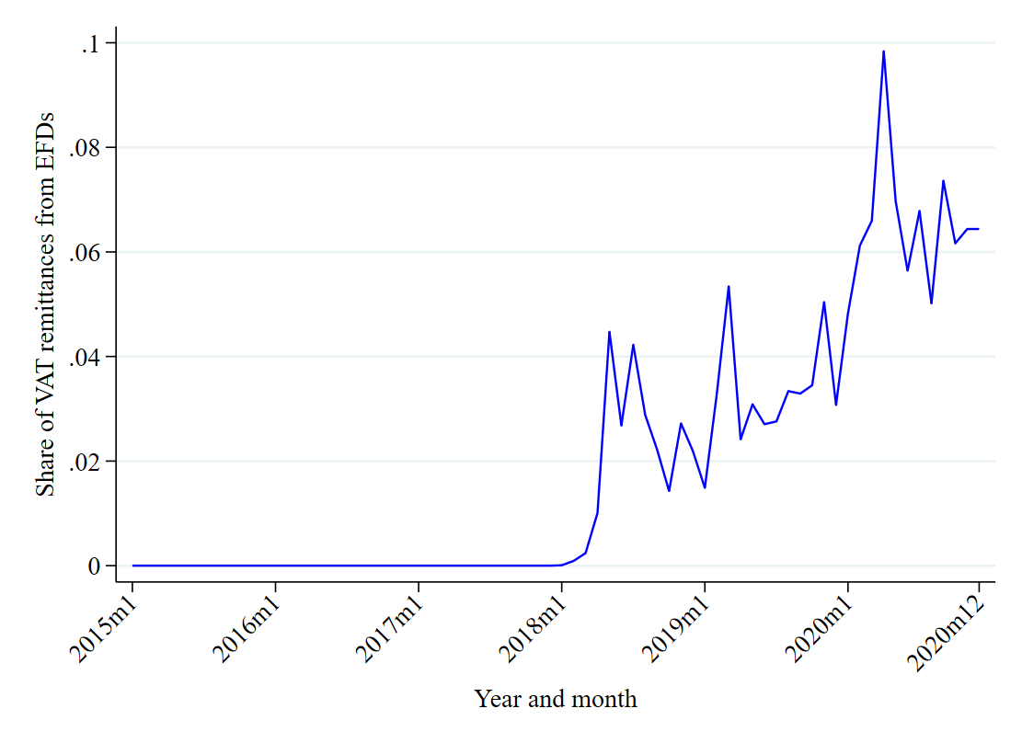
Share of EFD payments in total payments

Slide 5
What happens to payments after EFD registration?
Post EFD registration | -47610*
 | (28420)
Observations | 304868
R-squared | 0.50
Mean monthly remittance | 125729
This analysis controls for inflation, time trends, and average differences between firms
The implication is that remittances fall by 47610/125729 = 38% on average after EFD registration

Slide 6
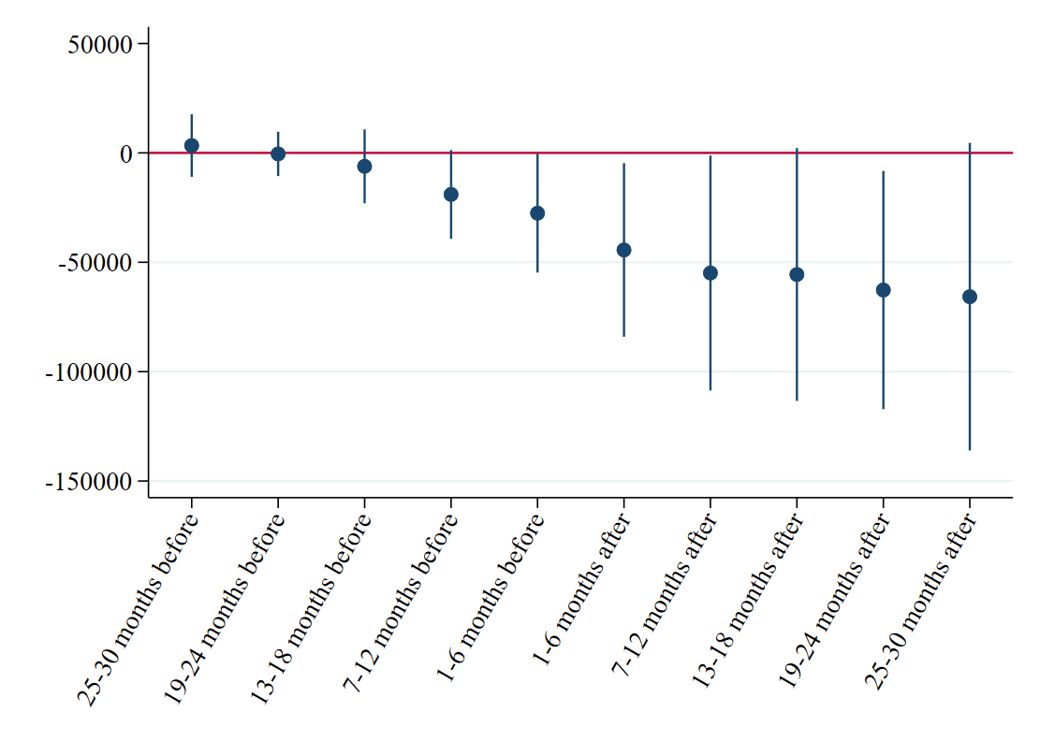
EFD effects over time

Slide 7
EFD effects by sector
Sector | EFD effect | Confidence interval | Significance
Accommodation and food service activiti | -46717 | [-100724, 7291] | *
Administrative and support service acti | -54850 | [-111875, 2175] | *
Agriculture, forestry and fishing | -45146 | [-99209, 8916]
Arts, entertainment and recreation | -39791 | [-86499, 6916] | *
Construction | -47197 | [-103670, 9276]
Education | -53012 | [-109844, 3821] | *
Electricity, gas, steam and air conditi | -56750 | [-107057, -6443] | **
Human health and social work activities | -47060 | [-106467, 12347]
Information and communication | -66080 | [-136412, 4253] | *
Manufacturing | -48934 | [-103792, 5924] | *
Mining and quarrying | 25610 | [-168876, 220097]
Other service activities | -15689 | [-100178, 68800]
Professional, scientific and technical | -57260 | [-116001, 1482] | *
Real estate activities | -46876 | [-103199, 9447]
Transportation and storage | -44762 | [-99198, 9674]
Water supply; sewerage, waste management | -46443 | [-101698, 8813] | *
Wholesale and retail trade; repair of m | -51392 | [-107556, 4773] | *

Slide 8
Summary and transition
Receiving an EFD leads to a reduction in VAT remittances
Effect is weak (confidence intervals are wide) but consistent
What could explain this finding?
Does it take time to learn/adjust? That doesn’t fit the time path
Power outages / problems with the machines?
Intentional avoidance to deter EFD program?
Other ideas?
Our ongoing work will examine firm-to-firm payment histories to examine how firm networks influence EFD usage
Next segment: our 2020 consumer survey

Slide 9
Phone Survey Respondent Characteristics
Sample Size: 625 respondents
Location: Lusaka, Ndola and Kitwe
Gender: 47 percent were women
Age: 75 percent of respondents were < 40 years old
Education Attainment: 38 percent > degree or higher
Income: 50 percent of the sample > K 3,000 or more

Slide 10
Findings: VAT, EFDs and Tax Invoices
Perceptions and beliefs about VAT and EFDs
Heard of VAT (=1) | 0.90
Can distinguish formal tax invoices from other receipts?
Not confident | 0.23
Somewhat confident | 0.49
Very confident | 0.28
What do you believe is the purpose of formal tax invoices?
Customer proof of purchase | 0.62
Help businesses track sales | 0.39
Ensure that taxes are paid | 0.64
Noticed EFDs in shops in recent years (=1) | 0.61

Slide 11
Formal Firms

Slide 12
Formal Firms
Purchases at formal shops | Mean | s.d.
Purchased from formal shops, last 6 months (=1) | 0.93
Percentage of time that received receipt | 90.7 | 18.5
Percentage of receipts that were VAT invoices | 68.9 | 35.5
Requested receipt and did not receive one (=1) | 0.17
Why not always request receipts from formal shops?
I always request a receipt | 0.07
Don't see the point / don't think of it | 0.27
Depends on item and shop | 0.61
Takes too much time | 0.14
Don't want to seem like I don't trust shopkeeper | 0.04
Other | 0.04

Slide 13
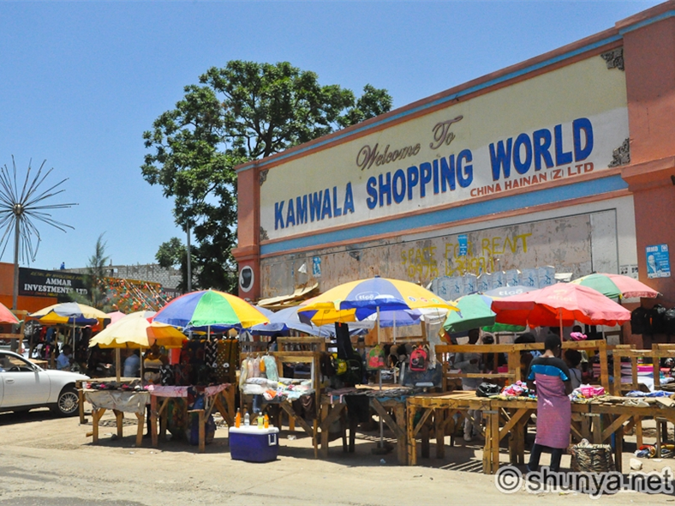
Semi Formal Firms

Slide 14
Semi-Formal Firms
Purchases at semi-formal shops | Mean | s.d.
Purchased from semi-formal shops, last 6 months (=1) | 0.97
Percentage of time that received receipt | 21.3 | 26.5
Percentage of receipts that were VAT invoices | 28.4 | 31.7
Requested receipt and did not receive one (=1) | 0.21
Why not always request receipts from semi-formal shops?
I always request a receipt | 0
Don't see the point / don't think of it | 0.38
Depends on item and shop | 0.64
Takes too much time | 0.14
Don't want to seem like I don't trust shopkeeper | 0.05
Receipts not available | 0.16

Slide 15
Findings: Price Negotiations and Special Discounts
Negotiation and special discounts | Mean | s.d.
Offered lower price for skipping receipt (=1) | 0.21
Lower price -- number of times | 4.9 | 6.7
Seller increased price after receipt request (=1) | 0.12
Price increased -- number of times | 5.1 | 12.4
Requested special discount (=1) | 0.49
Percentage of time special discount given only without receipt | 29.0 | 37.5
Price paid different from price on receipt/invoice (=1) | 0.27
Different price on receipt -- number of times | 2.8 | 2.5

Slide 16
Policy Implications and Next Steps
EFDs alone do not seem to increase VAT revenues in the short or medium term
What new policy initiatives could complement EFDs?
VAT rebate lottery
VAT goods lottery
Tax awareness and morale campaigns
Integration between audits and real-time EFD data
Taxpayer recognition programs
Many components of these policies can be piloted at small scale, to assess impacts and inform design
We will run some of these pilots later in 2021, conditions permitting

