Slide 1


Infrastructure projects for African integration into global value chains
Move on Up!
Building, embedding and reshaping global value chains through global investment flows:
Insights for regional innovation policies
Riccardo Crescenzi & Oliver Harman
London School of Economics
Global investment for local development

Slide 2
Three key messages
Importance of GVCs and African integration
Importance of a GVC lens for infrastructure development
Importance of regional collaboration in GVCs

Slide 3
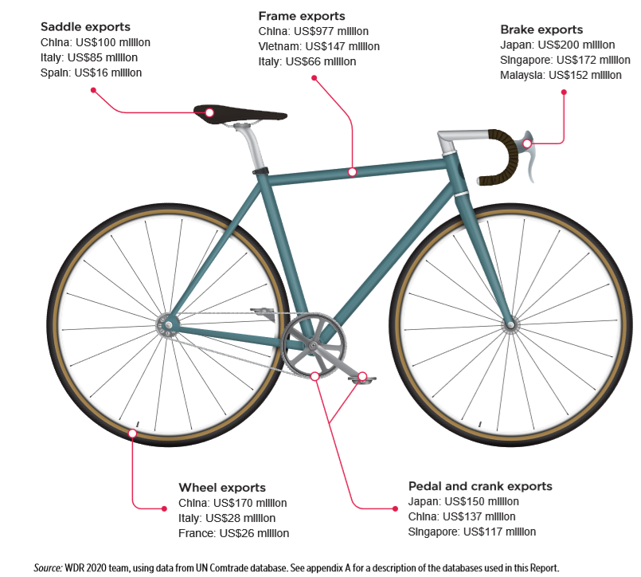
What is a global value chain (GVC) trade?
  GVCs emergence is relatively new, yet they are very important to leverage since they account for almost 50% of global trade today.
  More than half of the world’s manufactured imports are now intermediate goods
  More than 70% of world services imports are intermediate services - De Backeri and Miroudoti (2013)

Slide 4
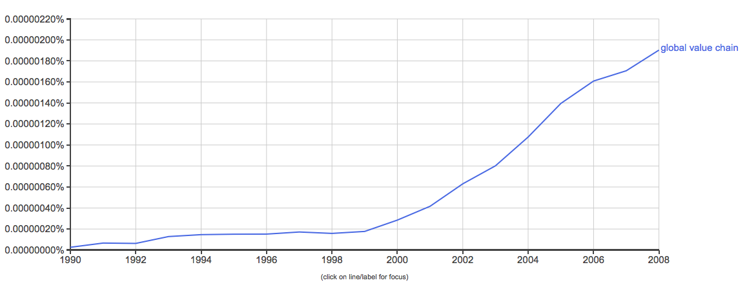
The Rise of ‘Global Value Chains’
Google Book Ngram Viewer (Keyword Term Prevalence in Books) [1990 – 2008]
Google Trends (Keyword Term Searched in Google) [2008 – Present]

Slide 5
“not only a matter of whether to participate in the global economy, but how to do so gainfully.”
Gereffi and Fernandez-Stark 2016 Pg.6

Slide 6
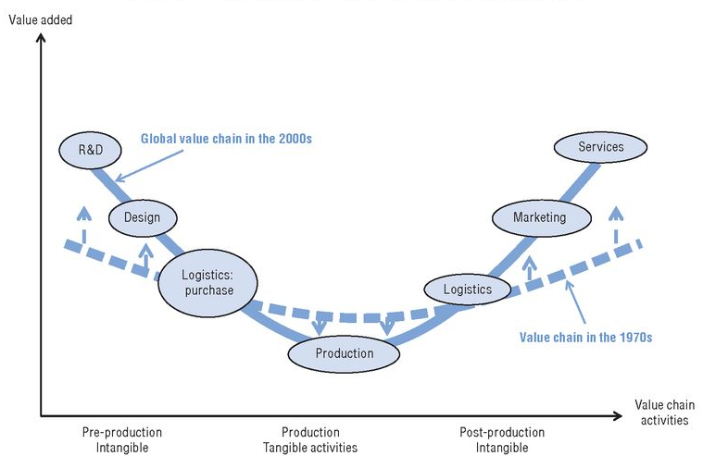
The value of a smile

Slide 7
GVC integration in the African context
EAC and other African RECs have increased their participation in GVCs over the period 1990-2015 but still lag behind the ASEAN region
Source: de Melo and Twum, (2019)

Slide 8
Sectoral breakdown of GVC trade participation for EAC
In EAC, this is across all sectors

Slide 9
“infrastructure needs differ substantially across different sectors and thus should clearly not be seen in aggregate…
…Developing countries should strategically target infrastructure development that is specific to the GVC sectors which they seek to engage.”
Bamber, P., K. Fernandez-Stark, G. Gereffi and A. Guinn (2014). "Connecting local producers in developing countries to regional and global value chains."

Slide 10
Current infrastructure needs (For agriculture with processing)
Energy - Operating costs for extraction and processing. Reliability maters. (Barnes & Morris, 2008; Tokatli & Kizilgun, 2009)
Transportation – roads, ports etc as cost and speed to market matters
Water - Essential for livestock maintenance
Future infrastructure needs (For GVC upgrading / GVC integration in services)
ICT - Main requirement for cross-border service exports;. Reliability and speed crucial.
Logistics – Warehousing and shipping management

Slide 11




associated with increased consumption
a reduction in poverty
The access to the internet translates into
  increased employment in wage or higher-skilled jobs.
  Positive spillovers.
  Reduces transaction costs for jobseekers or people seeking manufacturing inputs.
  It might also improve labour productivity.
not affect welfare

Slide 12


Both – Bottlenecks:
Low income and develoing countries (with scarce resources) should addressing the bottlenecks in infrastructure
Rather than ‘amount’ of infrastructure.
Key GVCs bottleneck – border infra:
border infrastructure and services
  the quality,
  availability and
  cost of appear essential for value chain activities
(Particularly those needing quick and cheap access to global import and export trade flows)

Slide 13
“The key point is that GVC trade…is far more regionalised than trade in final goods.”
Sorry for the graphs, they are horrible – you’ll have to trust me!
Source: Baldwin and Freeman (2020)

Slide 14
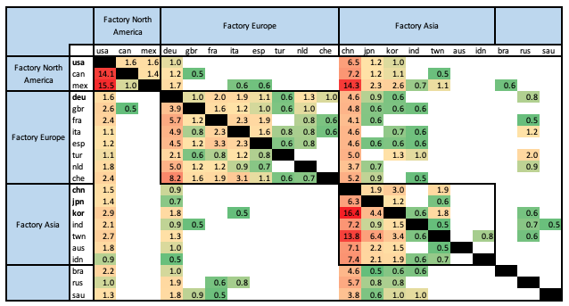
Source: Baldwin and Freeman (2020)

Slide 15
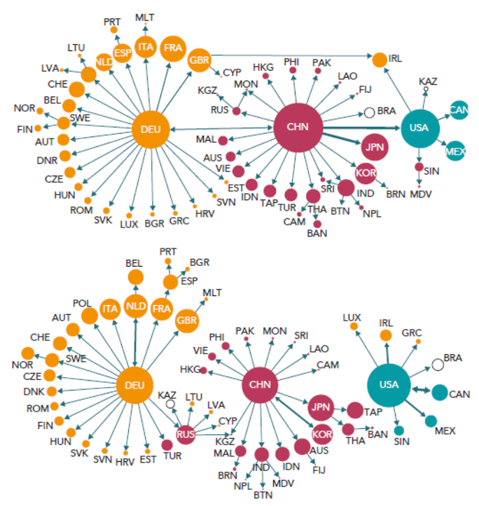
final goods
intermediate goods
Source: Baldwin and Freeman (2020)

Slide 16
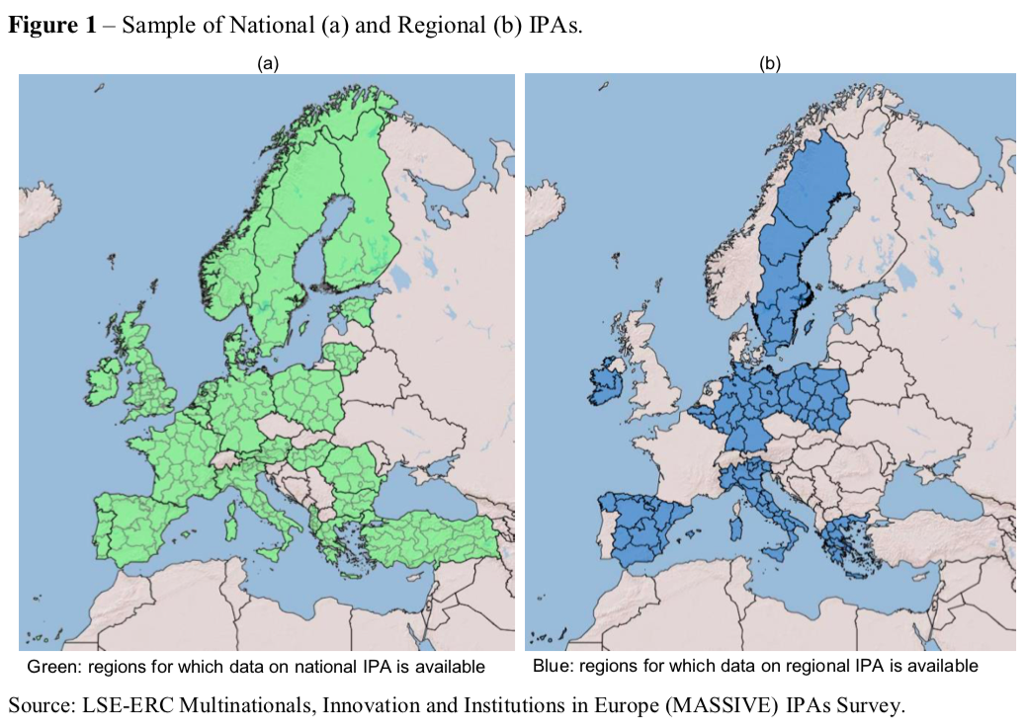
A late addition (prompted by Togo’s Director of External Trade, Katchali Batchassi & Ketema Pomy) IPAs
  targeted sectors saw increases in FDI.
  national and regional IPAs (where both present) seem to be jointly beneficial to the regional economy in terms of higher investment.
  Sub-national IPA worked better, were generative since closer to investor & market – information asymmetries
  National IPAs may just shift or coordinate FDI
Source: Crescenzi, Di Cataldo and Giua (2019)

Slide 17
Three key messages
Importance of GVCs and African integration
Importance of a GVC lens for infrastructure development
Importance of regional collaboration in GVCs
Reach out for applicability to your context, fully funded by ODA – oliver.harman@bsg.ox.ac.uk

Slide 18
Economics of funding models
Match funding source to project type and beneficiaries
Encourage private sector engagement on the most profitable projects
  (don’t keep them to yourselves!)

Slide 19
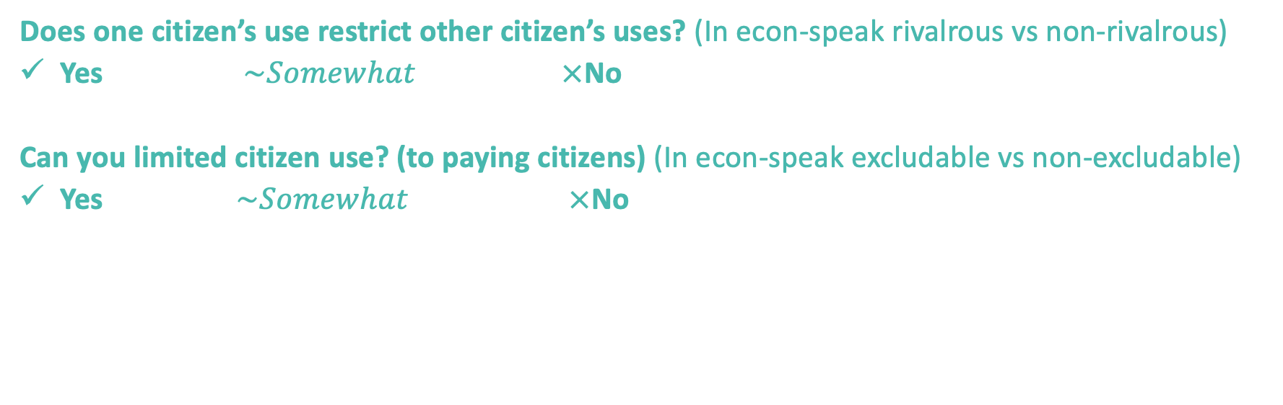
Two policy questions (for project financing)
Does one citizen’s use restrict other citizen’s uses? (In econ-speak rivalrous vs non-rivalrous)
Yes $\sim Somewhat$ $×$No
Can you limited citizen use? (to paying citizens) (In econ-speak excludable vs non-excludable)
Yes $\sim Somewhat$ $×$No

Slide 20






Can you limited citizen use?
Yes (Excludable) No (Excludable)
Parking spaces | Public waterways Local city forests
Toll roads Public transport fares Private parks Paid internet | Street lighting Public parks Drainage Clean air
Does one citizen’s use restrict other citizen’s uses?
No (Non-rivalrous) Yes (Rivalrous)

Slide 21




Can you limit citizen use?
Yes (Excludable) No (Excludable)
Private finance | Inter-governmental grants Multilateral Development Banks
Private finance e.g. PPPs Targeting land and property taxes | Inter-government grants Locally generated revenues Multilateral Development Banks
Does one citizen’s use restrict other citizen’s uses?
No (Non-rivalrous) Yes (Rivalrous)

