Slide 1
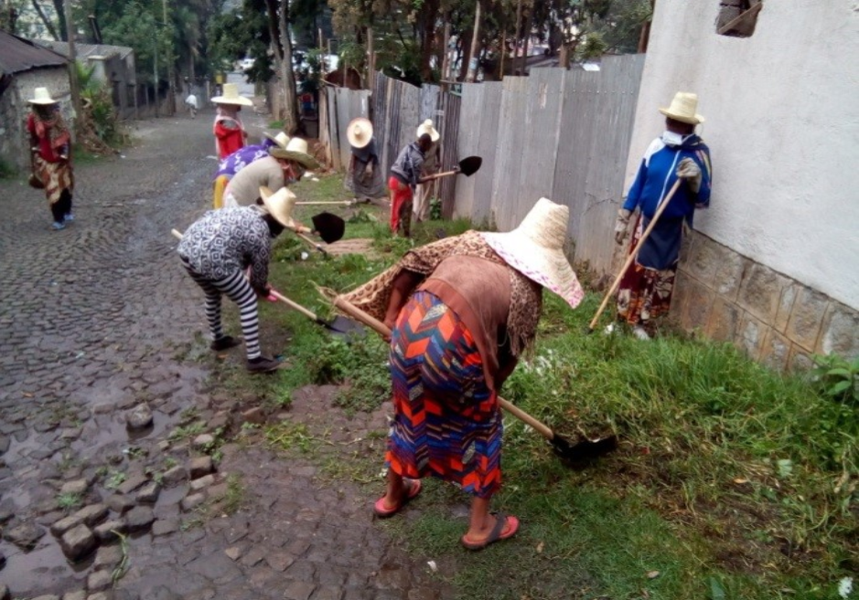
Public Works Programs
UPSNP workers, Addis Ababa (Ethiopia) Source: World Bank.
Arthur Alik-Lagrange and Clément Imbert
BREAD-IGC lecture on social protection
November 18th 2025

Slide 2
What are Public Works Programs (PWP)?
PWP are also called workfare or cash-for-work programs.
Provide employment to the poor on small infrastructure projects.
Active in 94 countries (World Bank 2015 State of Safety Nets).
Long history: in South Asia, 19th century England, US (1930s).

Slide 3
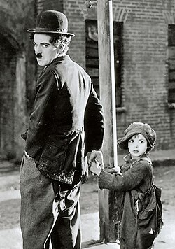
Workhouses in Europe and North America
Throughout the 19th century workhouses were the main option for the poor to receive public assistance in England, Europe and North America (Ravallion, 2015).
In his autobiography, the Hollywood movie star Charlie Chaplin recalls the time he spent with his mother and siblings in Lambeth workhouse, UK (Chaplin, 1964):
  “There was no alternative: she was burdened with two children, and in poor health; and so she decided that the three of us should enter the Lambeth workhouse.”
The Kid (1921) Source: Wikipedia

Slide 4
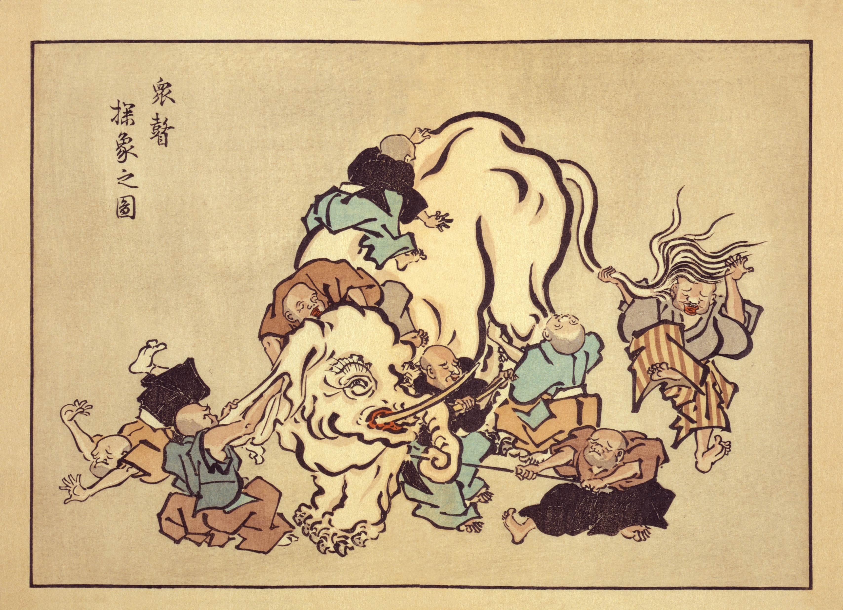
PWP are like the elephant of the parable.
Like the blind men, we only look at one part at a time:
  Labor markets
  Skills
  Consumption and savings
  Insurance
  Productive value of works
  Female empowerment
  Children’s education.
  Local politics
  Conflict …
Hanabusa Itchō (1652–1724). Source: Wikipedia

Slide 5
Which PWP are we talking about?
Program | Country | Context | #Studies
MGNREGS | India | Rural | 38
PSNP | Ethiopia | Rural | 7
Maharashtra’s EGS | India | Rural | 4
Trabajar/ Jefes y Jefas | Argentina | Both | 3
CWLP | Tunisia | Rural | 1
Empleo en Accion | Columbia | Both | 1
Londo | CAR | Both | 1
MASAF | Malawi | Rural | 1
PEJDEC | Cote d'Ivoire | Urban | 1
PEJDC | Burkina Faso | Urban | 1
RMG | Lao PDR | Rural | 1
STEP LIPW | DRC | Both | 1
UPSNP | Ethiopia | Urban | 1
UYEP | Papua New Guinea | Urban | 1

Slide 6
Outline
Introduction: What are PWP?
Why impose work requirement in poverty alleviation programs? Screening argument and direct income gains.
What do we know about the various impacts of PWP beyond direct income gains?
Conclusion: Takeaways for practicionners and knowledge gaps

Slide 7
Self-targeting: intuition
Policy makers often chose between two main form of social protection
  Workfare / Public Works / EGS: transfer conditional on work performed at a low wage
  Welfare / Cash: unconditional transfer
The main rationale for imposing work requirement relates to a screening argument: with limited information on who is poor, imposing a work requirement at a low wage rate separates the poor (low opportunity costs of participation) from the non-poor (high opportunity costs of participation)
Intuitively, this argument holds depending on:
(1) the amount of information government has on who is poor and who is not
(2) the difference in productivity (wage rate) between the poor and the non-poor
NB: self-targeting comes at the cost of forgone earnings for participants who would be working otherwise: transfers need to be higher to bring participants above the poverty line

Slide 8
Unconditional cash against work requirement: government optimization program
Let’s assume:
Poverty is driven by low productivity (agents below the poverty line get lower wage rates than those above the poverty line)
The government’s decision is between PWP against unconditional cash and its objective is to bring all the poor above the poverty line
Then the government optimal decision between PWP and unconditional cash depends on what is known about agents’ private-sector income.

Slide 9
Unconditional cash against work requirement under two information scenarios
Under full information on private-sector earnings, the cost-efficient policy is to transfer to each households what it needs to reach the poverty line (unconditional targeted cash)
Under asymmetric information - when only agents know their private-earnings - imposing a work requirement at a low wage-rate might be cost-effective, with two balancing effects:
  Positive effect: only part of the population will take-up (fewer beneficiaries than under unconditional cash => lower costs)
  Negative impact: participants lose income due to forgone earnings, which needs to be compensated (each beneficiary needs receive a larger amount to reach the poverty line than under unconditional cash => higher costs)

Slide 10
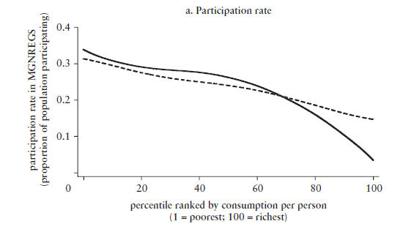

While scant, the empirical evidence on targeting suggests gains, with some inclusion errors
Dutta et al. (2014) find evidence of good self-targeting performance in India’s MGNREGS, with only few households participating in the upper deciles of the consumption distribution
Barrett and Clay (2003) find targeting errors in Ethiopia’s PSNP (richer households have more workers available)
India’s MNREGA
Source: Dutta, Puja, Rinku Murgai, Martin Ravallion, and Dominique van de Walle. 2014. Right to Work?
Assessing India’s Employment Guarantee Scheme in Bihar. Number 17195 in World Bank Publications. The World Bank
Note: Authors’ estimates from the National Sample Survey (2009/10)

Slide 11
The impact of work requirements on participants labor market outcomes depends on labor market conditions
The effect on wage-rates is organic: agents participate only if the wage rate offered under the scheme is higher than in the private-sector.
The effect on hours worked depends on the prevailing private-sector labor market equilibrium: under labor surplus conditions participants will work more hours than in counterfactual
The income effect is magnified when forgone earnings are smaller, which is the case when public works are implemented in context of low private-sector employment opportunities.
 | Effect of PWP on participants
 | Wage rates | Hours worked | Income
Lean season/underemployment | + | + | ++
Full employment | + | 0 | +

Slide 12
The empirical literature on net income gains broadly aligns with the theory
Substantial net income gains in rural areas (India’s rural PWP - MNREGS):
  Imbert and Papp (2015) find MGNREGS earnings 12% higher than the average daily earnings
  Alik-Lagrange and Ravallion (2018) document sizable increase in the number of days worked in Bihar, due to MNREGS
In urban areas, mixed findings:
  for Ethiopia PSNS, Franklin et al. (2024) estimate an average hourly wage premium of 1.67 but no impact on the total number of hours worked by participants
  for Côte d’Ivoire PEJDEC, targeted toward unemployed youths, Bertrand et al. (2021) earnings and total hours worked respectively 63% and 12% higher for participants
=> Empirical findings are consistent with the theory: more positive direct impacts on employment and income of participants in settings characterized by surplus labor (such as agriculture lean season in rural PWPs and youth underemployment in urban PWPs)

Slide 13
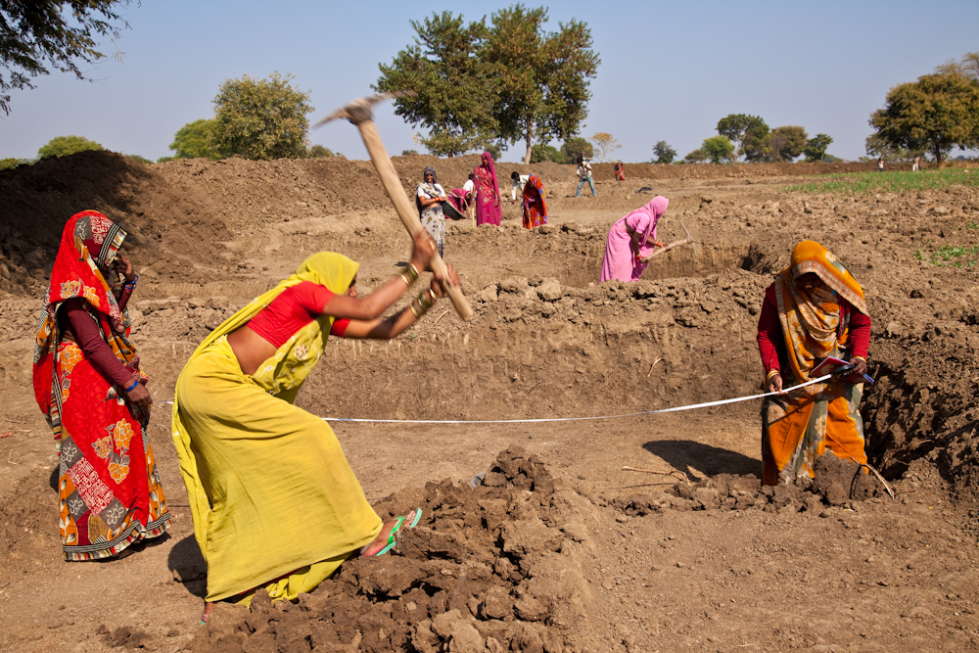
Extensions of the self-targeting and net income gains arguments
  Factoring the disutility of work (Besley and Coate 1995, Alik-Lagrange and Ravallion 2018) will affect the cost-efficiency of work requirement depending on:
    the assumption related to unemployment
    the “value” of the time working on the scheme, in the government objective function
  In the presence of covariate income shocks, the cost-efficiency of work requirement also depends on
    the relative magnitude of the shocks between the poor and the non-poor
    the correlation of the shocks along the distribution
Photo credit: UN Women/Gaganjit Singh Chandok

Slide 14
Outline
Introduction: What are PWP
Why impose work requirement in poverty alleviation programs? Screening argument and direct income gains.
What do we know about the various impacts of PWP beyond direct income gains?
Conclusion: Takeaways for practicionners and knowledge gaps

Slide 15
Impacts of PWP beyond direct income gains
Labor market effects
Skills
Consumption and savings
Insurance
Productive value of works
Female empowerment
Children’s education.
Local politics
Conflict …
Hanabusa Itchō (1652–1724). Source: Wikipedia

Slide 16
Labor market effects of PWP
Through PWP, governments intervene in the labor market to help the poor
Their effect depends on the wage they offer and the labor market equilibrium:
  PWP are usually motivated by the existence of “surplus labor”: PWP offer below market wages and attract the un(der)employed.
  If PWP wages are set above market wage, they can attract workers even in labor markets that are competitive / tight.
  Labor markets could also be non-competitive, with market power on the employer side (monopsony) or worker side (social norms).

Slide 17
Labor market effects of PWP
Labor Market Equilibrium | PWP Effect on Private Sector Wages | PWP Effect on Total Employment
Surplus Labor / Slack labor market | 0 | +
Monopsony (employer market power) | + | +
Socially accepted wage | + | ?
Competitive / tight labor market | + | 0
With “surplus labor”, PWP only increase employment.
In competitive labor markets, PWP increase wages, not employment.
In monopsonic labor markets, PWP can increase both

Slide 18
What are the labor market effects in practice?
MGNREGS has positive effects on wages:
  And negative effects on employment (Imbert and Papp 2015)
    Findings for all-India and with quasi-experimental variation.
    Positive wage effects interpreted in competitive framework.
  And positive effects on employment (Muralidharan et al. 2023)
    Findings in Andhra Pradesh with large-scale experiment.
    Positive wage effects interpreted in monopsony framework.
Less evidence outside of India:
  Rural Malawi (slack): Employment +, Wage 0 (Beegle et al. 2017).
  Urban Ethiopia (tighter): Employment 0, Wage + (Franklin et al. 2024).

Slide 19
Spatial equilibrium effects
Labor markets are not strictly local: commuting, migration.
MGNREGS increases wages in:
  Villages close to smart card blocks (Muralidharan et al. 2023).
  Districts neighboring program districts (Merfeld 2019)
  Urban areas through a decrease in seasonal migration (Imbert and Papp 2020a,b).
Ethiopian UPSNP (Franklin et al. 2024)
  Decreases commuting from program neighborhood.
  Increases wages in neighborhoods exposed to changes in commuting flows.

Slide 20
Better than Cash?
Labor markets change the terms of the comparison PWP vs cash:
  Through their work requirements, PWP impose costs on participants
  But they also change labor markets and increase wages for all workers.
Indirect wage effects are a substantial part of the gains:
  1/3 for MGNREGS Imbert and Papp (2015).
  2/3 for UPSNP (Franklin et al. 2024).
Poverty reduction from PWP comparable to cash:
  MGNREGS in Bihar does worse than cash (Murgai et al. 2016)
  UPSNP in Ethiopia does better than cash (Franklin et al. 2024)
Of course, employers need to pay higher wages:
  Top of landholding distribution suffers (Muralidharan et al. 2023).

Slide 21
Skills
PWP aim to improve long-term labor market prospects of participants by building their skills / work experience.
Bagga et al. (2023) meta-analysis finds:
  Positive short-term effects
  Small and insignificant effects in the long run.
Example: urban PEJDEC in Côte d’Ivoire (Bertrand et al. 2021)
  During the program: employment 15pp higher, earnings 3x larger.
  12 months later: no effect.
In practice, employment generation takes priority over training.

Slide 22
Consumption and Savings
PWP bring income gains: are those consumed or saved?
Bagga et al. (2023) meta-analysis finds:
  Small or null effects on food consumption.
    Effects only in poorer rural settings: DRC (Brandily et al. 2020)
  Large effects on durable consumption.
    Effects in all contexts reviewed in Bagga et al. (2023)
  Insignificant positive effects in savings:
    Effects mostly in urban settings (Bertrand et al. 2021, Franklin et al. 2023)
Effects on consumption vs savings depend on the level of poverty / credit constraints of beneficiaries.

Slide 23
Insurance
PWP provides not only income gains, but also income support.
  Temporary PWP during crisis: Argentina 2001 (Jalan and Ravallion 2002).
  Long run programs that can expand when needed: PSNP, MGNREGS.
PWP reduce economic distress / need for other coping strategies:
  PSNP reduce food insecurity: Berhane et al. (2014)
  MGNREGS reduce borrowing (Bell and Mukhopadhyay 2020)...
  ... and temporary migration (Imbert and Papp 2020a, Morten 2019)
PWP encourage (risky but productive) investment:
  PSNP increases technology adoption (Gilligan et al. 2009).
  MGNREGS increases risky crop choice (Gehrke 2019).

Slide 24
Value of works
PWP main priority is local employment provision:
  Implies that projects need to be labor intensive and small;
  MGNREGS list: rural roads, water harvesting, tree planting.
  UPSNP: street cleaning, drain maintenance, flowerbeds planting.
Value of works is seldom evaluated:
  PSNP has little effect on agricultural productivity (Bahru and Zeller 2022, Gazeaud and Stephane 2023).
  MGNREGS works are functional and seem useful (Deininger and Liu 2013, Ranaware et al. 2015), but their economic value is unknown.
  UPSNP improves neighborhood quality (Franklin et al. 2024)

Slide 25
Female Empowerment
PWP offer the same employment opportunity to men and women.
  MGNREGS has quotas for women and offers childcare facilities.
PWP can improve women’s employment and financial situation:
  In Burkina Faso they improve psycho-social outcomes (Ajayi et al. 2022).
PWP can change social norms around women work:
  In Central African Republic, change male and female attitudes towards household work (Alik-Lagrange et al. 2023).
  Paying female MGNREGS workers on their own bank account improves their labor force participation (Field et al. 2021).
More evidence is needed.

Slide 26
What about children?
Parent’s participation to PWP can have ambiguous effects on children:
  By increasing female labor force participation, did MGNREGS decrease school enrolment and increase child labor (Shah and Millett-Steinberg 2015, Li and Sekhri 2020)?
  Or did it increase schooling by increasing mothers’ income and strengthening their bargaining power in the household (Afridi et al. 2016, Mani et al. 2020)?

Slide 27
Corruption
PWP provide opportunities for corruption:
  “Ghost workers” and “Ghost days” in MGNREGS (Niehaus and Sukhtankar 2013, Imbert and Papp 2011).
  Stealing on workers vs material costs.
  Funds stolen locally to pay intermediaries (Banerjee et al. 2019).
And opportunities to innovate on anti-corruption policies:
  Smart cards with biometric identification reduce prevalence of ghost workers (Muralidharan et al. 2016).
  E-governance in fund management also reduce ghost workers but increase payment delays (Banerjee et al. 2019).

Slide 28
Politics
PWP empower local officials:
  Responsibility in registration, work organization, monitoring, pay.
  Awareness increases local political competition (Banerjee et al. 2024).
Local politicians can capture PWP:
  Favoritism in work allocation in PSNP (Cayers and Dercon 2012).
  Local elite uses or blocks Maharshtra’s EGS (Anderson et al. 2015).
Governments can use PWP to gain votes:
  MGNREGS won votes to Trinamool Congress in West Bengal (Dey and Sen 2016), to Congress in Rajasthan (Gupta and Mukhopadhyay 2016).
  But not in states with poor implementation (Zimmermann 2021),

Slide 29
Conflict
PWP often implemented in (post) conflict zones:
  Can help people cope with consequences of conflict..
  And dissuade them to join the conflict themselves.
Evidence suggests that PWP can reduce conflict:
  MGNREGS reduces Maoist conflict (Dasgupta et al. 2017)
  MGNREGS decreases wage and conflict response to droughts (Fetzer 2020)
  … increases conflict when it has no effect on wages or employment (Zimmermann 2020, Khanna and Zimmermann 2017).
Mixed evidence on violence / crime among participants:
  In CAR increase security but not social cohesion (Alik-Lagrange et al. 2023).
  In Papua New Guinea they have no effect on crime (Ivaschenko et al. 2017).

Slide 30
Outline
Introduction: What are PWP
Why impose work requirement in poverty alleviation programs? Screening argument and direct income gains.
What do we know about the various impacts of PWP beyond direct income gains?
Conclusion: Takeaways for practicionners and knowledge gaps

Slide 31
Main takeaways – public works basic parameters
Work requirements do not guarantee cost-efficiency: need to consider the difference in wage rates between the poor and the non-poor, and the share of poor in the population.
Labor market conditions matters for PWP cost-efficiency: Will participants work more thanks to the program or reduce their hours worked in the private sector?
Answering these questions should inform the decision on the program wage rate and number of days offered.

Slide 32
Main takeaways –impacts beyond direct gains
PWP may increase wages for non-participants (even far away!).
PWP have little effect on skills and employability.
PWP increase consumption (poorer HH) and savings (richer HH).
PWP provide insurance and encourage productive investment.
PWP have ambiguous effects on child labor / education.
PWP give opportunities for corruption / can be captured locally.
PWP generally reduce conflict.

Slide 33
Research agenda on PWP
Where more evidence is needed:
  Psychological costs vs gains from participation.
  Effects on female empowerment.
  Effects on children education.
  Value of PWP infrastructure projects.
PWP evaluation as a way to learn about:
  Opportunity cost of time
  Labor market equilibrium
  Worker heterogeneity (e.g. caste, gender).

