Slide 1
KCCA @ ADDIS ABABA
AFRICA GROWTH FORUM -
KAMPALA EXPERIENCE

Slide 2
KAMPALA- UGANDA’S STRATEGIC LOCATION
FACTFILE:
KAMPALA - UGANDA CAPITAL CITY
COVERS 192 SQUARE KMS,
1.57 MILLION NIGHT POPULATION
DAY POPULATION ESTIMATED AT 3.5 MILLION PEOPLE
RESIDENT POPULATION PROJECTED TO BE 3.1 MILLION IN 10YRS
AND GENERATES OVER 60% OF UGANDA’S GROSS DOMESTIC PRODUCT

Slide 3
Snapshot and Kampala City
Uganda is urbanising at 18%, Kampala accounts for 40%
Growth rate of 5.2% is one of the highest in the region with low levels economic activity
Low density, urban sprawl and informality that exacerbates poverty
60% live in informal settlements
Kampala is growing with a declining manufacturing sector; the few successful are scattered all over the city
Kampala is predominantly a retail city with a growing artisan industry

Slide 4
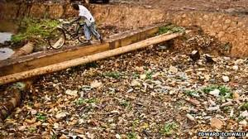
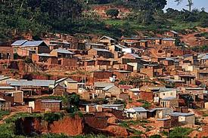
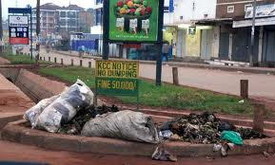
Kampala: Before 2011 restructuring
Kampala Suffered from maladministration that led to;
Uncontrolled development, -growth of slums
Poor Solid Waste Management and flooding drainage channels!
only 8% connected to sewer grid
Growing concern of on-site sanitation at h/h and community level
Low City Competitiveness and attractiveness

Slide 5
At Institutional Level, there was...
Lack of effective financial management
Poor Revenue Management Systems
Lack of Accountability that eroded public trust
Tainted Corporate Image
Poor management of city infrastructure including sanitation management

Slide 6
Kampala: 2011
In 2005 ,Constitutional Amendments that placed the city under Central Government
Kampala City Council (KCC) was replaced by Kampala Capital City Authority through an Act of Parliament (KCC Act 2010)
Introduced a professional technical wing headed by the Executive Director
Represented at Cabinet by The Minister for Presidency and responsible for Kampala
Streamlined internal management processes for revenue management, procurement and disposal of assets ,recruitment and public accountability

Slide 7
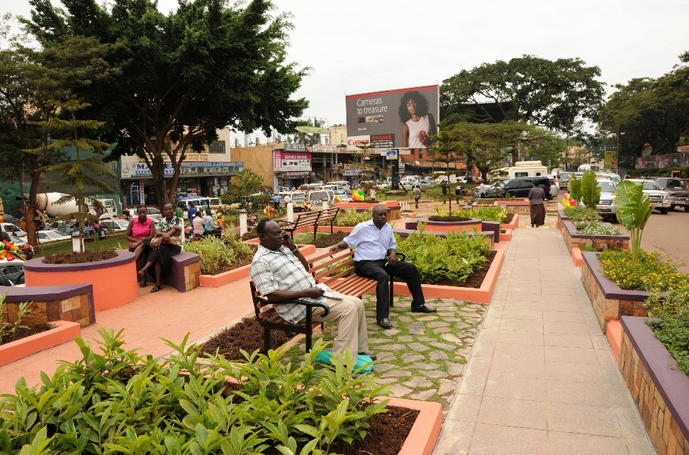
KCCA’s Vision and Mission
KCCA envisions Kampala as a Vibrant, Attractive and Sustainable City
With a mission to Deliver
Quality Services to the City.
Core Values:
Client Care-Integrity-Teamwork-Innovativeness-Excellence

Slide 8
KCCA’s Strategic Challenges
How to make the city economy work and provide a dissent employment?
How to preserve the city’s natural ecosystems?
How to enhance inclusive growth and social cohesion?
How to address the current Infrastructure deficit in the city
How to promote urban governance to deliver value for money and enhance citizen accountability?

Slide 9
Institutional Restructuring and Transformation
Embraced a culture of zero tolerance to corruption.
Streamlined Domestic Revenue Mobilisation
Performance Management across all levels of the organisation was instituted.
Strengthened transparency and accountability for public funds (reduced bank a/cs from 151 to 8 accounts).
Regained public trust as a result of a new corporate Image.
key concerns: To what extent can we attribute the results at KCCA to Leadership style, mode of restructuring and what best practices can be identified from it

Slide 10
Achievements cont’d: REVENUE MOBILISATION TREASURY MGT
Local revenue has increased from UGX30bn(US$10mn) in 2010/11 to UGX82bn(US$30mn) in 2014/2015 and projected to 111.8bn in 2015/2016.
Grown the Asset base from UGX45bn to 450bn in the same period

Slide 11
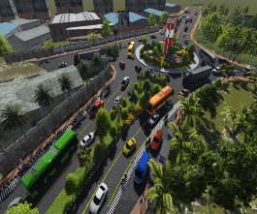
Completed Roads Works
2011 | 2012 | 2013/14 | Total
9.42Km | 77.42Km | 72Km | 158.84km

Slide 12
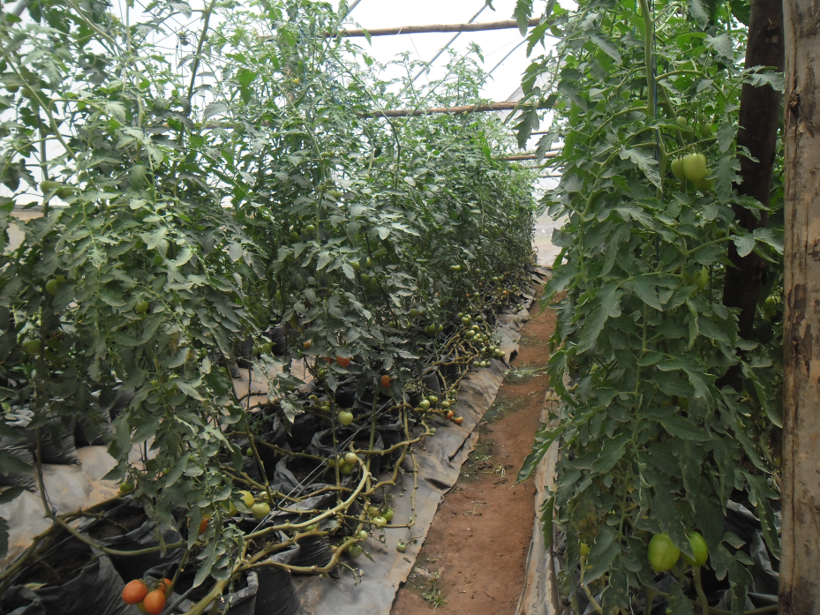
Urban Agriculture (Kyanja Agriculture Resource centre)
Research trials started on a Pig breeding center at Kyanja. Total of 394 piglets born out of which 217 have been distributed.
Demonstrations green house farming introduced
3,086 kroiller birds distributed to 808 groups
3,108 urban farmers offered with farm inputs

Slide 13
Social Services Delivery
Intensified efforts to minimise new HIV/AIDS infections.
Drained all malaria breeding grounds and increased coverage of mosquito nets.
Conducted 37,555 deliveries .Received 124,120 antenatal visits accounting for 43% of all antenatal care visits for pregnant mothers.
3 Health clinics have been developed into division hospitals
Improves school infrastructure to support UPE and USE programs.

Slide 14
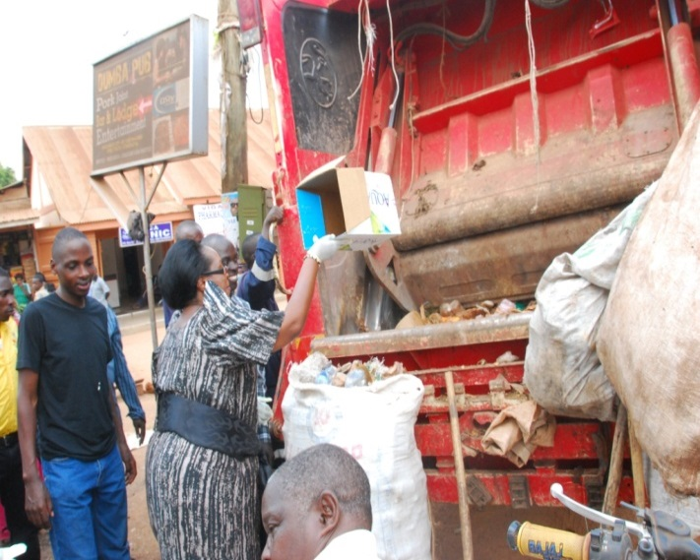
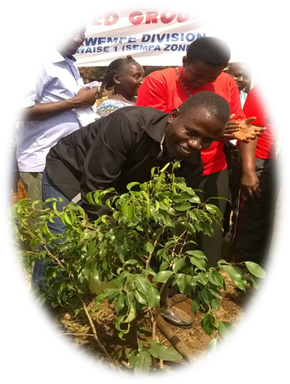
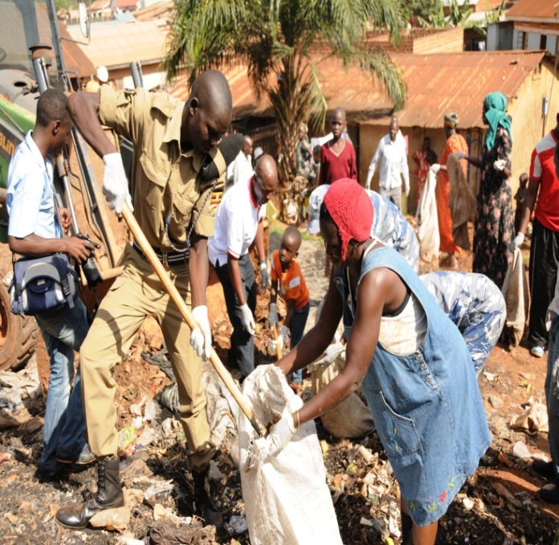
The Kampala Goes Green Campaign
The key objective is to change the attitude and behavior of both visitors and residents of Kampala on proper waste management practices.
It involves monthly cleaning drives and trees planting in all Divisions.

Slide 15
Landscaping & Beautification
Greening and beautification done on a number of areas in a bid to reduce mud and dust in the city.
The plan is to plant 500,000 trees in five divisions as part of the ‘Go Green Campaign’ by 2019/2020.
Developing Low Carbon Development City Resilience Strategy.

Slide 16
Encouraging Firm Agglomeration and increased densification :Success stories at firm level
Started off with UG 1mn (USD 350)
Has established a regional cosmetic industry with a portfolio of UGX 35bn exporting to countries in East Africa and Comesa market.
In 15 yrs has 170 product lines ,
Employees 700 staff and 1000 casuals. Expanding in agricultural production with a loan of UGX 19bn
Major challenges company relies on 95% imports and all challenges of international trade
See; https://movit.co.ug

Slide 17
Delight U ltd
Juliana started off working with her brothers
Mobilised her savings which was stolen by her partner
Determined to move on with her dream went back mobilised savings and started off her little savings
Her products control 45% of national market and makes an annual Turnover of US$4mn
Today Juliana is the owner of Uganda’s largest juice processing factory, Delight Limited
Her Products are all exported to East Africa DR Congo, Sudan
She currently employs 1000 staff
Today, she is one of the most decorated woman entrepreneurs in East Africa and has received honours and awards including the Commonwealth Entrepreneur of the Year 2014.

Slide 18
Major concerns
.The role of rural urban migration Vs natural growth in Urban expansion and city productivity
The usefulness of growth models: The push factors (from agricultural productivity growth) and pull factors ( from Industrial productivity growth leading to production cities)

Slide 19
Critical Drivers for Firm Agglomeration and Increased density in Kampala
The Urban design; In Africa Urban Planning follows development
(Densification Vs Mixed Used, which way for African cities?)
Significant investment in Infrastructure that promotes quality of life and connectivity
Improving Housing conditions and settlements Patterns
Promoting business Incubations and technical skills transfer
Significant Improvement in basic social services
Local Economic Development strategies, that promotes social inclusion and revitalisation of value added production

Slide 20
Major forum concerns
Generation of credible Evidence on how to build better Cities
KCCA has set up A research and Innovation unit under the Office of the Executive Director primary to develop the necessary partnership and collaboration with research agents and Academic institutions.
Is there Room for Experiments in Informing policy
Little is known about urbanisation in Africa , the variable are complex and systems are not linear , therefore the room for experimenting while documenting results is key if Africa is to develop best Practises to guide African urbanisation drive
Program Evaluation provides a basis for assessing the relevance and impact of various interventions in the city performance. The role of citizens in program evaluation is however important.
Every year KCCA conducts a citizens accountability workshops to community level and at government level, government conducts government performance review where all Government Agencies account for their performance against agreed set targets.
A lot however needs to be done evaluate the various programs KCCA is implementing to enhance efficiency and performance of the city

Slide 21
In conclusion
Where as firm agglomeration and increased density is necessary for economic prosperity;
Is efficient system of urban management capable of influencing public service delivery a major missing link in Africa
what can Kampala experiment offer to African urbanisation?

Slide 22
Thank You
and
Welcome to
Kampala

