Slide 1
Tax Capacity in Africa
Nada O Eissa
Georgetown University, NBER and IGC
AGF Presentation, 1 July 2015
Slides adapted from Taxation and Development, Henrik Kleven (2014)

Slide 2
Tax capacity across countries
An empirical regularity is that developing countries have low tax capacity. By that, we mean:
the share of taxes in GDP is at levels far below what we observe in developed economies
Besley & Persson (2012):
the central question in public finance and development is: “how does a government go from raising around 10% of GDP in taxes to raising around 40%”?
Notes:
More reliance on distortionary taxes than incomes taxes than what we see in developed economies
􏰀 Even with comparable statutory rates, developed countries raise much more revenue (as a share of GDP) than developing countries.
􏰀 Explanation likely in tax administration: tax rates independent of tax ratios.

Slide 3
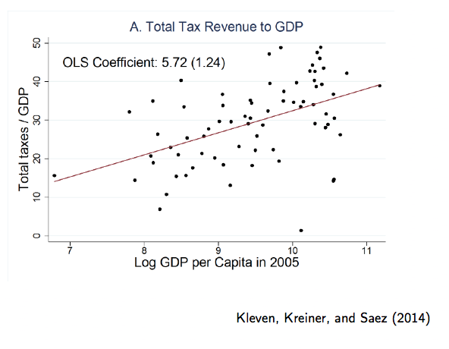
Rich countries collect a much larger share of their income in taxes than do poorer countries.
Rich countries
Poor countries

Slide 4
Tax capacity in Africa is very low but revenues have been increasing
Government revenue share in GDP has been rising over time
Caveat: tax vs. other sources (natural resources)
A lot of variability in revenue changes across countries with different income levels
Poorest countries experienced minimal gains.
The composition of taxes has tilted from trade towards indirect taxes

Slide 5
How to proceed?
Macro approach: not obvious we could get policy recommendations
Micro approach:
Focus on specific problems in a given country
Use empirically grounded research to design (incremental) policy innovations
Lends itself to—and often requires—collaboration between researchers and policy makers

Slide 6
Micro Tax Research
Data: Administrative data provide a wealth of information in tax records
Empirical Methods: could use tax schedules or tax reforms, previous changes in tax rates and enforcement to credibly estimate impacts
Framework: Public Finance has a well-developed theory that can be brought to bear in designing policy
Policy: Strong interest from policy makers in getting taxes right

Slide 7
What are the factors that determine/shape tax capacity?
Tax enforcement – compliance
Tax policy – design of the tax system, which base to tax?
Tax administration – role of tax collectors, auditors
Tax morale – intrinsic motivation, social norms, culture
Notes:
Intrinsic motivation (within-individual preference)
Social norms (depend on other individuals)
Reciprocity (depends on the state)
Culture (long-run societal effect)

Slide 8
Tax Enforcement
In a world where people cheat, tax authorities rely on a range of tools to compel taxpayers to declare income honestly:
Audits – likelihood of detection
Penalties
Third-party information reporting/verifiable trail of information
Technology

Slide 9
Tax Enforcement: IGC Research Agenda
Almunia-Gerard-Hjort (ongoing) [Uganda]
Role of information, and human capital of auditors in Uganda
Khan, Kwaja, Olken (2014)[Pakistan]
Kleven-Kreiner-Saez (2009, 2014) [cross-country]
Eissa and Zeitlin (2014, ongoing) [Rwanda]

Slide 10
Tax Enforcement
Kleven et. al. (2009, 2011)
Denmark Experiment: Tax evasion rate is close to zero for income subject to third-party reporting, but substantial for self-reported income
Tax enforcement is successful if and only if verifiable third-party information has wide coverage
Absent wide coverage of third-party or other information
How can we expand third-party information?
How should we design audits, set penalties?

Slide 11
Third-Party Reporting: Evidence from Denmark (Tax take: 50%)
Source: Kleven, Knudsen, Kreiner, Pedersen, Saez (2011)

Slide 12
Third-Party Reporting: Cross-Country Evidence
Tax Share vs Fraction Self-Employed
Source: Kleven (2014)
Notes:
Policy recommendation is not to replicate the Danish information reporting system:
Tax administration, self-employment; industrial composition; firm size and complexity; financial sector; scope for evasion substitution

Slide 13
Technology and Tax Compliance: Electronic Billing Machines and VAT Revenues
Collaboration with Rwanda Revenue Authority (RRA) Immediate question: What is the impact of EBMs on tax revenue?
Broader question: How can the government encourage compliance?
Data
Quarterly VAT declarations, from 2012 through 2014
2. EBM registration data

Slide 14
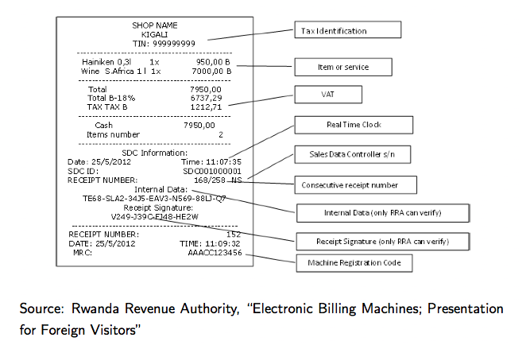
EMB Receipt

Slide 15
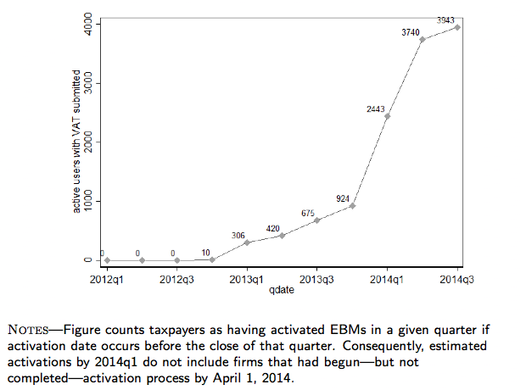
EBM Adoption

Slide 16
EBM Machines led to higher VAT Revenues
VAT revenues increased by 5.4%
But, to better understand what’s underlying this impact, we set up a mystery-shopper study
To what extent are machines being used?
Can consumers encourage more usage?

Slide 17
Tax Policy
Traditional recommendations from the tax theory literature:
Use progressive income taxes and VAT
Do not use differentiated consumption taxes, capital taxes, and taxes on turnover, trade, and intermediate goods
These theoretical results generally assume:
Perfect tax enforcement (administration costless)
Full set of tax instruments available to policy makers
Notes:
Much academic work studies optimal tax rates conditional on a policy instrument
E.g., much work on the optimal progressive income tax schedule
This is typically not first order for developing countries in which personal income taxes are hard to implement and enforce

Slide 18
Optimal Tax Policies
Diamond-Mirrlees (1971): assuming perfect enforcement, only production efficient tax instruments should be used
Production inefficient tax policy in developing countries ubiquitous:
Minimum Tax Schemes (MTS) whereby firms are taxed on either profits or turnover depending on which tax liability is larger
Turnover taxes are production inefficient, but maybe harder to evade?

Slide 19
Choice of Tax Instrument and Weak Capacity
In settings with weak tax capacity, the choice of instruments is key
Which instruments represent the best trade-off between standard efficiency-equity concerns and compliance/administration concerns?
Example: Best-Brockmeyer-Kleven-Spinnewijn-Waseem (2014) the MTS in Pakistan:
Turnover taxes reduce evasion by up to 60-70% of corporate income
Compliance gains outweigh the loss of production efficiency
So the MTS is a good policy in a weak tax capacity setting

Slide 20
Tax Policy: IGC Research Agenda
Examples of IGC tax policy research:
Gadenne-Singhal (ongoing) [India]
Best-Brockmeyer-Kleven-Spinnewijn-Waseem (2014) [Pakistan]
Waseem (2014) [Pakistan]
Kleven-Waseem (2013) [Pakistan]
Notes:
Again, the default recommendation to IGC country X is not to replicate policies from high-income countries, but to consider the specific context
Sometimes the conclusion is that the existing policy is exactly right, sometimes that it’s not
Both findings are useful

Slide 21
Takeaway
Rather than rely on transplanting developed country solutions, we examine country-specific policies
Challenging but doable:
Data: High-quality data [e.g. administrative data]
Design: Credible research design [RCTs, quasi-experiments]
Evaluation: Rigorous evaluation techniques
Collaboration: Engagement between policy makers and researchers

