Slide 1
Growing African cities: economic principles for functional cities
Tony Venables
Dept of Economics, University of Oxford
Africa 1/3 of way through its urbanisation
500 mn Africans will enter cities in the next 30 years
350k per week

Slide 2
Introduction
Cities contain three types of structures:
Commercial & industrial
Jobs and income generation
Residential
Well-being of households
Public -- infrastructure
Public goods and services necessary
for the city to function
This talk: How do these forces play out in successful cities?
How do you get there?
Want to be central and to co-locate
Land becomes the scarce factor
Transport to relax the land constraint.

Slide 3
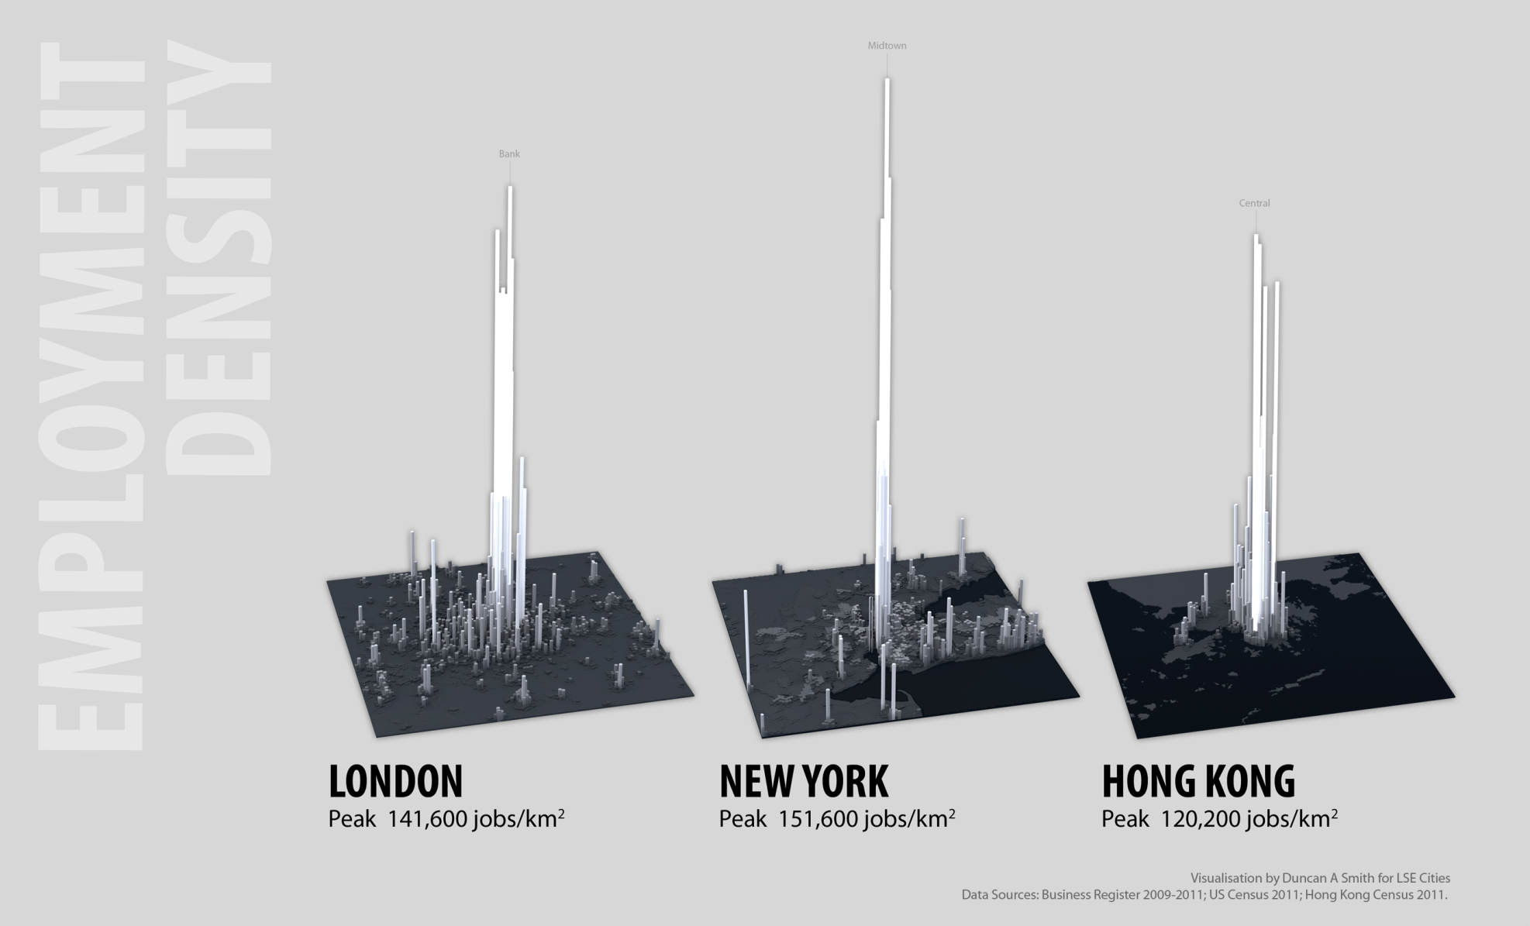
Successful cities: employment density
Notes:
300,000 in square mile

Slide 4
Successful cities: employment density
Features
Clustering in central business district
Sub-centres: Second level spikes of employment
Driven by?
Agglomeration forces: Double scale increases productivity 3 – 7%
Business links: forward and backwards
Intensity of competition
Thick labour markets – specialised skills, matching
Knowledge spillovers
What sectors are most subject to these forces?
Services, innovation, creative & media sectors
Finance: London, New York
R&D: silicon valley
Hollywood
Modern manufacturing: e.g.
Garments: - Dhaka
Engineering, automotive
Sectors in developing economies?

Slide 5
Successful cities: residential density

Slide 6
Successful cities: residential density.
Broadly ‘monocentric’ shape
Efficient use of land:
Land occupied by those with highest willingness to pay
Land can be developed – investment in structures
Market system achieves this:
Rent gradient from centre to edge ➔ monocentric structure.
High density near centre:
NB: density can be achieved two ways
Height / low-rise and crowding:
As cities develop go from crowding to height (London: Old Nichol, St Giles Rookery, LSE)
Level of density depends on transport, land availability

Slide 7
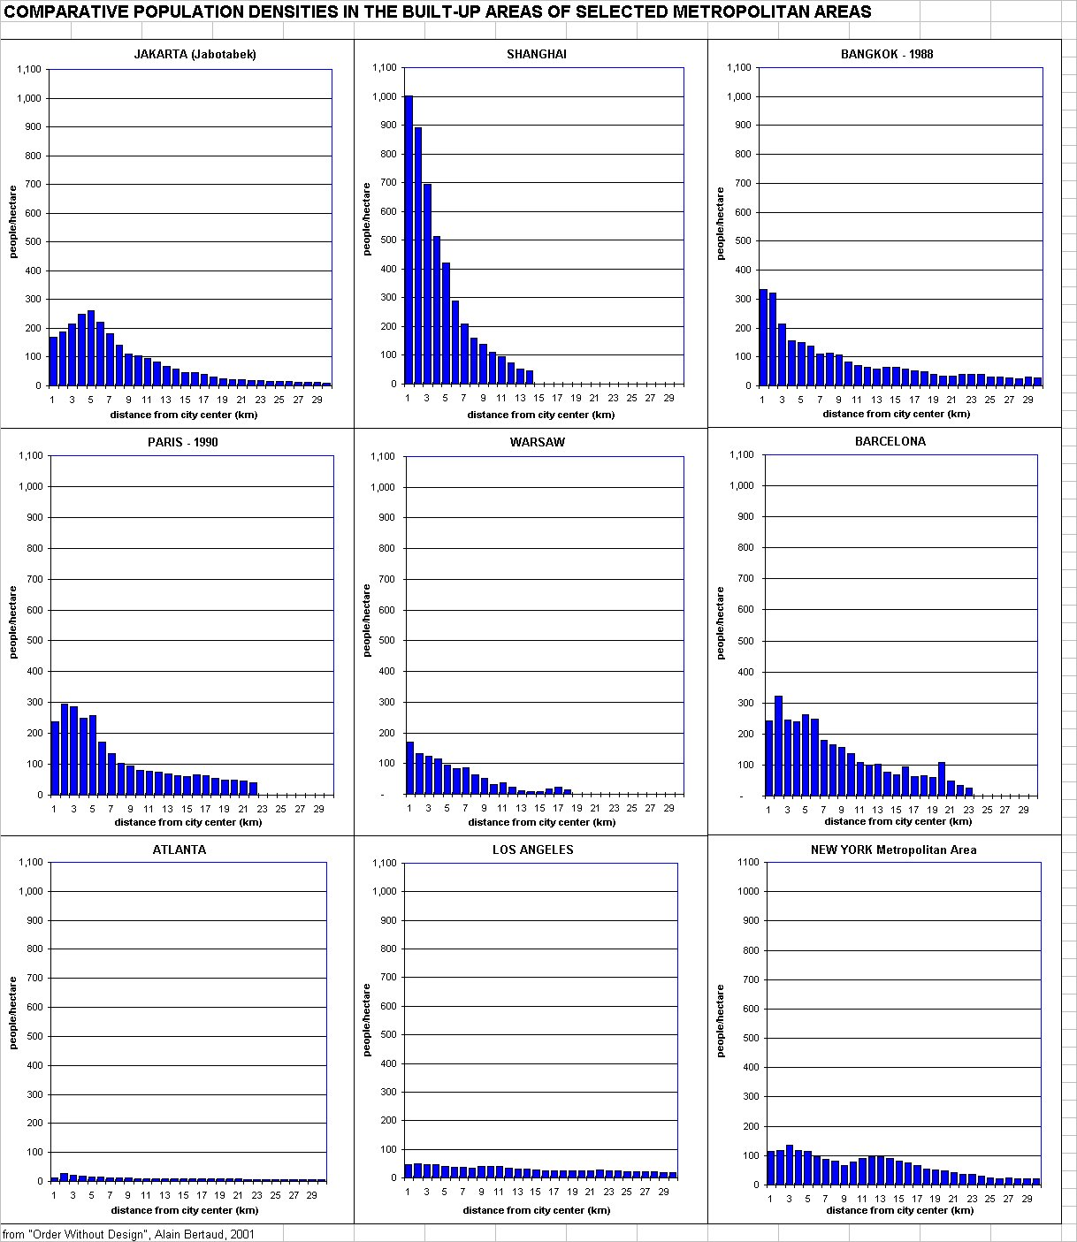
Urban form: residential density

Slide 8
Urban form: residential density with non-market outcomes
Johannesburg
Moscow
Brasilia

Slide 9
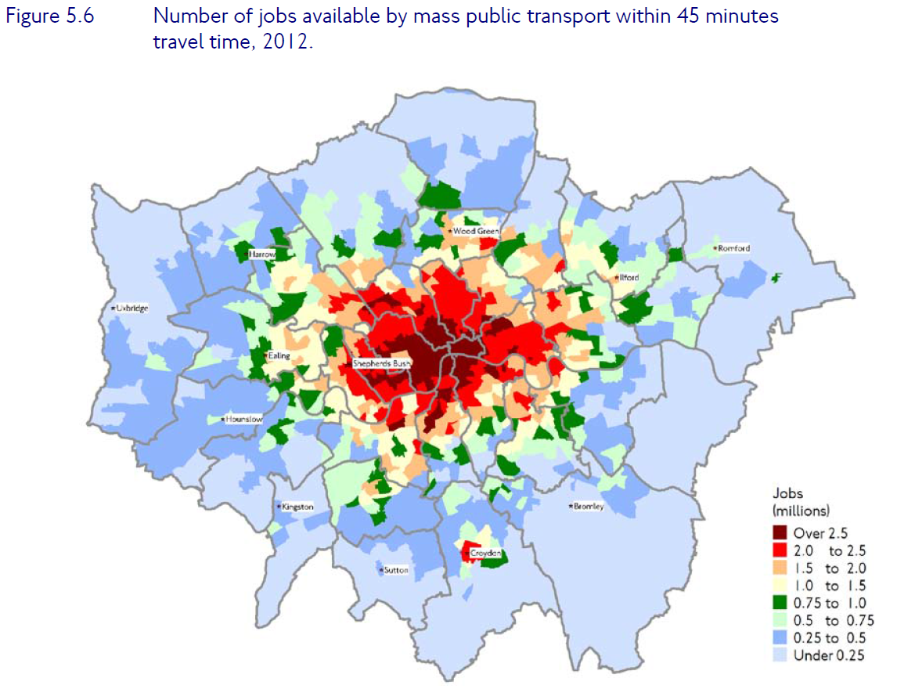
Successful cities: Infrastructure

Slide 10
Infrastructure & public finance
High levels of infrastructure provision:
Public goods:
Transport infrastructure
Public services: Waste collection/ Security/ Education/ Health
Utilities:
Water/ Sanitation / Power
Urban public finance:
Much of productivity benefit of cities accrues to landlords – land value uplift
Strong case for land tax
Ethical – land value uplift created by city as a whole not particular individual
Relatively easy to administer – if land records exist
Economic efficiency – ‘lump-sum’.
Sufficient to cover (in present value) all urban public goods. (Henry George theorem).

Slide 11
How to get there: Residential
Challenge: - Provision of formal mass housing
- In a way that delivers density.
Is it technically feasible at low income levels – and what form does it take?
How to attract private investment?

Slide 12
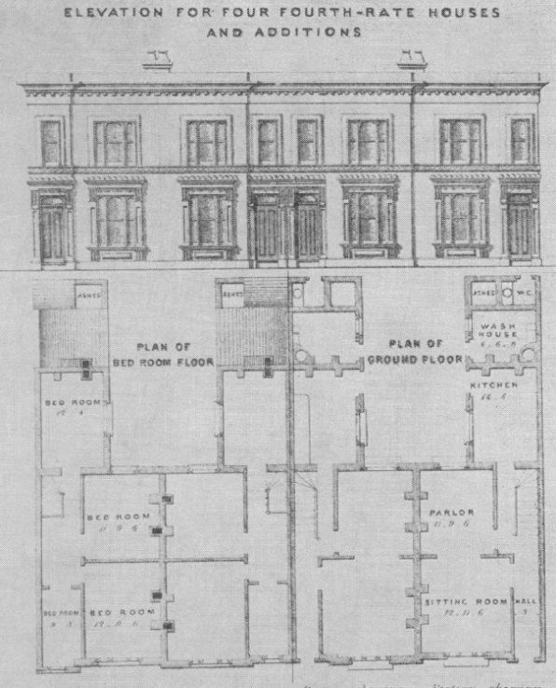
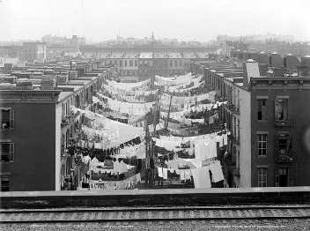
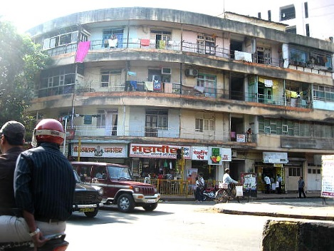
How to get there: affordable provision?
London New York (1900)
(1870)
Mumbai

Slide 13
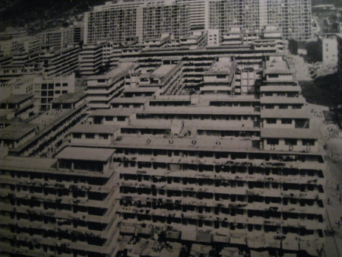
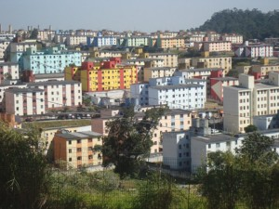
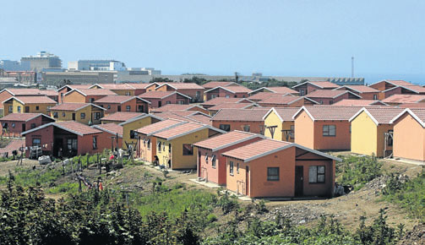
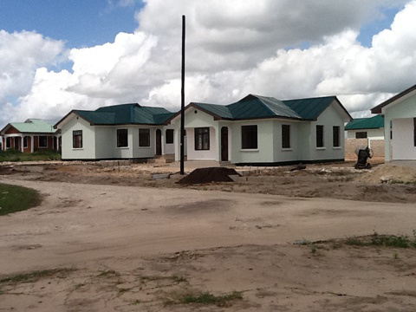
How to get there: affordable provision?
Hong Kong (1960) Sao Paolo
South Africa Dar es Salaam

Slide 14
How to get there: attracting private investment in housing
Need to get private investment – but frequent obstacles:
Lack of clarity (and enforceability) of property rights
Inappropriate regulation
Dar es Salaam, 92% of properties break plot size regulations
Lack of financial innovation
Need for mortgage finance: long-term, low initial payments
High cost building/ construction sectors
Skills shortages: monopoly power.
Provision of local public goods: sites & services:
Increasing returns in public good & utilities provision:
City-wide:
Local:
Street layout/ sanitation/ water/ power
Public or private provision? Large developers

Slide 15
How to get there: jobs, commerce and industry
Challenge: How to create urban jobs and raise productivity?
The business environment…… John Sutton
The urban trade-off: Cities are high cost but offer high productivity
High cost: commuting, congestion, land values
High productivity: agglomeration and clustering
How to manage this trade-off?
Illuminate a simple message with very simple model:
Labour demand from
Non-tradables: diminishing returns to expanding the sector (price falls)
Tradables: increasing returns – agglomeration and fixed world price
Labour supply from
Immigration at fixed real wage PLUS urban costs that increase with city size.

Slide 16
How to get there: jobs, commerce and industry
Labour demand
Non-tradables – price falls
Tradables – productivity increases
Labour supply: outside wage w₀ + urban costs (commuting, rent etc)
Outcomes:
EN: city with high costs and/or income from resources/ hinterland
stuck with low real wages, high nominal wages,
unable to attract tradable production.
ET: Low cost city:
both tradable and non-tradable sectors;
urban costs offset by high productivity
Multiple equilibria and low level trap, EL:
wage
Labour supply, high cost city
Labour supply, low cost city
ET
w_{T}
w_{N}
w₀
Labour demand (= value productivity)
EN
EL
CBD
Population (=density x area)

Slide 17
How to get there: infrastructure, density and urban costs
Attracting tradable activities:
Urban costs lower if:
Good infrastructure:
Commuting, congestion, business costs
Efficient land use:
Cost-effective and high density residential development
Infrastructure plays multiple roles
Direct ‘user benefits’
Enables scale and density: Enlarges labour pool
Coordinates expectations:
Private investment depends on expectations about growth of particular places.
Cannot contract on this.
Urban plans….. Not credible?
Infrastructure as commitment
Brings down urban costs indirectly, as enables efficient land use and the investments necessary for high density.

Slide 18
Concluding
Cities are potentially drivers of growth and job creation
But must work well-enough to attract investment & create jobs
Need to see the city as a whole:
Decent (and dense) housing is valuable for liveability and for attracting investment.
City can be self-financing: land value taxation
Vicious circle:
Poor land-use/ infrastructure/ urban form/ low investment/ low revenue.
Virtuous circle:
Efficient land-use/ infrastructure/ urban form/ high investment/ job creation/ revenue.

