Slide 1
Information is Power: Experimental Evidence of the Long Run Impact of
Community Based Monitoring
Martina Björkman-Nyqvist (Stockholm School of Economics)
Damien de Walque (DECRG, World Bank)
Jakob Svensson (IIES, Stockholm University)
IGC Workshop, Maputo
July 7, 2015

Slide 2
Introduction
Poor quality plagues public service provision in many developing countries (Das et al. (2008); Chaudhury et al. (2006); Bold et al. (2011)).
In response, many have argued for policies to enhance beneficiary involvement, empowering the users of public services.
Despite the recent enthusiasm for this approach, however, evidence from randomized evaluations provides mixed results about its short-term effectiveness (see for example Mansuri and Rao, 2013).
Whether beneficiary control can lead to sustained improvements in service provision is largely unknown.

Slide 3
What we do in this paper:
First, provide evidence of the longer run effects of a local accountability intervention in primary health care provision in Uganda.
  Four years after the initial intervention, we find significant improvements in both health care delivery and health outcomes
Second, investigate why this intervention resulted in such a large and sustained change in service provision while several other seemingly similar interventions have not had much of an impact.
  Focus here is on the role and impact of information.
  Compare the impact of a fairly standard community empowerment project without provision of information on the health clinics performance to an intervention that provided such information.

Slide 4
What we do in this paper (2):
Holding context constant, we can investigate whether differences in intervention design can help explain the mixed findings in the literature.
Finally, investigate why and how information can make a difference to the process.

Slide 5
Institutional background
The study took place in 75 rural communities served by public dispensaries (level III) in 9 districts covering all four regions in Uganda.
Dispensaries are the lowest tier of the health system where a professional interaction between users and providers takes place.
The standard for dispensaries includes preventive, promotional, outpatient care, maternity, and laboratory services.
In our sample of facilities, on average, a dispensary was staffed by a clinical officer (doctor), two nurses (midwives), and three nursing aids.

Slide 6
Background
According to baseline data:
  roughly 50% of the staff were absent from the clinic on a typical day.
  average waiting time was more than 2 hours
  only 4 out of 10 patients report that any equipment was used during last visit

Slide 7
Evaluation design
A pilot project was initiated in 2004 and extended in 2007 with the aim of enhancing community involvement and monitoring in the delivery of primary health care.
Project included 75 facilities in total
  50 facilities and its communities were included in the first-phase of the project in 2004 (the Participation & Information intervention)
  25 facilities and its communities were added in 2007 (the Participation intervention).

Slide 8
Evaluation design (2)
Participation & information intervention: after stratifying on location and population size, 25 facilities/communities were randomly assigned in 2004 to the treatment group and the remaining facilities were assigned to the control group (25 units).
Participation intervention: 25 new facilities were randomly assigned in 2007 to a treatment group (13 units) and control group (12 units).

Slide 9
Evaluation design (3)
The research design allows us to estimate three treatment effects, holding the context constant:
  (i) the short-run treatment effect of the participation &
information intervention (reported in Björkman and Svensson, 2009);
  (ii) the long run (four years after the initial intervention)
treatment effect of the participation & information intervention;
  (iii) the short-run treatment effect of the participation
intervention.

Slide 10
Intervention design
Both interventions shared a similar package of process-based components aimed at enhancing beneficiary involvement:
  facilitated meetings
  meetings with the provider and the users, with the final outcome being a joint action plan identifying the issues most important to address and how to address them.
In the Participation & Information intervention, the facilitators also disseminated quantitative information on the health facility and staff’s performance as part of the process of agreeing on the joint action plan.

Slide 11
Intervention design (2):
Participation only
Community meeting:
A two-day (afternoon) meeting with approximately 150 participants from the community.
To avoid elite capture, invited participants from different spectra of society (i.e. young, old, disabled, women, mothers, leaders).
Used participatory methods to encourage community members to identify and prioritize the key problems and issue they view as the most important to address and how to address them:
  focus group discussions
  community members score (0-100) using their own knowledge about performance on a set of performance indicators and use this rating as the baseline for their agenda on improvements.
  end of the meeting: the community had suggestions for improvements summarized in a draft action plan.
Action plan: health issues/services that had been identified as the most important to address; how these issues could be addressed; and how the community could monitor improvements (or lack thereof).

Slide 12
Intervention design (3):
Participation only
Health facility staff meeting:
  a one-day (afternoon) meeting held at the health facility with all health facility staff present.
  staff discussed ideas for improvements and changes.
Interface meeting:
  participants from the community and all health facility staff.
  community representatives and health workers presented their independent suggestions for improvements and changes.
Main outcome: a "contract" - shared action plan - outlining the community’s and the provider’s agreement on what needs be done, how (with existing resources), when, and by whom.
  The joint action plan identified how the community was to monitor the provider and a time plan.

Slide 13
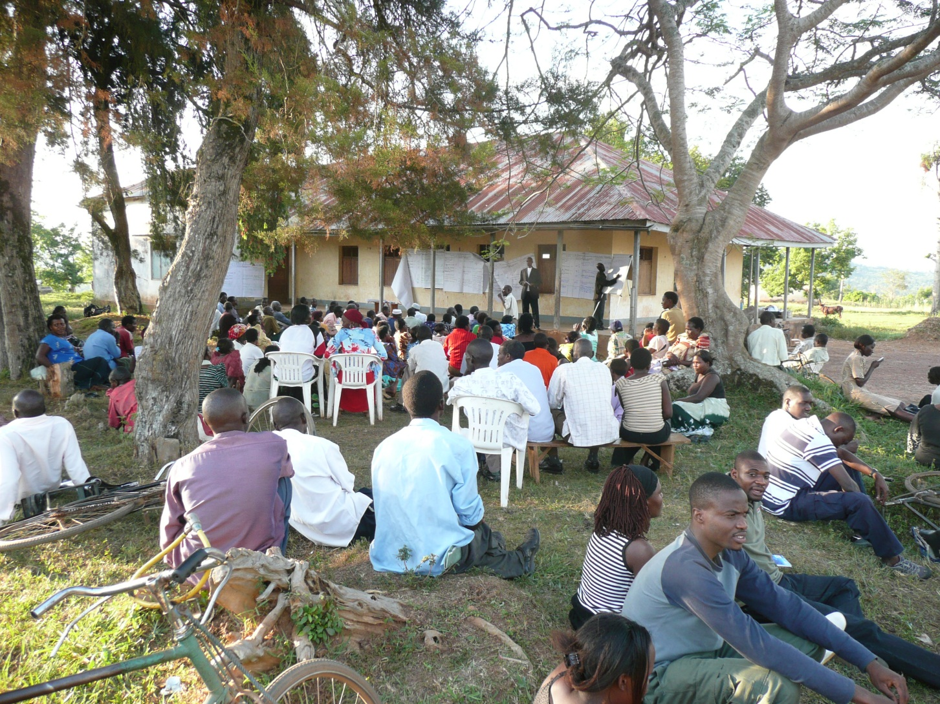
Community meeting

Slide 14
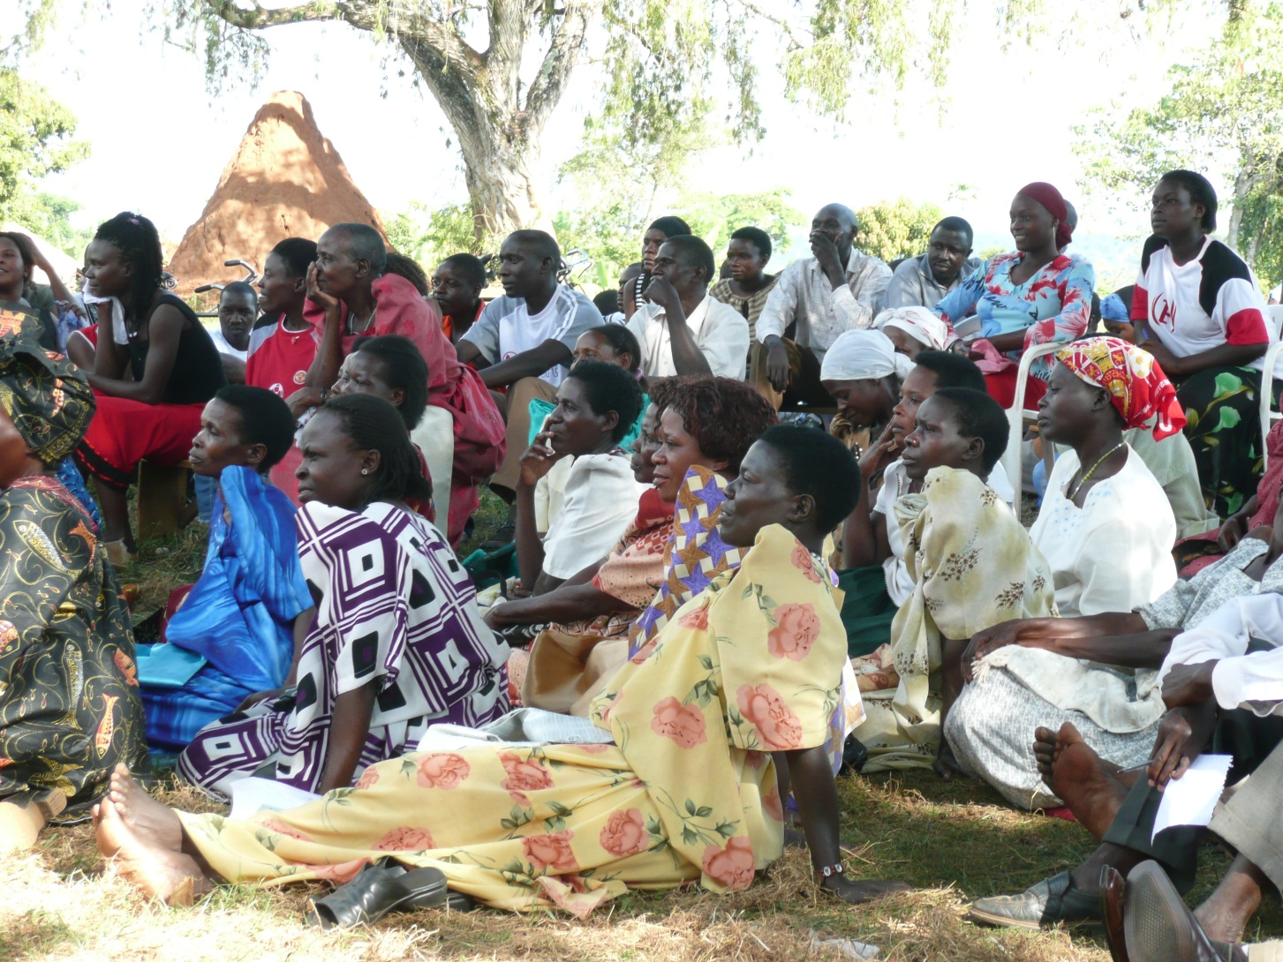
Community meeting

Slide 15
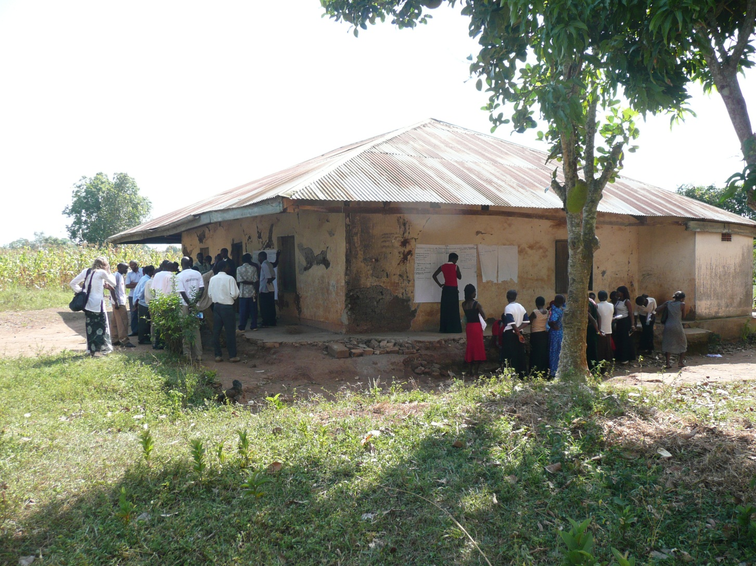
Community meeting by sub-group

Slide 16
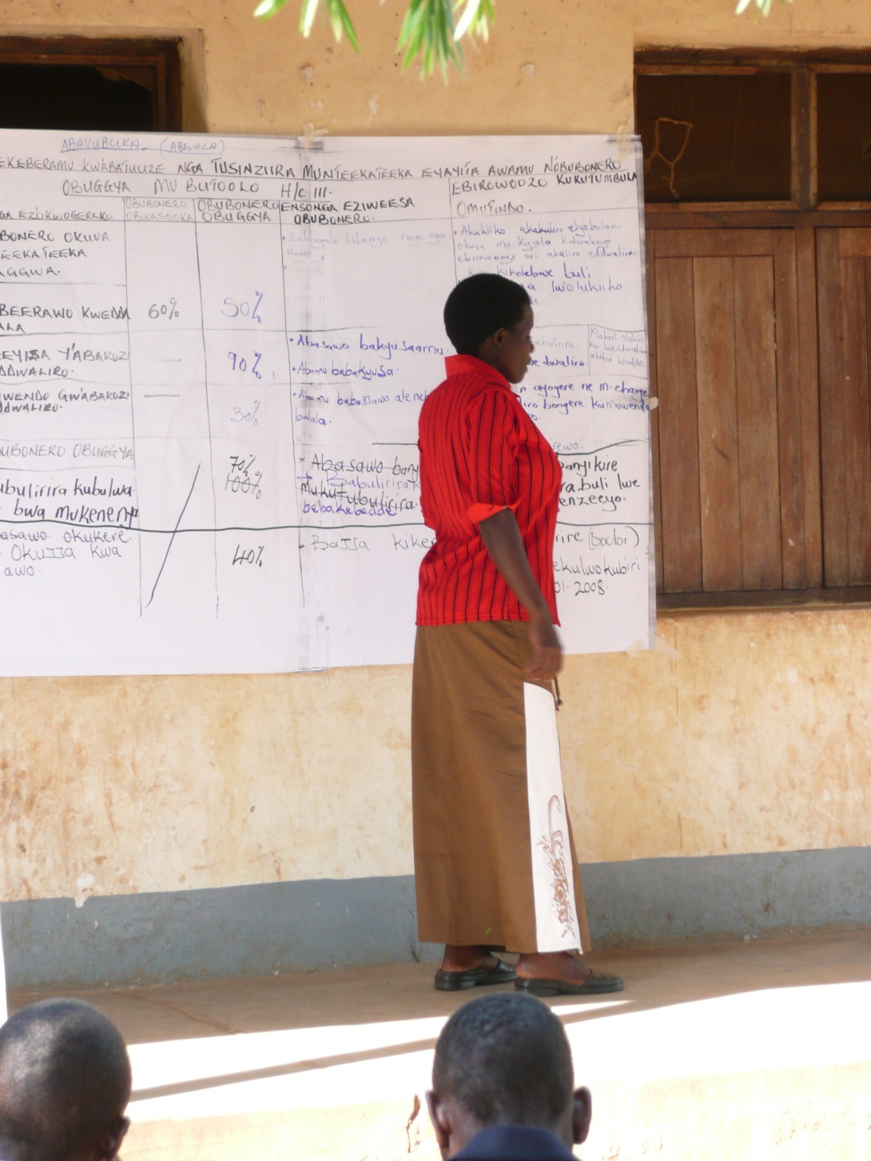
Community score cards

Slide 17
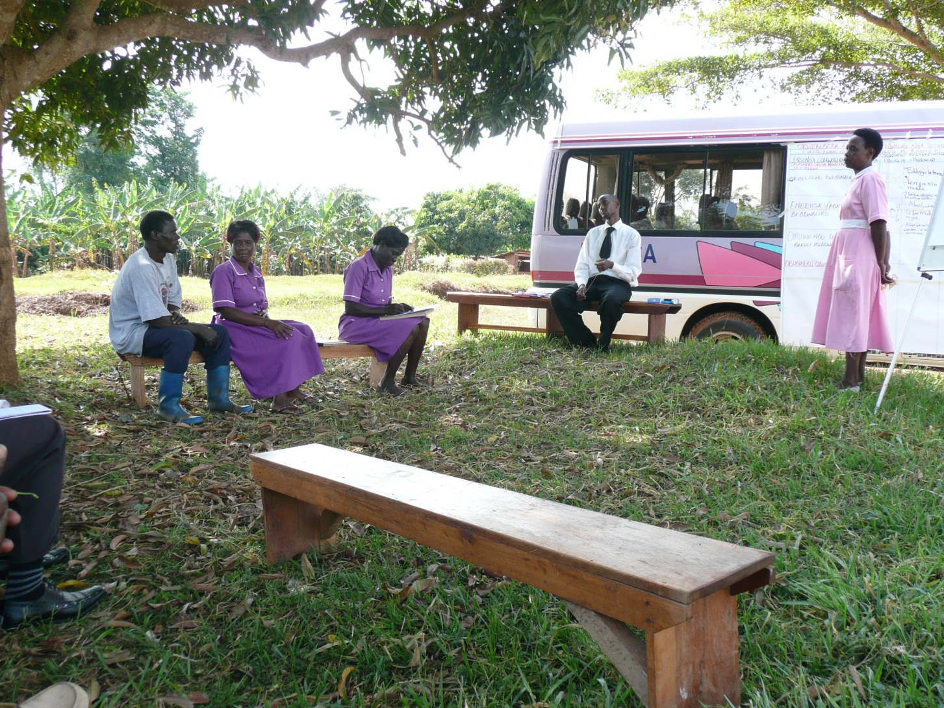
Health facility meeting

Slide 18
Intervention design (4):
Participation & Information
Program intervention mirrored the participation intervention.
Difference: at the start of both the community and health facility meetings, the facilitators provided the participants with quantitative data on the performance of the provider.
Report cards:
  A unique report card for each facility summarizing information that were identified from the baseline data as key areas subject to improvement, including utilization, access, staff availability, and patient-clinician interaction.
  Also included comparisons vis-à-vis other health facilities and with the national standard for primary health care provision.

Slide 19
Timeline

Slide 20
Data collection
Data collection was governed by two objectives:
  to create report cards which assess how the community views the quality and efficacy of service delivery (for the participation & information intervention).
  to rigorously evaluate the impact.
To meet these objectives, two surveys were implemented:
  a survey of health care providers (75 facilities)
  a survey of health care users (7,500 households).

Slide 21
Balance at baseline

Slide 22
Long-term results :
Participation & Information

Slide 23
Long-term results :
Participation & Information

Slide 24
Long-term results :
Participation & Information

Slide 25
Distribution of Weight-for-Age z-scores for the Treatment and Control groups – Participation & Information model (2004-2008)

Slide 26
Long-term results : Participation & Information; Utilization

Slide 27
Long-term results : Participation & Information; Monitoring and Process

Slide 28
Results: Participation only

Slide 29
Results: Participation only

Slide 30
Conclusion
Findings provide both encouraging and less encouraging news for the beneficiary control/CDD approach.
  A fairly standard process based intervention WITH information provision resulted in large and long run improvements in both health service provision and health outcomes.
  BUT a more standard, and CDD inspired, beneficiary involvement intervention, in which the potential informational asymmetries are not explicitly dealt with, had no impact.
The results of the two field experiments suggest that unless the community have access to objective information on staff performance, community involvement is not likely to have much of an impact.

Slide 31
The role of information
Information under the form of report card allows the clients to distinguish between lack of effort from provider (local level) and lack of resources assigned to facility (higher level).
Deals with information asymmetry
Allows for action plans focused on activities actionable at the local level.

Slide 32
Share of local actions for the 2 treatment groups

Slide 33
outpatient care conditional on the share of local action

