Slide 1
The Impact of Covid-19 in India and Pathways to Recovery
Farzana Afridi
Indian Statistical Institute (Delhi)
IGC India
May 5, 2021

Slide 2
Aggregate labor market impact of Covid-19
Source: Afridi, Mahajan, Sangwan (2021)
Date: CMIE CPHS

Slide 3
Micro study in urban India
Afridi, Dhillon and Roy follow a random sample of poor, primarily informal workers, residing near industrial clusters in 5 districts of Delhi.
Household survey (N=1613) and matched husband-wife panel of married couples in the 18-45 age group residing in surveyed households (N>3000)
Three rounds of surveys:
Pre-Covid : May-July 2019 (in-person)
During Covid-19 lockdown : April - May 2020 (men’s phone survey)
Post-Covid19 lockdown : Aug-Oct 2020 (phone survey)

Slide 4
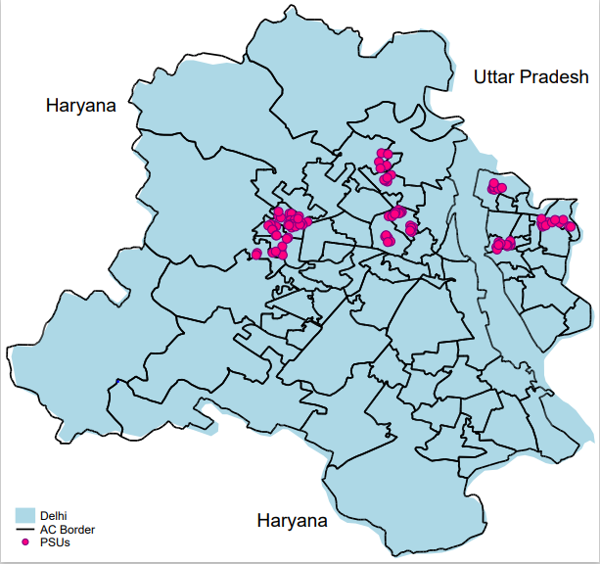
Sample areas
Source: Afridi, Dhillon and Roy (2021)

Slide 5
Impact on “working status”
Source: Afridi, Dhillon and Roy (2021; work-in-progress)

Slide 6
Impact on monthly earnings
Source: Afridi, Dhillon and Roy (2021; work-in-progress)

Slide 7
Impact on earnings conditional on occupation
Source: Afridi, Dhillon and Roy (2021; work-in-progress)

Slide 8
Impact on mental health
Source: Afridi, Dhillon and Roy (2021; work-in-progress)

Slide 9
Pathways to recovery: Urban Social Protection?
Source: Afridi, Mahajan, Sangwan (2021)
Date: NREGA Data Portal

Slide 10
Summary
Self reported working status fell by over 85 pp (during lockdown) and remained lower by 14 pp post lockdown, relative to pre-crisis for men.
Women’s self-reported working status fell by 10 pp relative to pre-crisis.
Men’s earnings were lower by 27.8% relative to pre-crisis, while women’s fell by 47%.
Persistently high levels of mental distress, relatively higher for women.

