Slide 1
POLICY IMPLEMENTATION LANDSCAPE IN UGANDA
Ramathan Ggoobi
Permanent Secretary/ Secretary to the Treasury, Ministry of Finance, Planning and Economic Development, Uganda
5TH Annual Economic Growth Forum
Kampala, 13th January 2021

Slide 2
Outline
Policy implementation landscape in Uganda
Policy implementation: A case of Uganda’s industrialisation agenda.
General policy implementation challenges and remedies in Uganda
An example of policy implementation success story

Slide 3
Preamble
The popular view is that Uganda is good at making policies but poor at implementing them.
We investigated Uganda’s policy-making and implementation record, as well as the factors behind the implementation challenge (Ggoobi, 2019).
We focused on implementation of Uganda’s industrialisation agenda.

Slide 4
What does the literature say?

Slide 5
Empirical evidence
Top-down implementation is only successful if goal consensus among key actors is high.
…and also if policymakers are able to stop bureaucrats from engaging in the following:
Budget games – to attract bigger budgets
Easy life games – civil servants doing things in their own established way and within their own self-sufficient order of priority.

Slide 6
Empirical evidence (cont’d…)
Implementation has been more successful when:
Street-level bureaucrats (the people closer to the real problems) are offered key roles in solving the problems.
Front-line implementers are given a large amount of discretionary power.
More weight is given to coordination and collaboration among separate but mutually dependent actors.

Slide 7
Key Cross-Cutting Challenges

Slide 8
Implementation issues (identified by OPM 2008)
Weak collective decision-making and oversight = policy incoherence at the national level.
Delegation rather than devolution of authority to Districts = weakened sense of responsibility and accountability.
Deficiencies in compliance & accountability in public service = inefficiency & corruption.
Strong budgeting and weak planning = budget incrementalism.
Weak Gov’t performance management = service delivery units are not effective and work in silos.

Slide 9
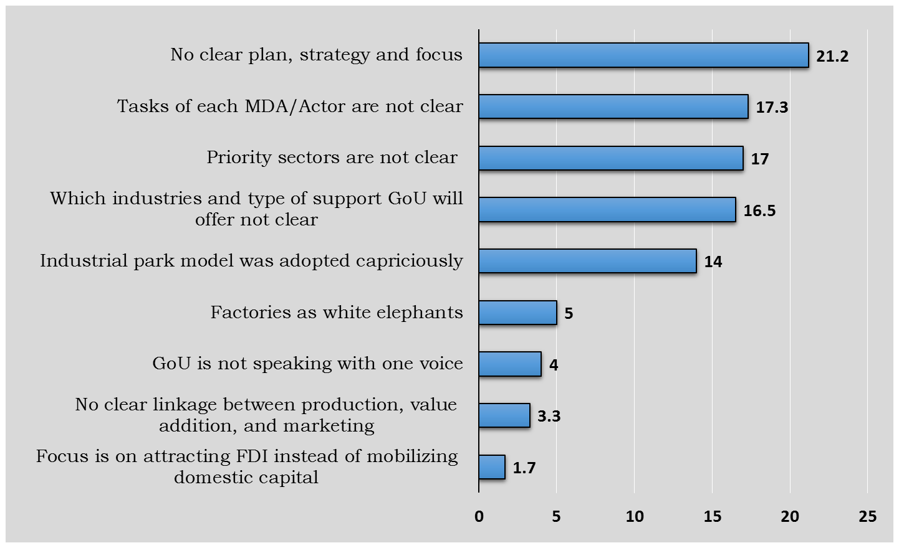
Uganda’s industrialisation strategy: Key Weaknesses
Source: Ggoobi, 2019

Slide 10
Overall factors for failure of policy implementation in Uganda

Slide 11
Policy implementation successes

Slide 12
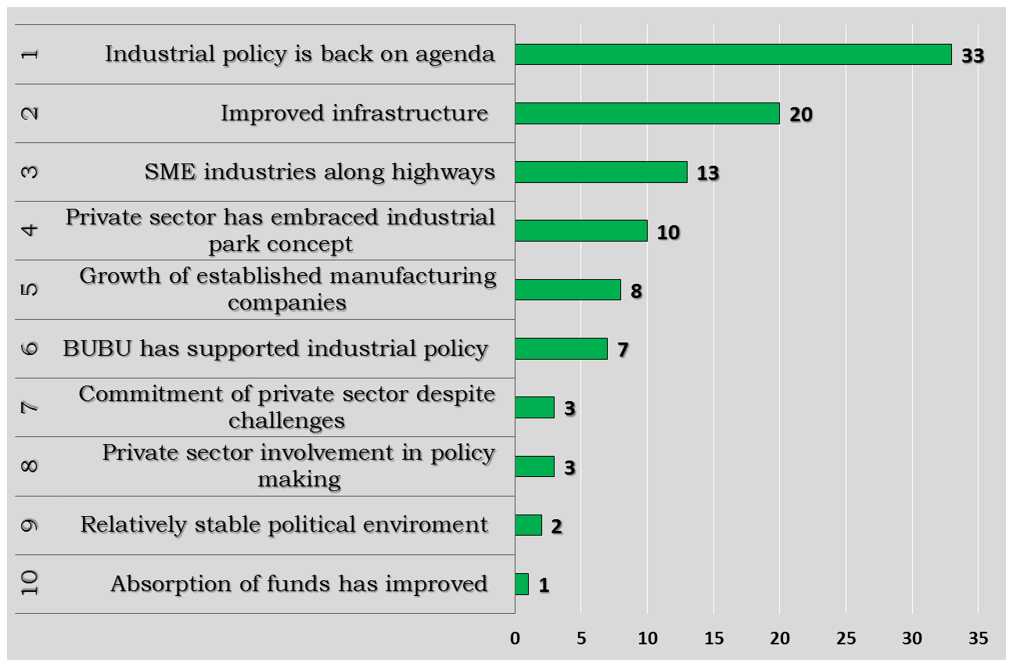
Main Success Stories
Source: Ggoobi, 2019

Slide 13
Measures to policy implementation in Uganda
Clarity of the goals and objectives of the policies or plans
Staff recruitment, training and supervision.
Internal management support
Defined roles and responsibilities
Evidence based decision making
Accountability
Proper coordination of implementing authorities

Slide 14
Conclusion
There is evidenced weaknesses at policy implementation in Uganda.
However, this originates from weak policy implementation planning which culminates into execution shortfalls.
We need to stop the habit of running away with policy pronouncements and develop the discipline of preparing actionable implementation plans informed by research,

Slide 15
THANK YOU

